Slide 1


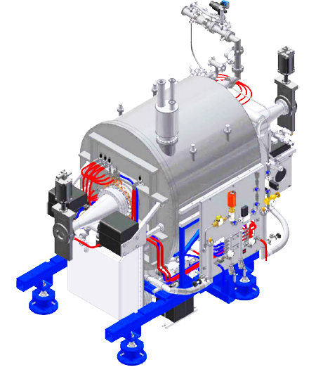
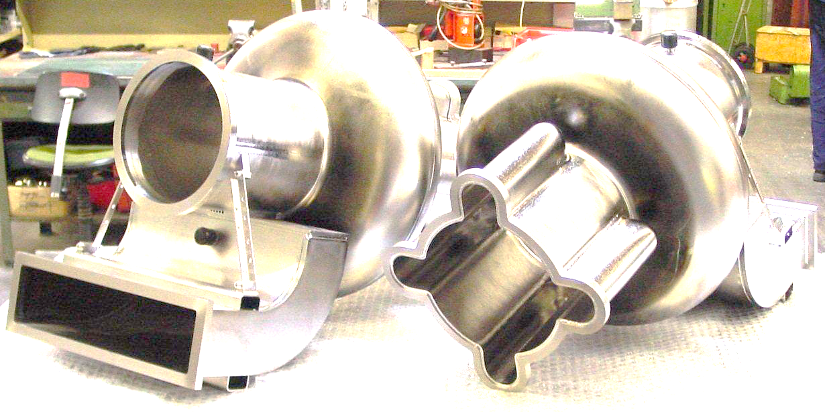
TTC2022 Aomori, TESLA Technology Collaboration
Machine Availability and Reliability of PLS-II at PAL
Younguk Sohn
Pohang Accelerator Lab., POSTECH
Oct 11-14, 2022

Slide 2
Abstract
3 SRF cryomodules have been operated since September, 2012 for the Pohang Light Source (PLS-II). They are the CESR-B type which were fabricated by the industry with the turn-key contract. For the less faults, the operation Vacc and RF power are about 60-70% of their specifications. There have been no severe problem in the coupler/window and cavity itself. But recently two vacuum leak events between cavity and He vessel were found, after 7.6 years’ and 7 years’ operation. Also at the beginning several years, we were suffered from the turbine troubles of He refrigerators.
The fault statistics and analysis of SRF system at PLS-II are reported in the presentation

Slide 3
Parameters of PLS-II RF System
Parameters | Value
Energy [GeV] | 3
Current [mA] | 400
Emittance [nm-rad] | 5.9
Beam loss power by synchrotron radiation [kW] | 500
RF frequency [MHz] | 499.973
No. of RF cavities | 3
Accelerating voltage, Vacc [MV] | 4.5
Vacc / cavity, [MV] | 1.5
Klystron amplifier | 3- 300 kW amp.
Cryogenic cooling capacity @4.5 K [W] | 700

Slide 4
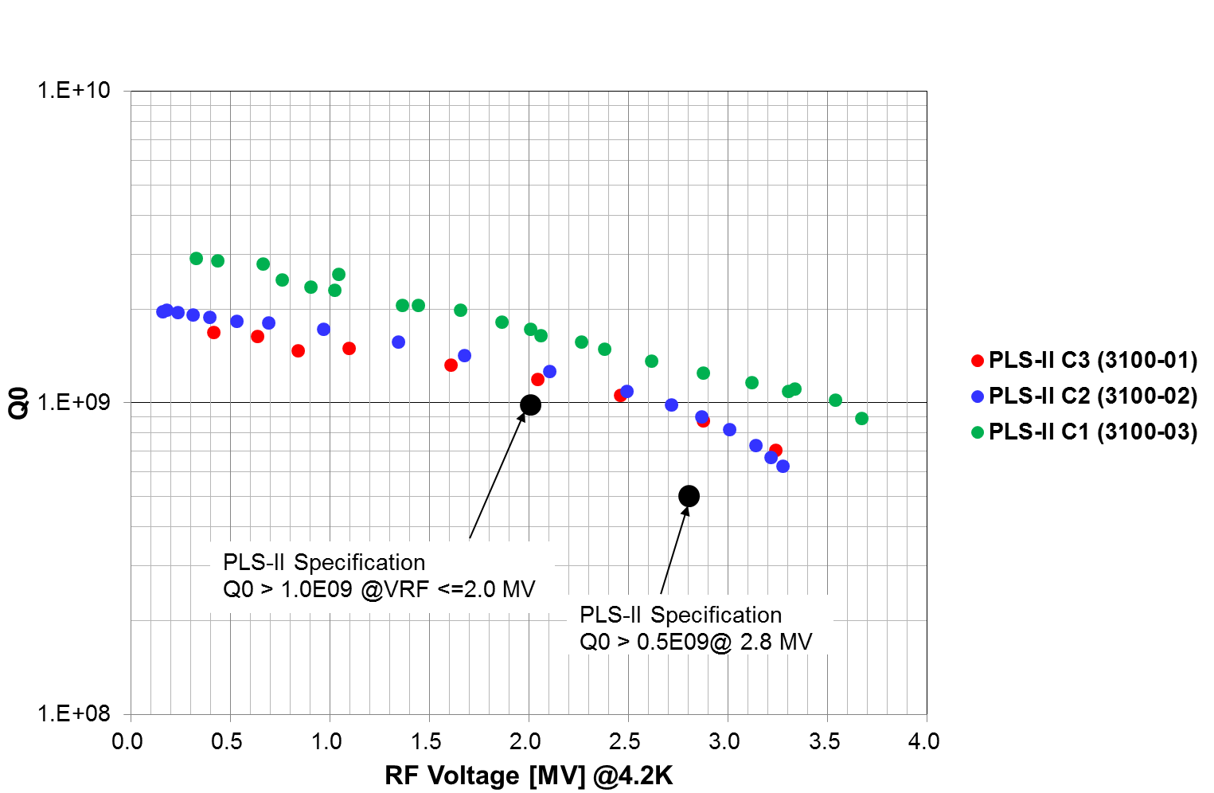
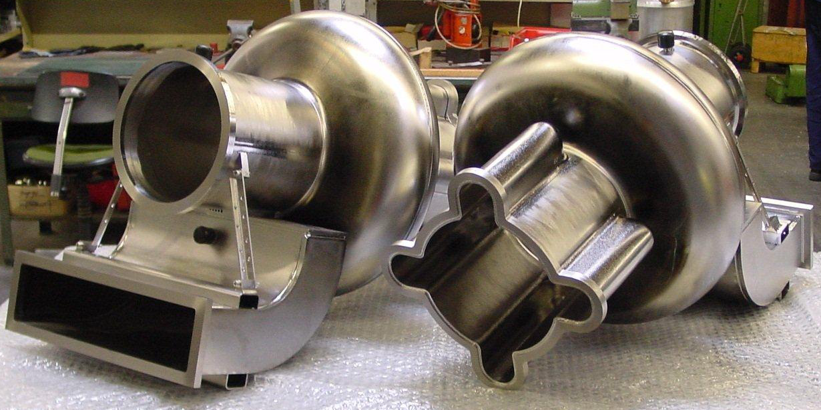
Accelerating Voltages @ Bare Cavity
(CESR-B cavities, operation voltage: 1.4 MV (4.7 MV/m)
2.0 MV = 6.7 MV/m
2.8 MV = 9.3 MV/m
1.4 MV = 4.7 MV/m

Slide 5
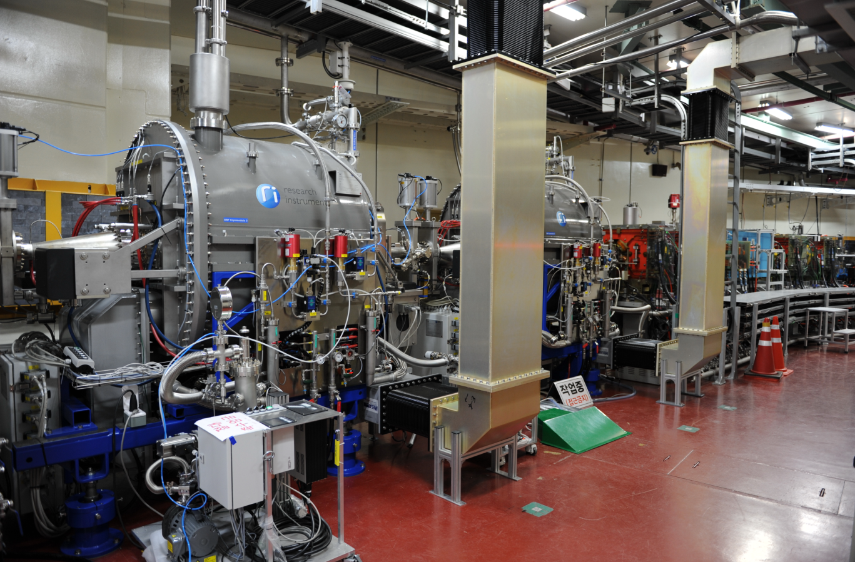
SRF Modules @Tunnel
SRF module 2
SRF module 3

Slide 6
Operation Parameters
RF voltage, per unit: 1.4 MV (4.7 MV/m)
Forward power through window (coupler), per unit: 140 ~ 190 kW CW
Reflected power, per unit: < ~2 kW
Vacuum pressure at window and cavity: ~ middle 10⁻¹⁰ mbar

Slide 7
Operation Carrier of Each Module
Year |  | Y-2012 |  | Y-2013 |  | Y-2014 |  | Y2015 |  | Y2016 |  | Y-2017 |  | Y2018 |  | Y2019 |  | Y-2020 |  | Y2021 |  | Y2022
Status |  | 1st | 2nd | 1st | 2nd | 1st | 2nd | 1st | 2nd | 1st | 2nd | 1st | 2nd | 1st | 2nd | 1st | 2nd | 1st | 2nd | 1st | 2nd | 1st | 2nd
CM1 | Installation & commissioning
 | Operation |  |  |  |  |  |  | 8 years and 7 months
 | Out of service
CM2 | Installation & commissioning
 | Operation |  |  | 9 years and 9 months
 | Out of service
CM3 | Installation & commissioning
 | Operation |  | 7 years
 | Out of service |  |  |  |  |  |  |  |  |  |  |  |  |  |  |  | 2 years & 4 months
Vacuum leakage He vessel to cavity during cooldown
Warmed up to room temperature every years for maintenance of refrigerator
For some years, un-planed warmed up by many reasons such as site blackouts, cryogenic problems, site utility maintenances, …
Partial warmed up to 40K at beginning of each user-service term for vacuum improvement during the first 6 months operation after installation
Regular partial warmup for every 5 user-services

Slide 8
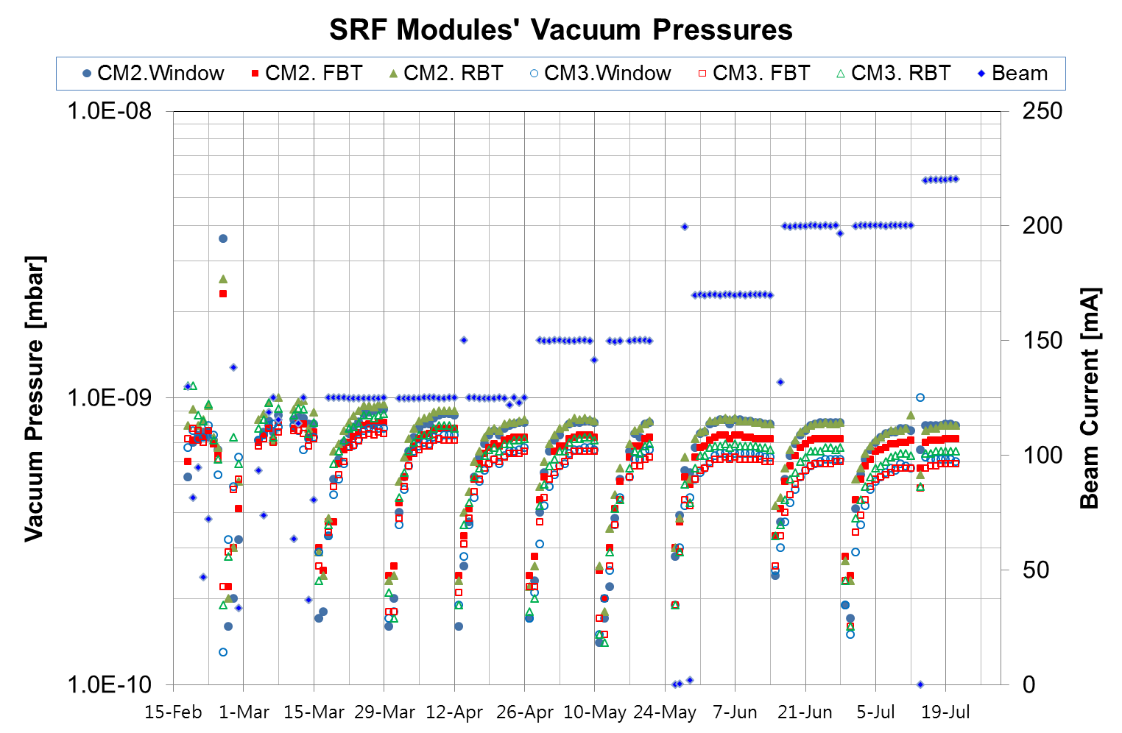
History of Partial Warmup (Feb.-Jul, 2013)
Partial warming-up cavity up to 40K
Threshold pressure vacuum bursts >1 x 10⁹ mbar

Slide 9
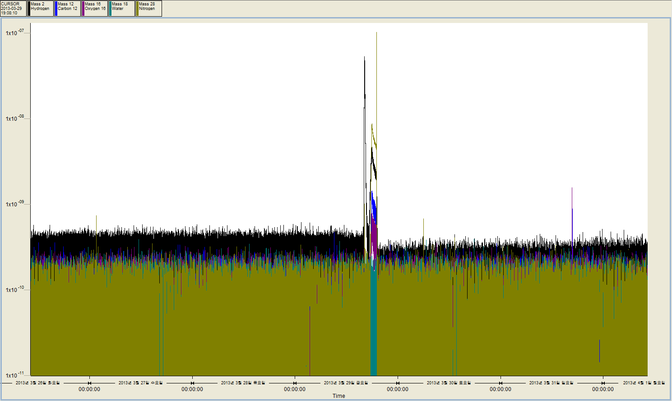
Partial Warmup & Cooldown
Mass-Spectrometer (RGA)
4 days before partial warmup, and 3 days after re-cooldown
Partial warmup
Before partial warmup
After re-cooldown
Partial Pressure of Hydrogen (Black)

Slide 10
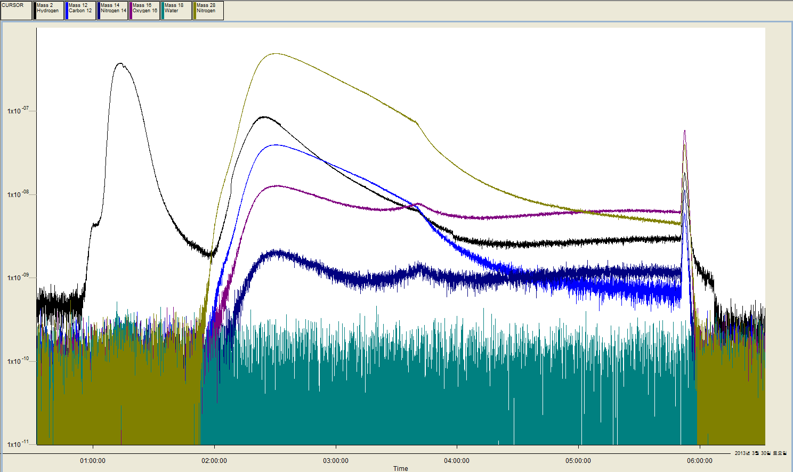
Partial Warmup & Cooldown
During partial warmup & cooldown with TMP operation
N2: Mass 28
1 Ion pump @window on by mistake
(03:40)
H: Mass 2
TMP on
1.4e-8 mbar
(01:00)
C, Mass 12
All Ion pump on
TMP off
Cavity top:43K
Cavity bottom: 31K
(06:07), 2.9e-9 mbar
Ion pump off
(00:28)
O:Mass 16
N:Mass 14

Slide 11
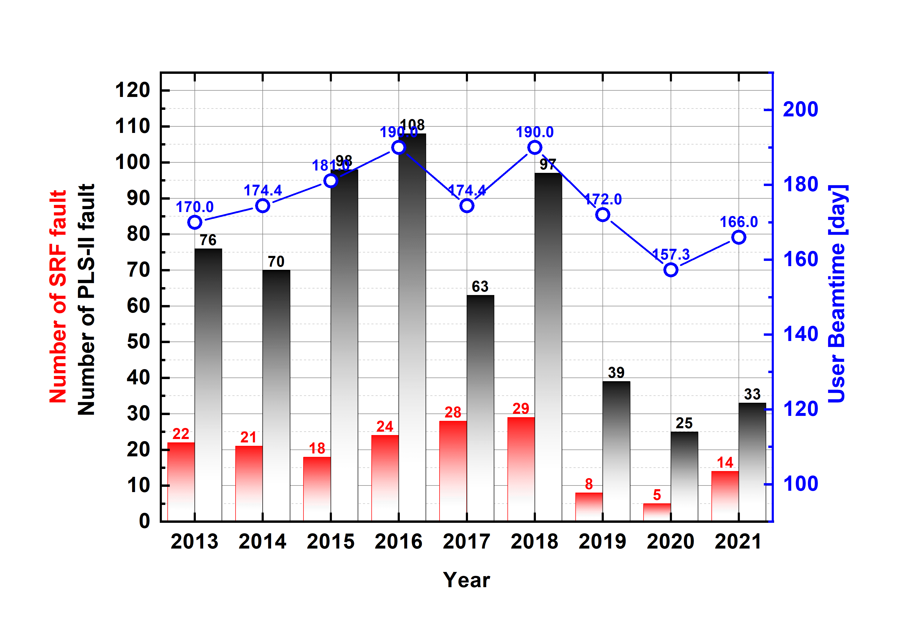
Number of SRF fault, SRF fault time
※ SRF includes all components of RF system such as cryomodule, cryogenics, HPRF, LLRF and control
2 modules
3 modules
2 modules

Slide 12
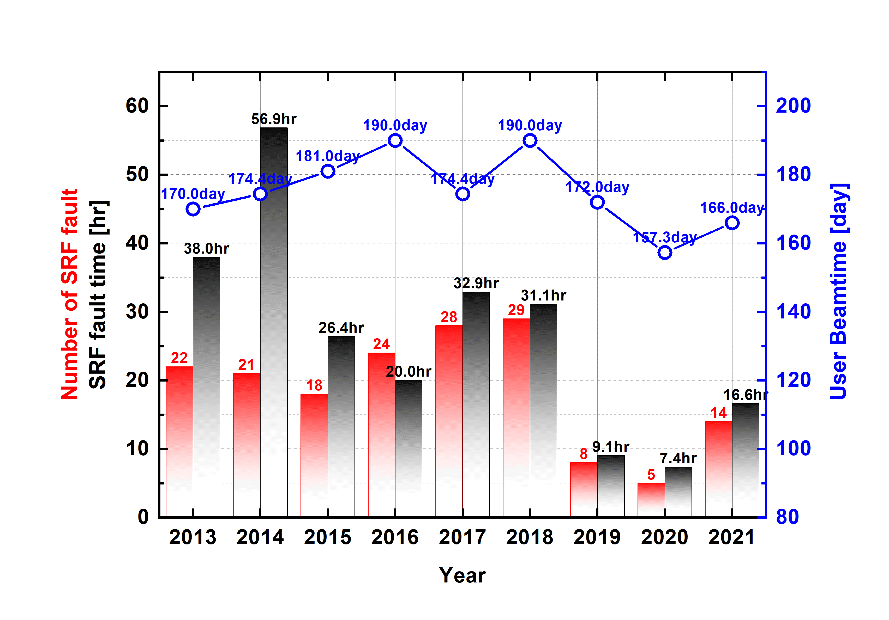
Number of SRF fault, SRF fault time
2 modules
3 modules
2 modules

Slide 13
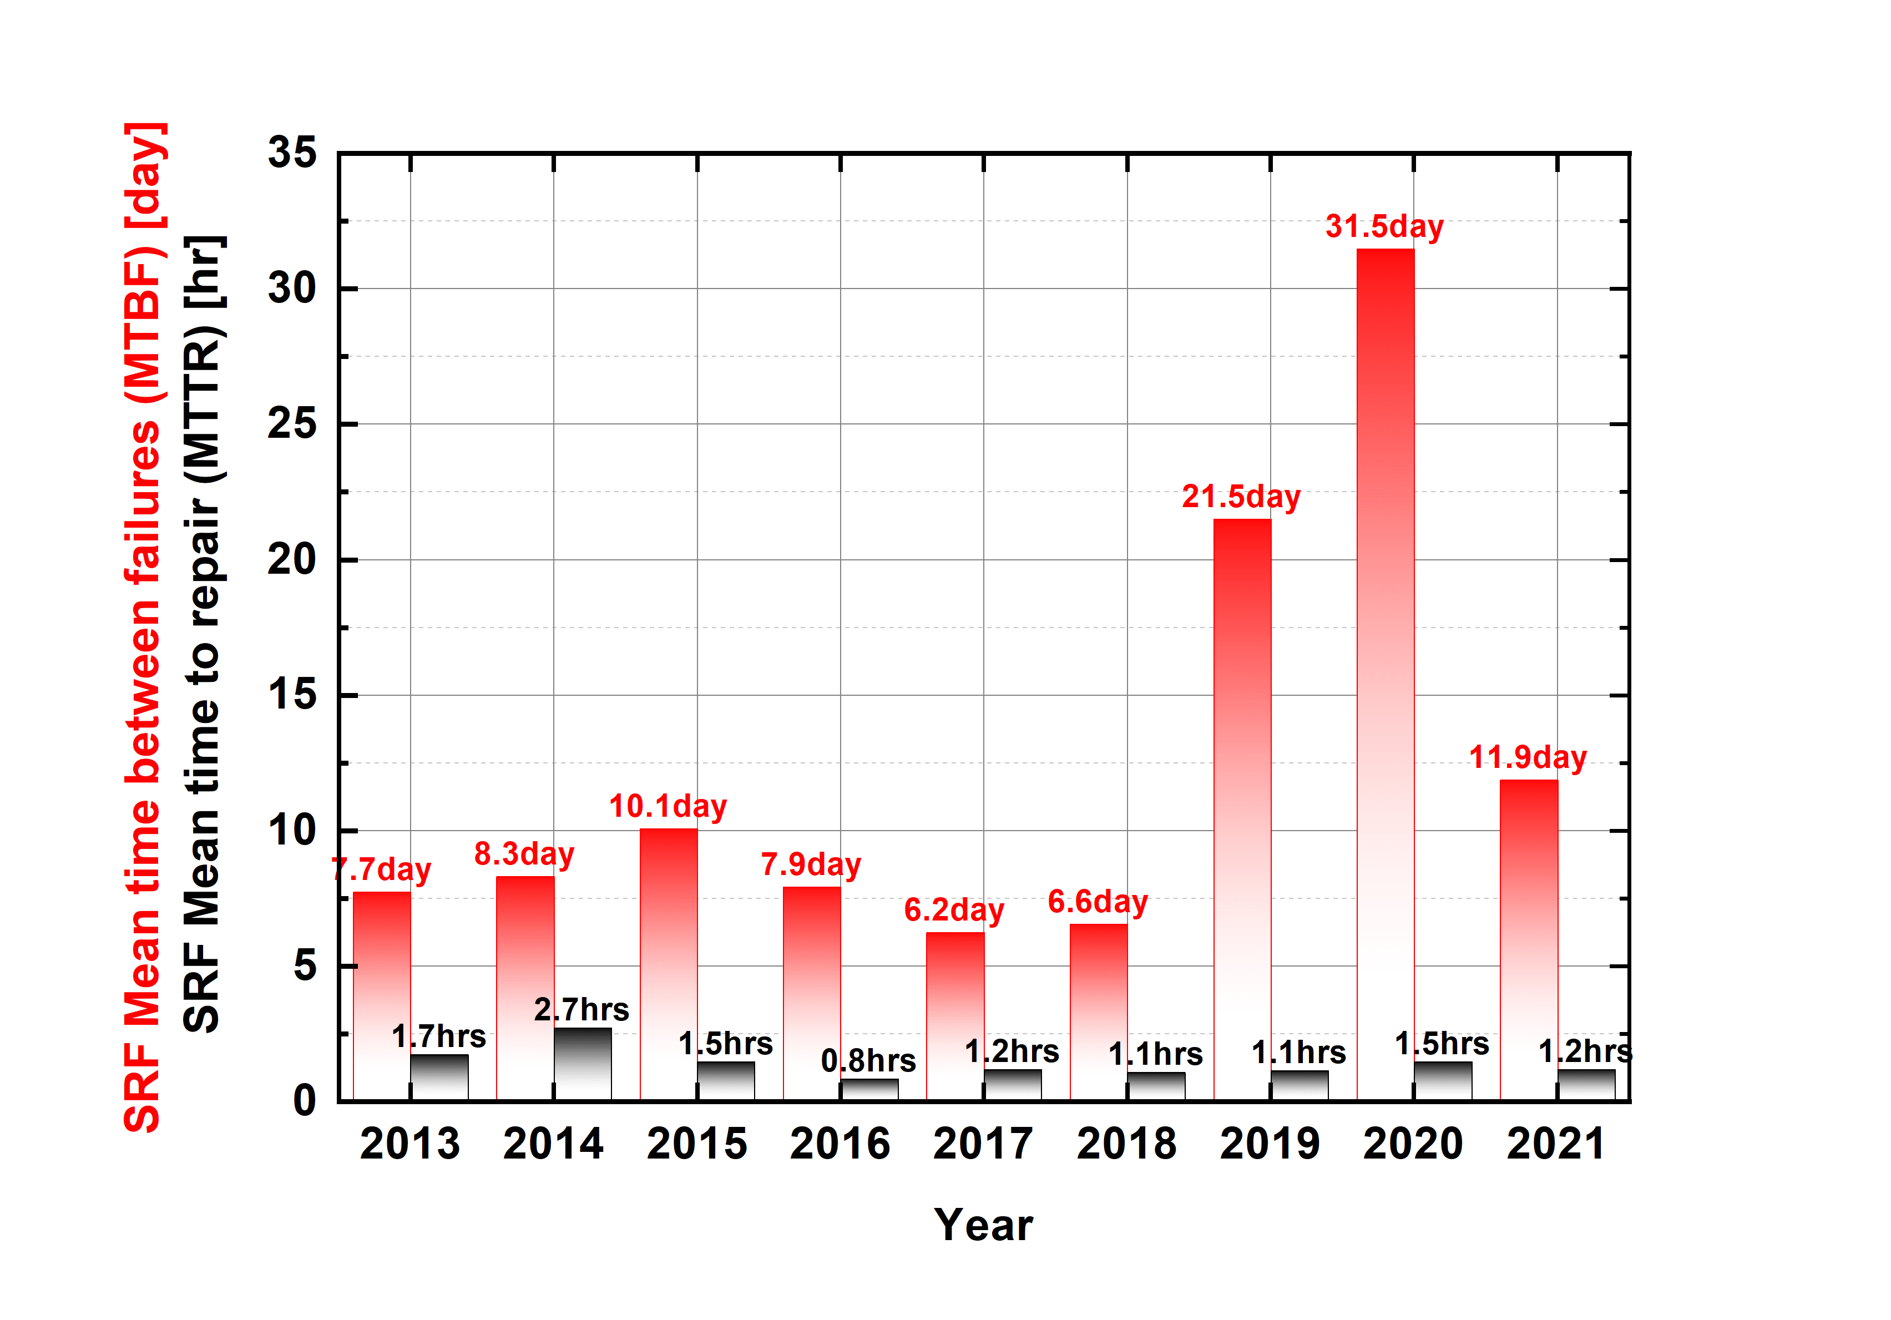
MTBF, MTTR from SRF System only
MTBF: mean time between failures, MTTR: mean time to repair
2 modules
3 modules
2 modules

Slide 14
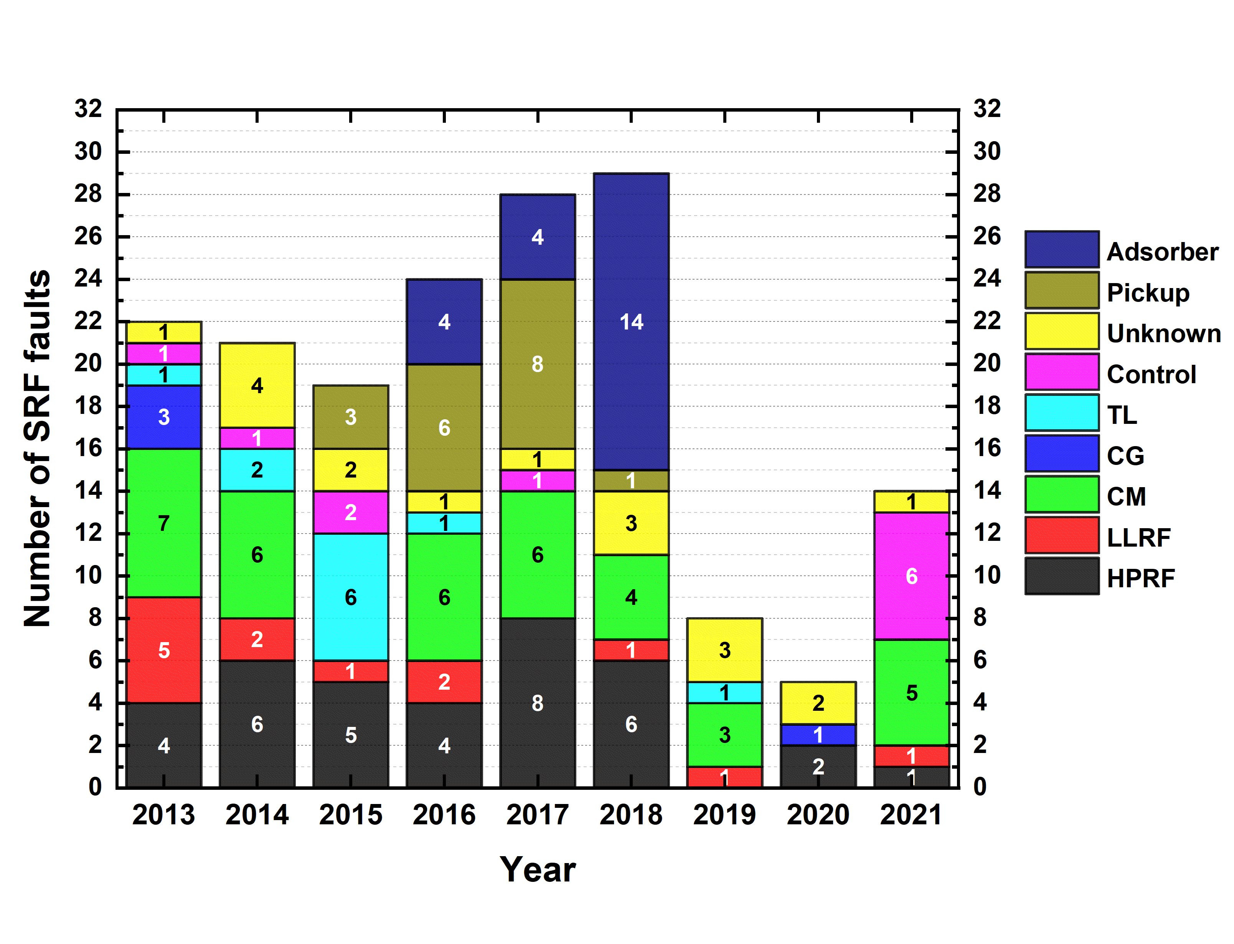
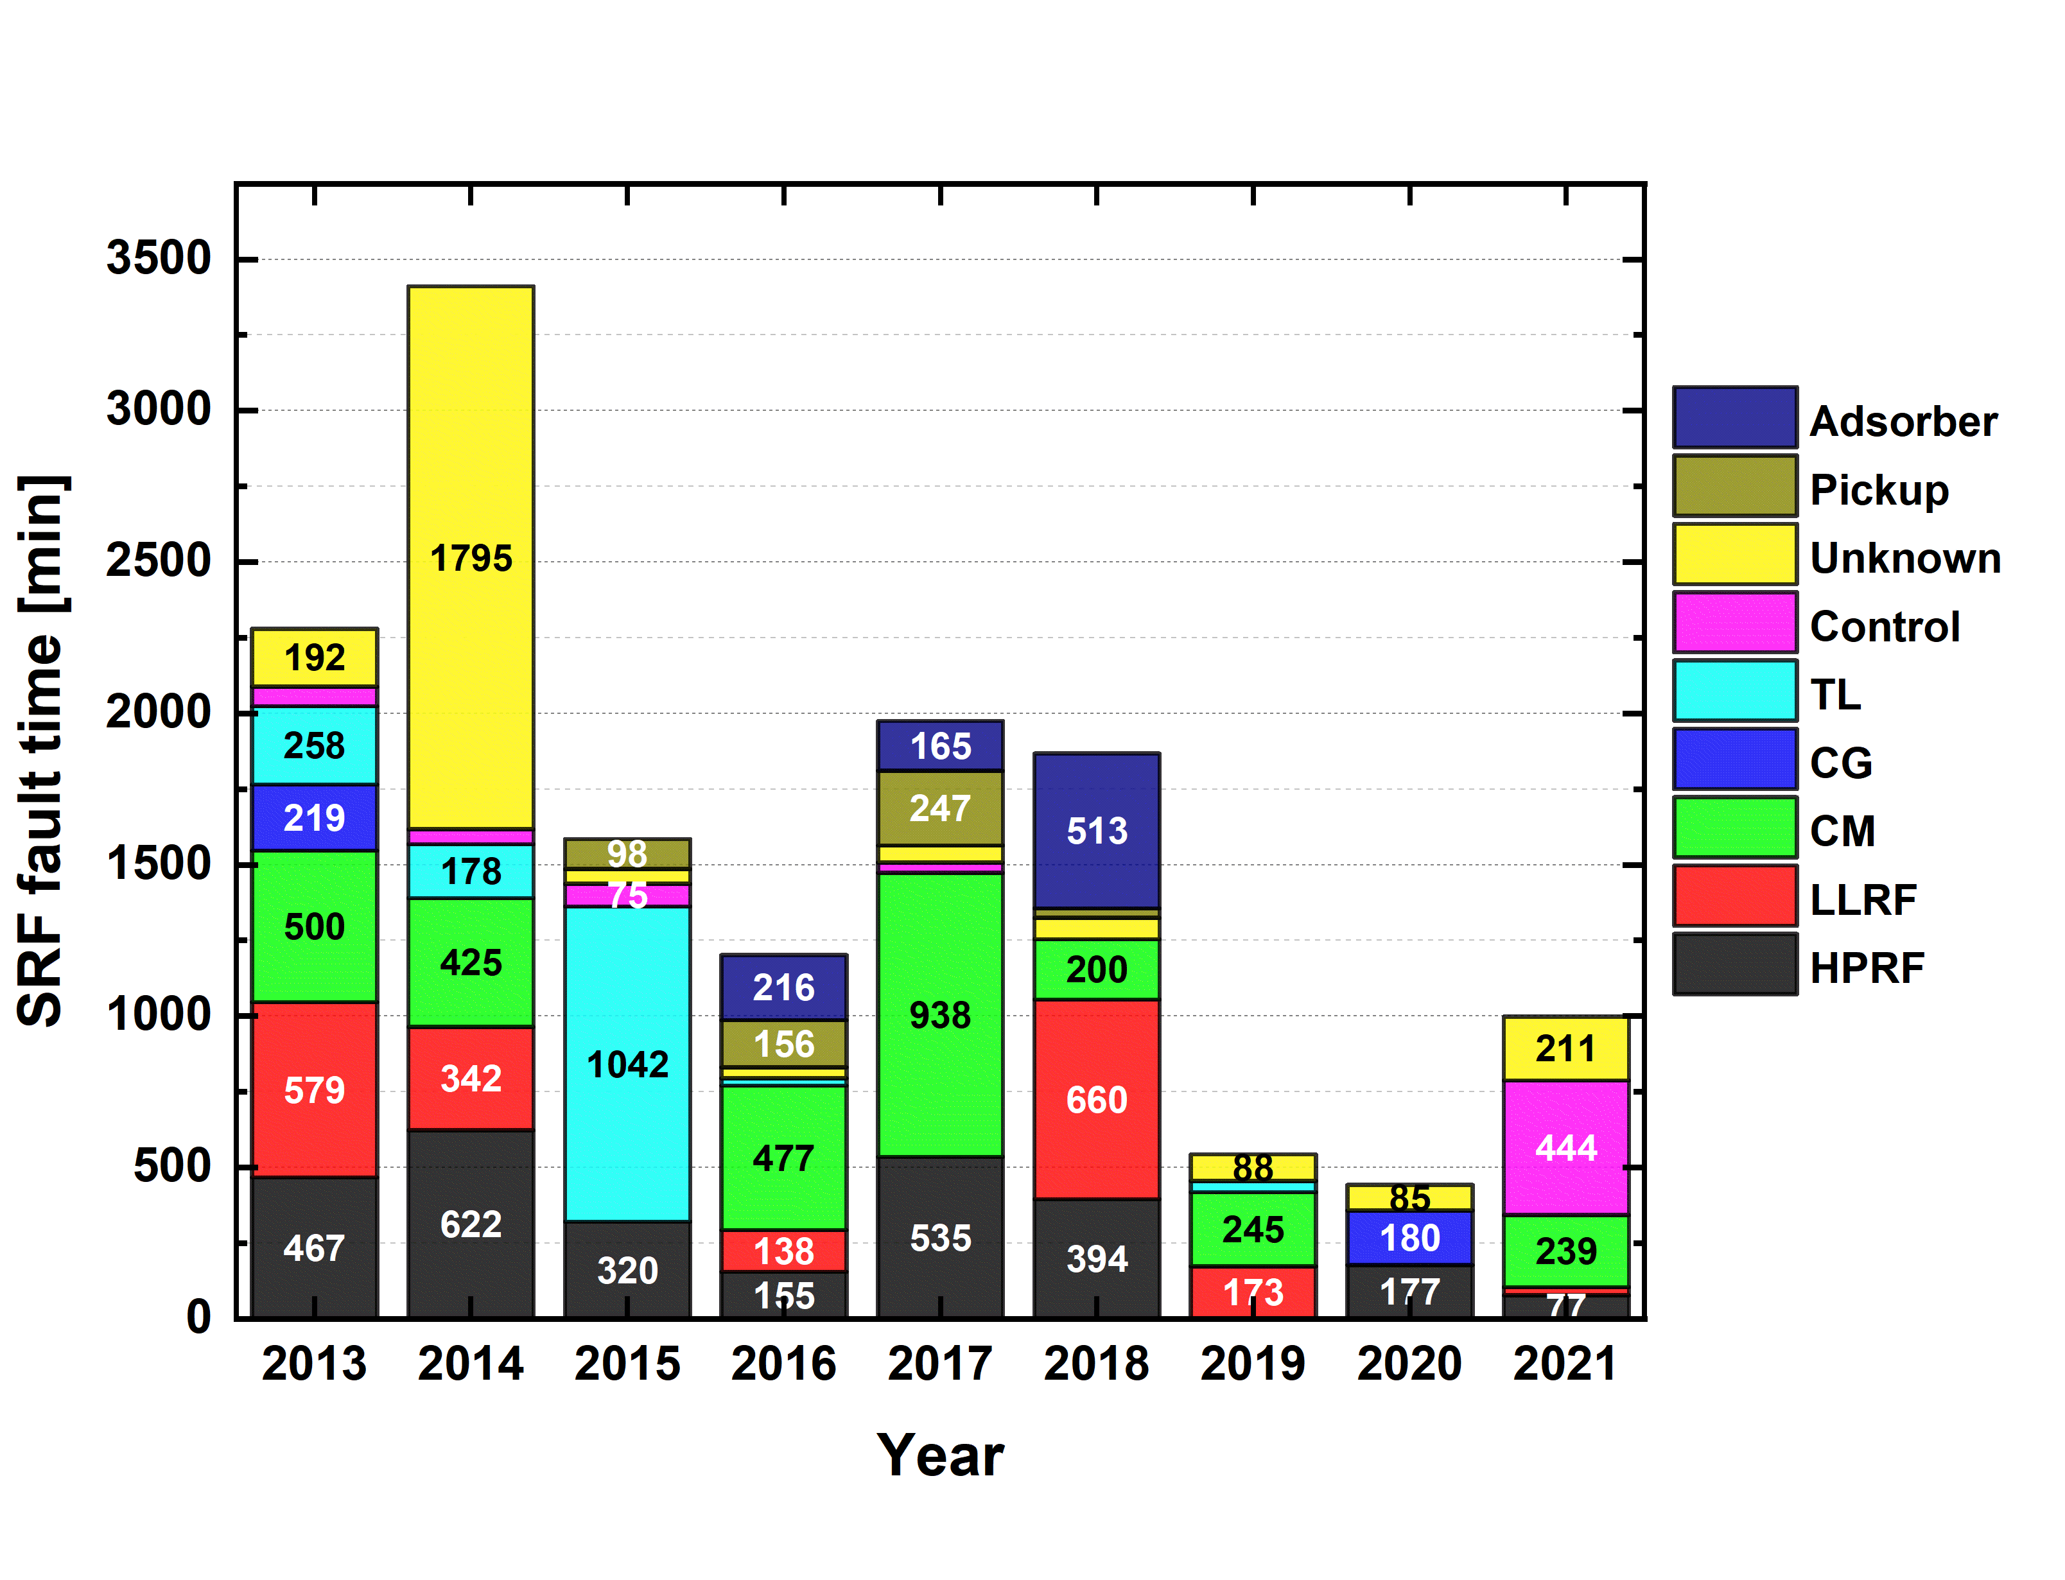
Faults for each RF Components
Absorber is the device installed in the coldbox of He refrigeration to remove impure gas from He gas. During absorber A working with every 12 days operation, the valves and vacuum pump manipulation makes He pressure disturbance at the high pressure line of cold box. It occasionally disturbs He pressure of module He vessel.
Pickup is the field pickup probe: with 5~8 user-service terms, condensed gases are expended abruptly then it makes vacuum pressure disturbance at CM3 only.
TL is the power transmission line including water load, circulator and RF switch.
CG is the He refrigerator including compressor, coldbox and He dewar

Slide 15
Severe Faults, Experienced
(more than 2 weeks downtime)
Blocking particle filter in LHe supply line during the 1st trying to cooldown cryomodules
Stoppage of expansion turbine in cold box during cavity cooling after planed maintenance: 26 Jan., 2014 (20 days’ out of service), 14 Feb, and 24 Mar., 2017(45 days out of service) maybe impurity makes turbine jamming, but unknow cause and no pre-detected symptoms by system monitoring.
Tearing out of LN2 supply tube (bellows) of MCTL during cavity cooling: 19 Feb. - Mar. 26, 2014 (28 days’ loss of beamtime), mis-design of section bellows and mis-selection of bellow type (blade guide)
Vacuum leakage between He vessel and cavity: CM3 – Sep. 2029, CM1 – Sep. 2022, maybe fatigue of indium sealing through the frequent thermal cycle and aging, resulted to reduced beam current, ordered spare module.

Slide 16
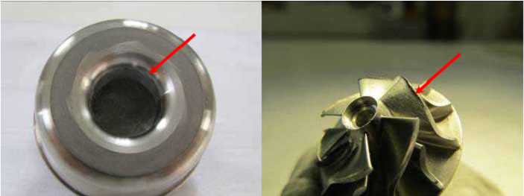
Turbine Troubles
Scratch
Deformed
Contact marks between turbine wheel and exhaust turbine diffuser

Slide 17
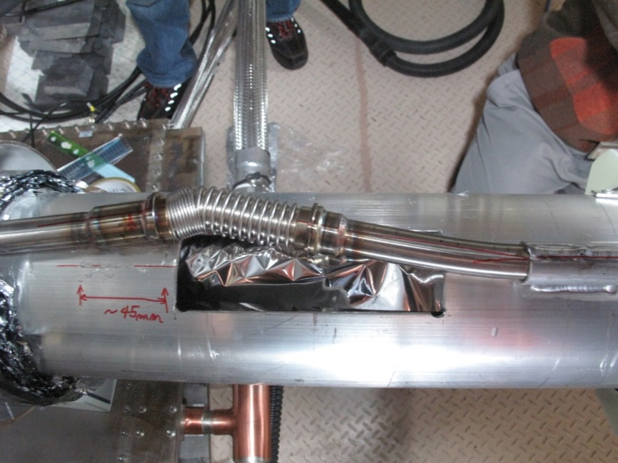
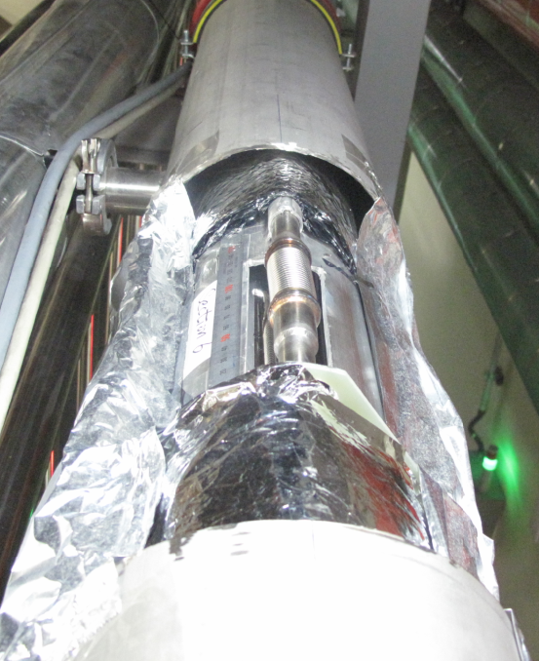
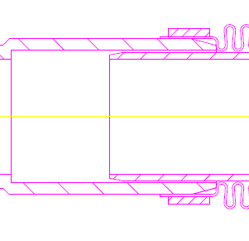
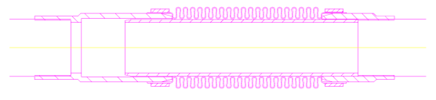
Damaged Bellows
LN2 thermal shield
Teared bellows @ MCTL Section 8
Deformed bellows @ MCTL Section 6
Guide blade
End type of bellow

Slide 18

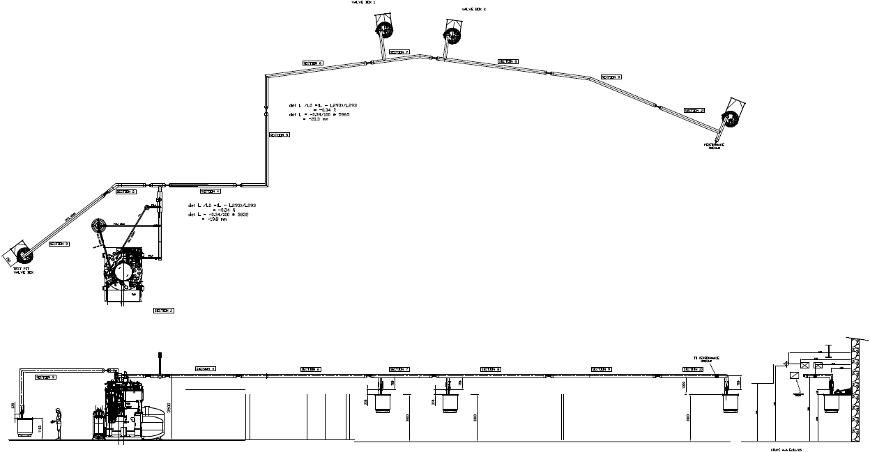
Repair of LN2 Lines
Bellow replacement
Improvement of bellow position
& window area
VB 3
VB 2
Bellow position is 560mm different than drawing
Section 6
Section 7
Section 8
Section 9
Section 10
Section 5
VB 1
Section 4
Checking bellows soundness
Improvement of bellow position
& window area
※ VB: Valve box for SRF cryomodule
Cutting MCTL vacuum vessel
(10 vacuum ports)

Slide 19
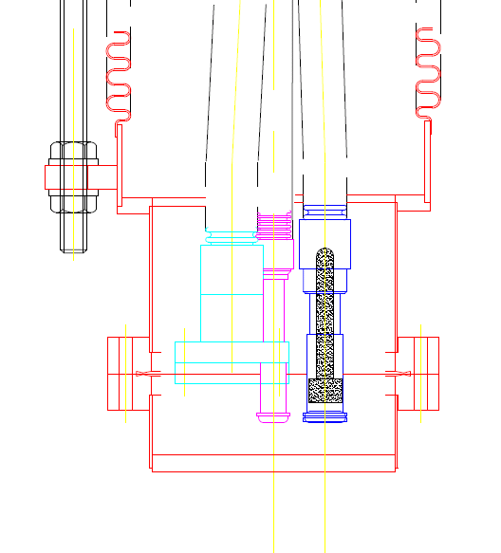

Blocking Particle Filter in LHe Supply Line
LHe supplying line in MCTL
VB3
VB2
Filter
Cryomodule
VB1
Line filter

Slide 20
Discussion
How frequently a cold box and compressor should be maintained for the keep their performance ?
Whether the skipping some procedures (sequences) to resume coldbox operation would be recommended, after safe stop of turbine (just few minutes ~ few hours) due to the facility troubles such as site blackout, losses of cooling water and pneumatic air ?
Is it possible for a large volume of LHe dewar to keep cavity cold (not over 50K) for the long idle standby, ? and recommendable ?
Is there any special idea to detect the possibility of turbine stoppage ?
(We monitor turbine speeds, pressure disturbances around turbines and He impurity of several positions of warm and cold parts)
Life time of ceramic window ?
Calibration of field pickup, how frequently ?
Necessity of dual refrigerators, worthwhile ?
END

