Slide 1
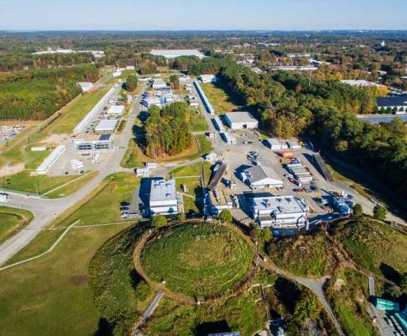
Machine Availability and Reliability in CEBAF
At Thomas Jefferson National Laboratory
Thomas Jefferson National Acceleration Facility
A presentation to the Tesla Technology Collaboration (TTC) meeting; Aomori, Japan
Michael D McCaughan
SRF Operations
CEBAF Particle Accelerator

Slide 2
Scheduling
Experiments are proposed annually to a panel of outside experts [The Program Advisory Committee or PAC] and are ranked according to their scientific merit and awarded some number of experiment day.
PAC Days x 2 = Scheduled Days
(Stuff happens…)
This accounts for projected inefficiencies and failures, but not experimental overhead. (Say installing a new spectrometer…)
Experiments are arranged into a schedule with combined input of members of scheduling committee (Experimental Hall leaders, Physics & Accelerator Division leaders, Director of Accelerator Operations, etc.):
www.jlab.org/physics/experiments/schedule
M. McCaughan
TTC: Aomori, Japan 12Oct22

Slide 3
Scheduling (Cont.)
Implicit in this schedule are certain negotiated activities which are overhead:
Beam Studies + RF Recovery (12 hrs/week)
Maintenance (4 hr/week)
(S)RF Maintenance (8 hrs/week)
Beam Tuning (8 hrs/week) [Program reconfiguration, quality issues, restore beam after one of the above… etc.]
This time is all taken out of that ‘inefficiency’ time granted by PAC; the remaining time: 136 hrs/week are scheduled research.
Now as noted – stuff happens – so if beam stops for longer than 5 minutes for a reason other than the scheduled program this is considered a Down Time. These down times are created and managed by the operations crew on-duty, but may later revisited offline by the operability group with the advantage of hindsight to make sure binning/categorization is appropriate for affected systems once the situation is clear.
M. McCaughan
TTC: Aomori, Japan 12Oct22

Slide 4
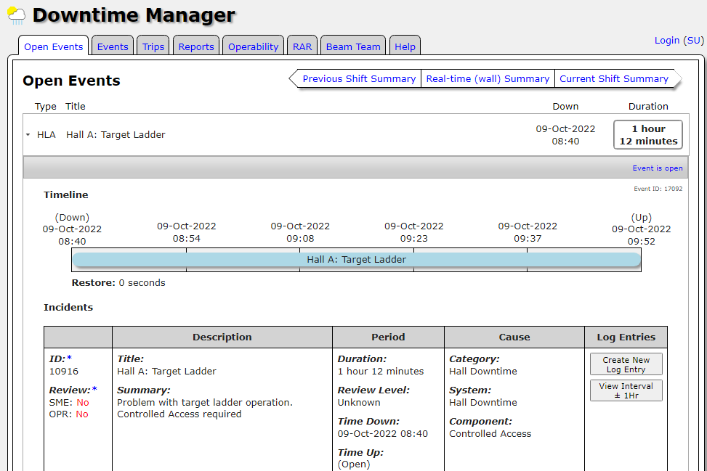
Downtime: Example
M. McCaughan
TTC: Aomori, Japan 12Oct22

Slide 5
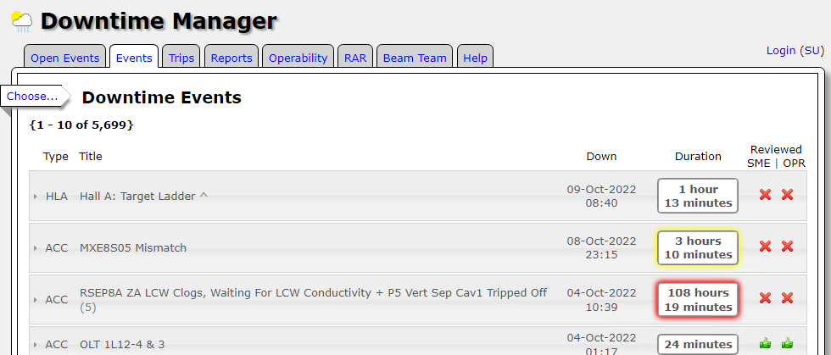
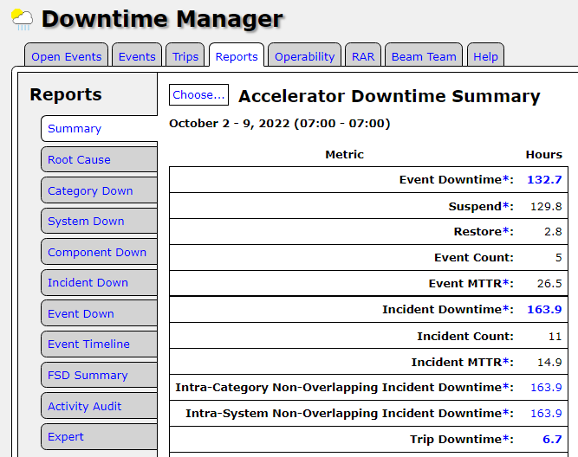
Downtime Example
Data is sliced up lots of different ways other than time accounting for machine reliability purposes.
(Outside scope of this talk)
Details available upon request…
M. McCaughan
TTC: Aomori, Japan 12Oct22

Slide 6
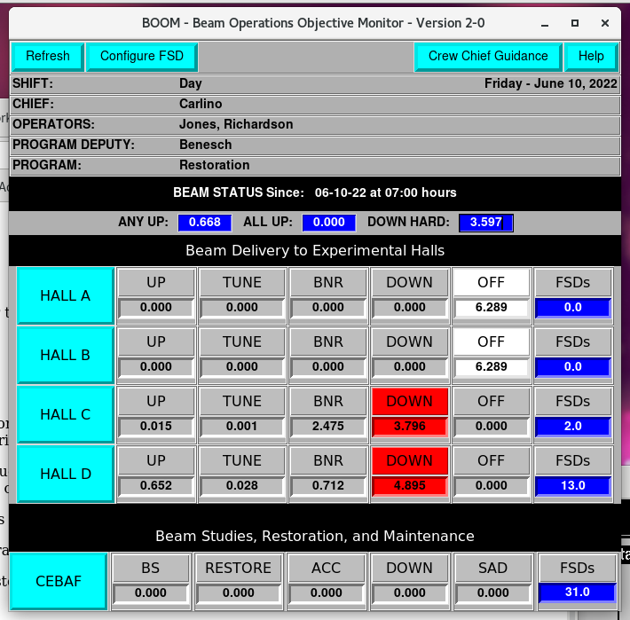
Beam Time Accounting
Recorded online; checked by Crew Chief.
Hall states:
Up – Executing program
Tune – Tuning beam for program
BNR – Beam Not Requested (Accelerator okay; hall unready)
Down – No beam from Accelerator
Off – Not scheduled for beam
CEBAF States:
BS – Beam Studies
Restore – Scheduled machine set-up time at start of run / after long downs
ACC – Accelerator configuration change
Down – No beam available
SAD – Scheduled Accelerator Down [Off]
States != OFF / SAD count against budgeted PAC hours
M. McCaughan
TTC: Aomori, Japan 12Oct22

Slide 7
Reliability
Research
Research = Physics Uptime (BTM) + Quality – Physics Down
Quality – scheduled extra hours for sub-optimal setups due to experiment multiplicity (ex. Low polarization, energy, current, etc. means running longer to achieve the same data set)
Physics Down = Recorded Downtimes – Hall down/unavailable
Tune and Restore time:
Tune/Restore Time = Accelerator Configuration Change + Restore
Note recovery periods from downtimes are encapsulated in the downtimes and will not be extracted unless excessive (O(days+))
Total Beam Delivered & Scheduled:
Total Delivered = Research + Tune/Restore + Beam Studies
Total Scheduled = Total Delivered + Down Times – Agreed Maintenance
Reliability == Total Delivered / Total Scheduled
(Note: Further corrective action to this number may be taken for other unaccounted for items like integrated FSD faults time, schedule / program changes/etc.) The number following these 2nd order corrections is what is submitted with Joule report.
M. McCaughan
TTC: Aomori, Japan 12Oct22

Slide 8
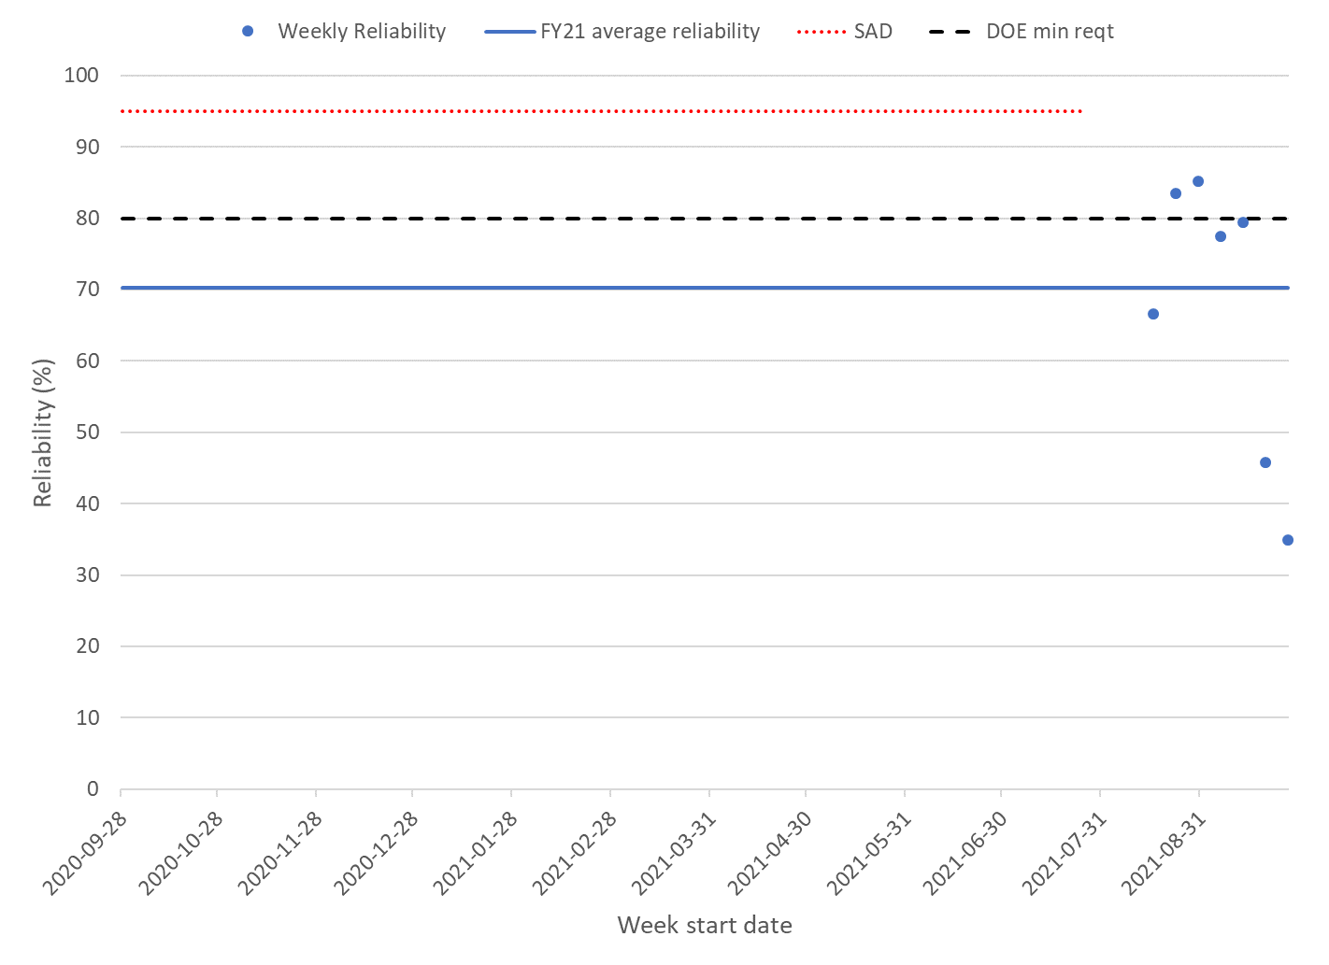
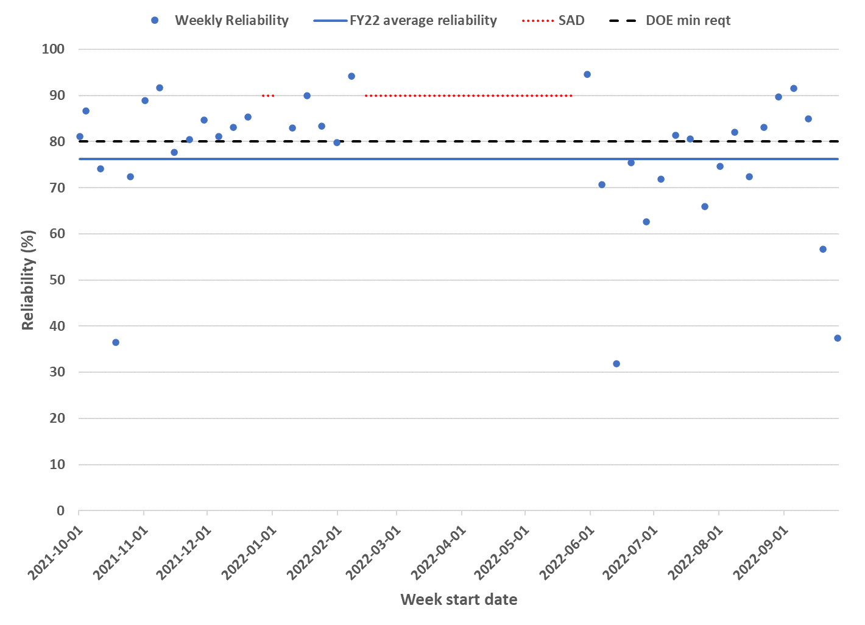
Reliability
CEBAF Reliability (performance measure reported to DOE)
FY21 reliability (short run after long shutdown): Achieved 775.9 total delivered hours/780 planned [1104 scheduled] 70.3% reliability
FY22 reliability: (33 weeks (1 technical stop, 2 recovery, 30 physics) @ 3 linac energies (910, 980, 1047 MeV/linac)) Achieved 4153 delivered operating hours & 1293 unscheduled failure hours; reliability 76%
CEBAF Target: 80% / year
FY21 weekly reliability
FY21 weekly reliability
FY22 weekly reliability
Transition to higher energy after FY22 SAD has been painful
Availability/Reliability in CEBAF
TTC: Aomori, Japan 12Oct22
M. McCaughan

Slide 9
Michael McCaughan
12000 Jefferson Ave. Suite 19
Newport News, VA 23606 USA
O: (757) 269-5572 / michaelm@jlab.org
-Fin-

Slide 10
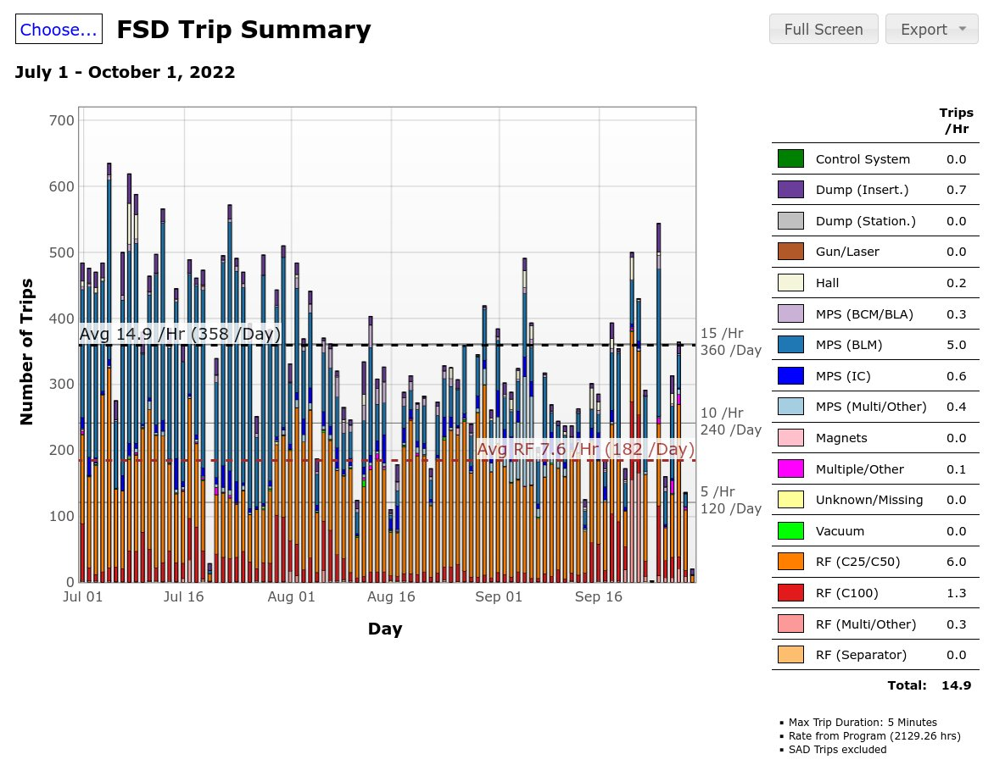
Back-Up Slides
Availability/Reliability in CEBAF
TTC: Aomori, Japan 12Oct22
M. McCaughan

Slide 11
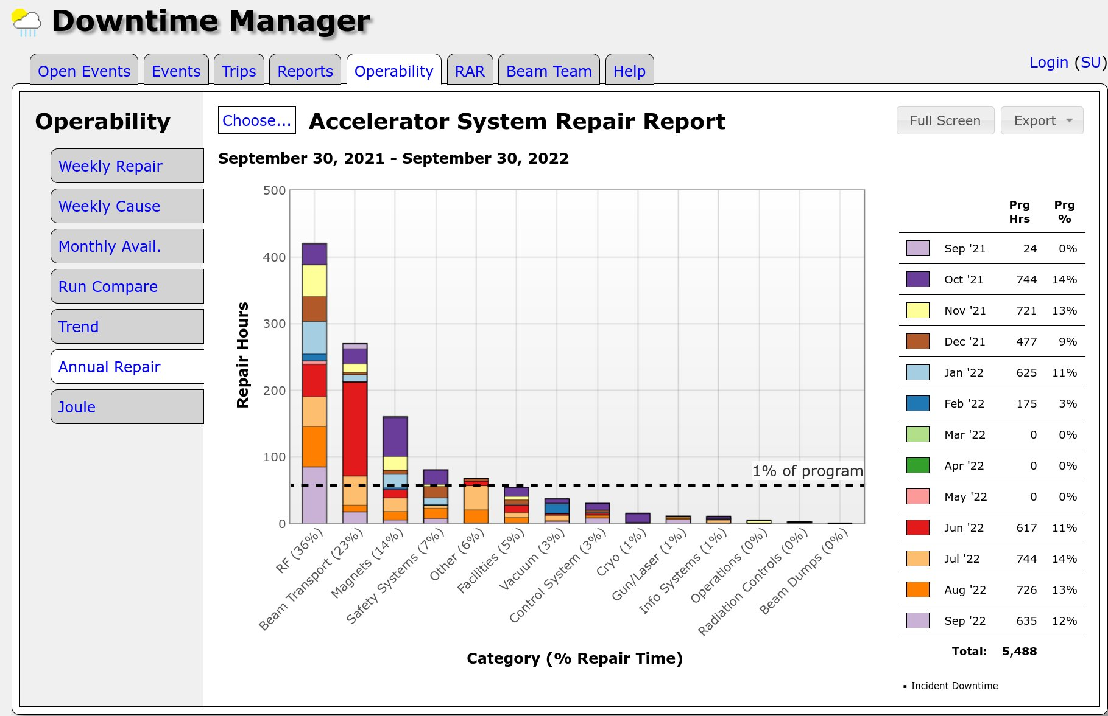
Back-Up Slides
Availability/Reliability in CEBAF
TTC: Aomori, Japan 12Oct22
M. McCaughan

