Slide 1
Lessons learned during high pressure rinsing of the superconducting solenoids of the LIPAc SRF linac
T. Ebisawa and LIPAc unit
Aomori Japan – 2022/10/12
@TTC 2022 Aomori

Slide 2
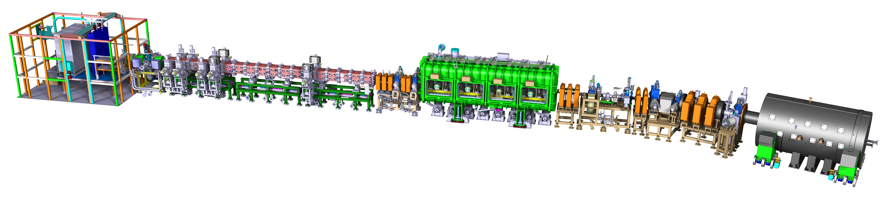
LIPAc project
IFMIF(International Fusion Materials Irradiation Facility) is an accelerator-based D-Li neutron source to test the reactor material of the Fusion DEMO. The project is in the Engineering Validation and Engineering Design Activities (EVEDA) phase, the construction and the commissioning of the Linear IFMIF Prototype Accelerator (LIPAc) is ongoing at QST Rokkasho site.
IFMIF/EVEDA LIPAc
RFQ : 0.1→5MeV
SRF: 5→9MeV
Beam dump
ECR ion source
LEBT
MEBT
Injector
HEBT+DPlate
D+, 125mA/9MeV @CW

Slide 3
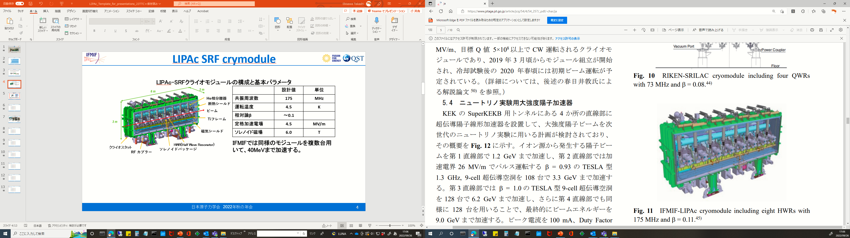
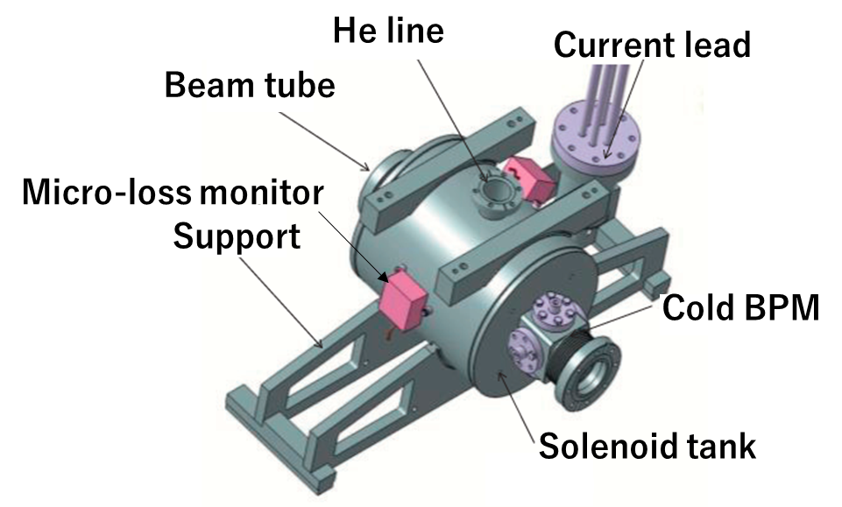
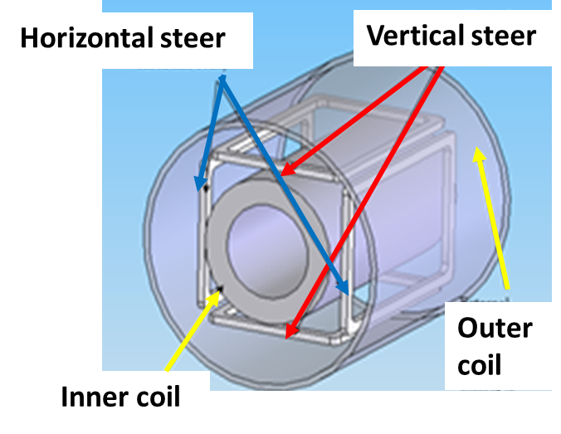
LIPAc SRF cryomodule
Construction and parameters of LIPAc cryomodule
 | Value | Unit
Frequency | 175 | MHz
Temperature | 4.5 | K
Relativistic β | ～0.1
Nominal acc field | 4.5 | MV/m
Solenoid max field | 6.0 | T
Cryostat
HWR(Half-Wave Resonator) x8
RF coupler x8
Solenoid package x8
Solenoid packages
Material:
NbTi coil

Slide 4
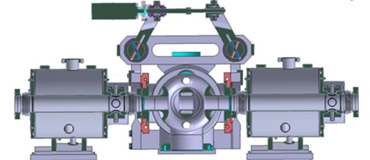
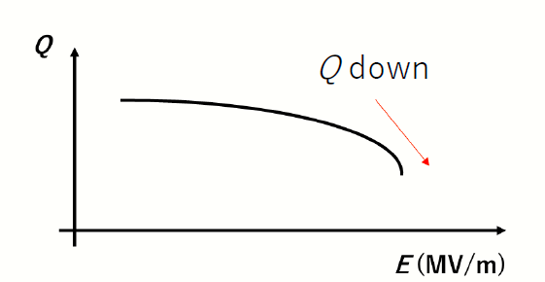
Solenoid HPR cleaning
Why is HPR necessary?
Beam
HWR cavity
Solenoid package
HWR cavity vacuum and solenoid beam vacuum are connected directly.
The particles from solenoid can degrade the cavity performance.
To prevent degradation by Field Emission of cavities, solenoid HPR (High Pressure Rinsing) is necessary.

Slide 5
Solenoid cleaning task list
Solenoids experienced some rework in 2019.
Because of that, the ultrasonic cleaning with alkaline detergent is required.
All the solenoids were cold-tested at 30 K at RI, Germany in Apr-Dec 2021.
Cleaning work was conducted in Japan (at MHI factories).
The cleaning task list and its procedure was defined by F4E and QST based on CEA’s suggestion.
Cleaning task list
Visual inspection of the solenoid
Preparation of the cleaning
Ultrasonic cleaning of the solenoid with alkali detergent
High Pressure Rinsing and clean up in clean room
Mounting BPM button and vacuum leak check
Double packing

Slide 6
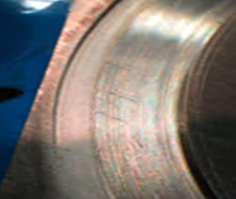
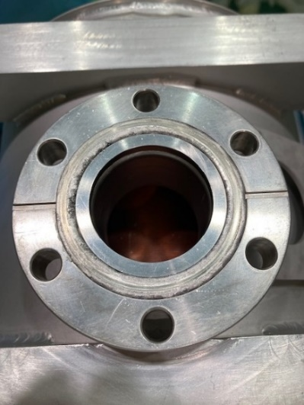
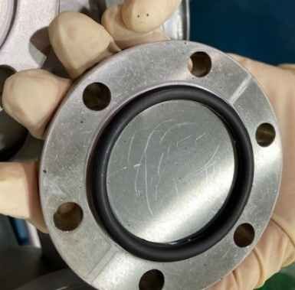
Visual inspection
Before shipping to Japan, the cold test and packing the solenoid have performed properly in Germany. However, visual inspection after transported to Japan…
Improper closing or many scratches…
-> Possibly due to the vibration during transportation or messy handling at customs of airport …
He ports were closed by silicon rubber or helicoflex, and copper nut.
-> Unsuitable for alkali detergent.
Not spring washers and plated screws.
-> Infeasible ultrasonic cleaning.
By unexpected customs inspection, reclosing the He port was necessary. This is the difficulty of the international project…

Slide 7
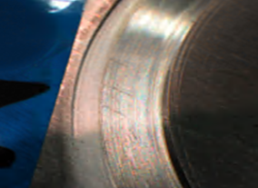
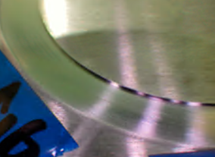
Preparation of the cleaning
Additional work before ultrasonic cleaning.
- Processing damaged surface by sponge abrasive.
Reclosing He port flange by appropriate materials.
Leak check immersion in pure water.
Before | After | Reason
Metal gasket or Silicon rubber | NBR(AcryloNitrile-Butadiene Rubber) O ring | Because of strong alkali resistant material.
Stainless steal screw and copper nut | Silver plated screw and stainless steal nut | To prevent the screw seizing by ultrasonic vibration.
No spring washer | Installed spring washer | To prevent the screw loosen by ultrasonic vibration.

Slide 8
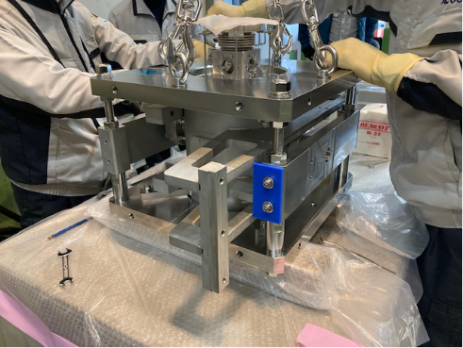
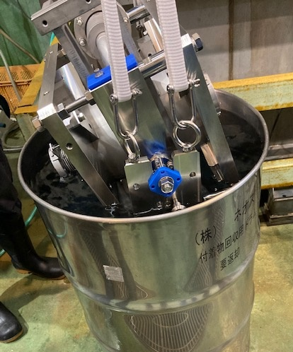
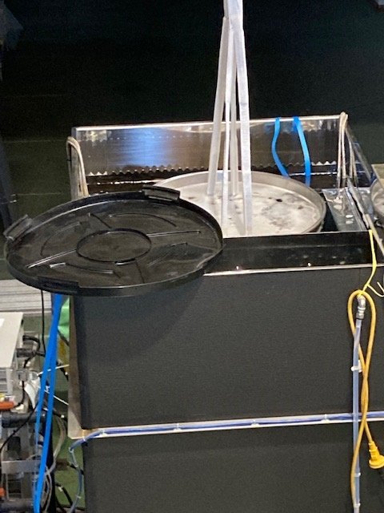
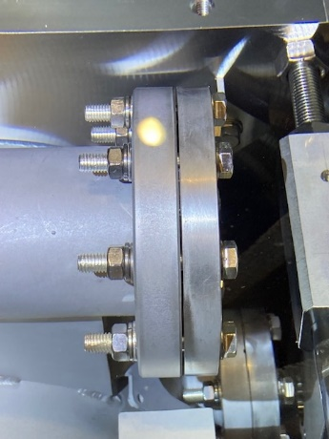
Ultrasonic cleaning with alkali detergent
Ultrasonic cleaning @NEOS (subcontractor of MHI)
JIG assembly after
closing the He port.
Leak check in pure water.
-> No air bubble, OK!
Cleaning in ultrasonic bath.
@50℃, 20min, 40kHz, 8kW
No screw loosing or seizing of flanges.
->Changing material and reclosing succeed !!

Slide 9
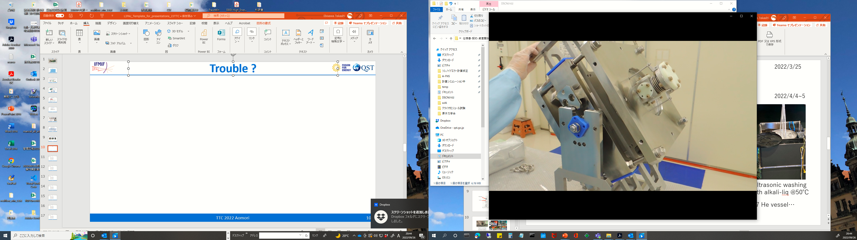
Trouble?
Metal collision?
Rotating the support JIG after the ultrasonic cleaning, the strange sounds (metal collision?) was heard from inside of No6 &No7 solenoid packages.
-> In this time, workers guessed that screw was retracted inside by vibration.
Screw retracted ?

Slide 10
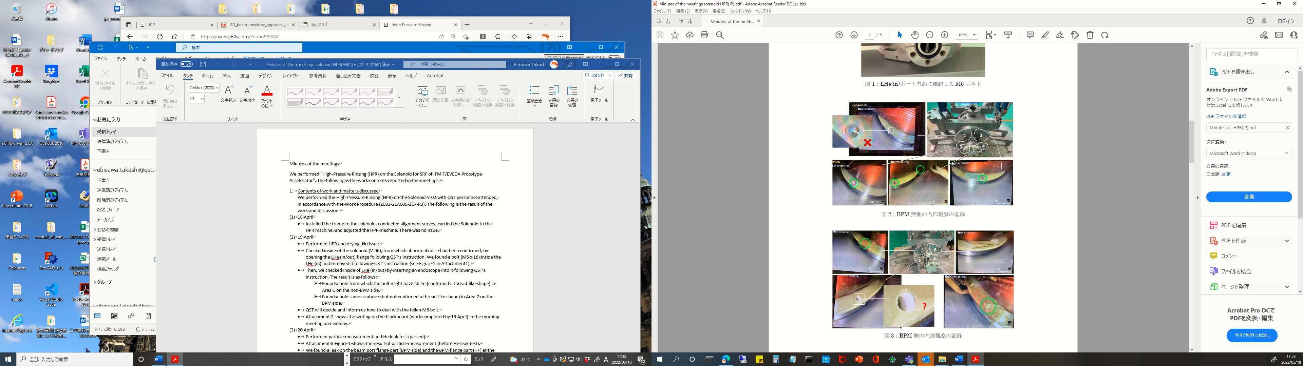
Inspection of the He vessel
Open He port flange No6 solenoid and retracted screw was found…
Dropped screw hole was detected by fiber scope.
Regarding No7, there were no retracted screw in accessible area…
No alkali detergent leak to inside of He vessel.
Details will be presented by Janic Chambrillon “LIPAc cryomodule assembly progress and lessons learnt” in TTC 2022 Aomori.

Slide 11
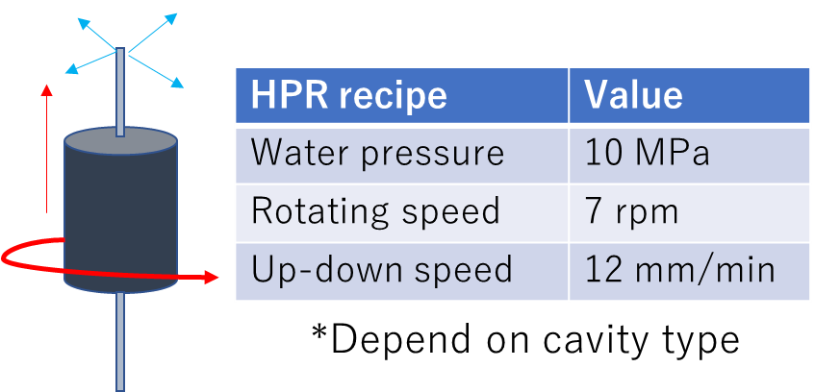
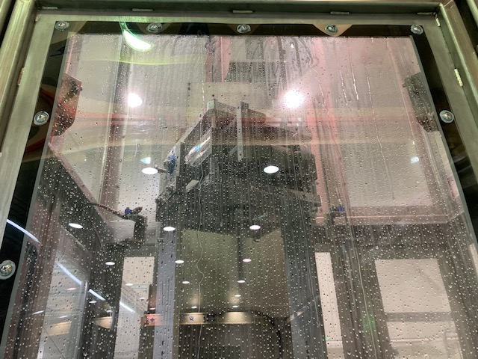
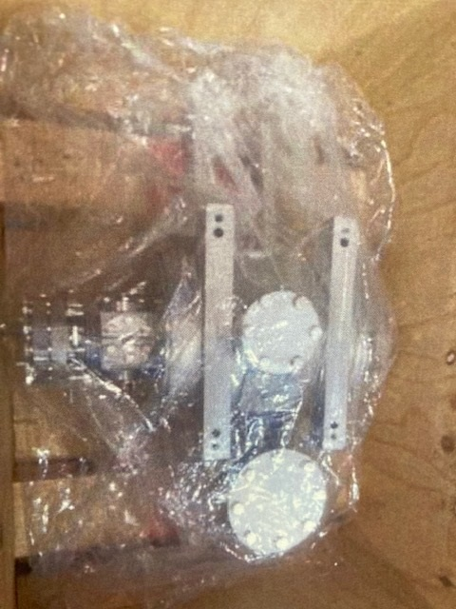
High Pressure Rinsing
Clean room for HPR @MHI facility
HPR condition for solenoid
HPR system
Specification
- ISO class1
- Lateral flow
- 7m×4m
Filter unit
Dry &N2 blow.
1counts @0.3μm!
BPM mount and
leak test.→No leak!
HPR in cleanroom.
Double packing.

Slide 12
Summary
The ultrasonic cleaning with alkali detergent, HPR and N2 blow of the solenoids was successfully carried out.
-> 1count or less than detection limit of particle counter!
By unexpected bad handling at customs inspection, additional work for the reclosing the He port flange was necessary.
Closing He port flange by silver plated screw, alkali resistant NBR O-ring and spring washer, and leak check immersion in pure water was succeeded.
-> No screw loosen or seizing. No corrosion. No leak alkali detergent.

