Slide 2

Beam Commissioning and Early Operations of the
REX / HIE-ISOLDE LINAC
Jose Alberto Rodriguez
Erwin Siesling
Mathieu Therrase
Daniel Valuch
Walter Venturini

Slide 3
Outline:
Introduction to the ISOLDE Facility
The REX/HIE-ISOLDE Post-Accelerator
Highlights Beam Commissioning
Highlights Early Operations
Selected Issues
Summary
J.A. Rodriguez et al. – TTC 2022, Aomori, Japan – 2022/10/11

Slide 4
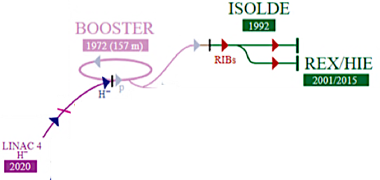
Introduction to the ISOLDE Facility:
ISOLDE is a Radioactive Ion Beams (RIBs) production facility located at CERN
ISOLDE is the destination of around 50% of the protons accelerated by the PS Booster (~ 2 uA at 1.4 GeV)
J.A. Rodriguez et al. – TTC 2022, Aomori, Japan – 2022/10/11

Slide 5
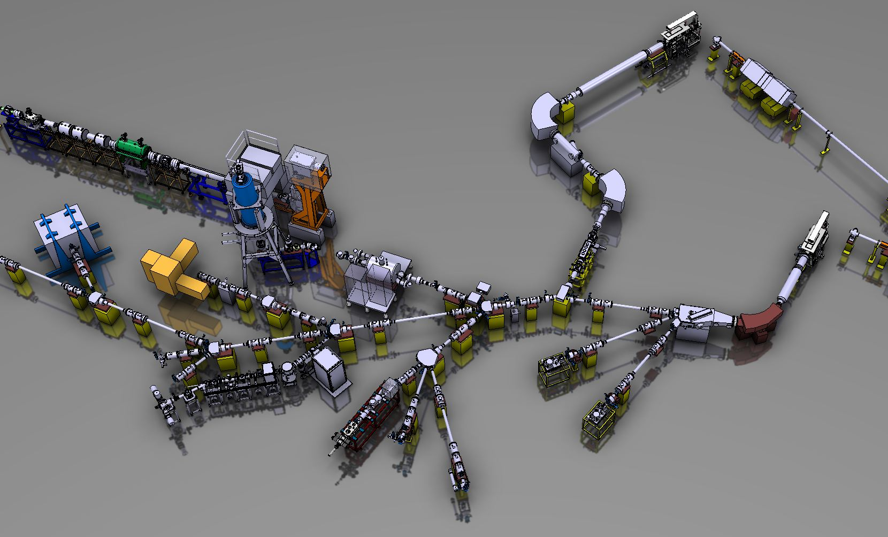
Introduction to the ISOLDE Facility:
Isotopes extracted from one of the two front-ends are transported using electrostatic elements to a separator dipole where the RIB of interest is selected
A beam switch yard is used to redirect the beam to the desired destination
HRS target front-end
BTY line (PSB/ISOLDE proton transfer line)
HRS separator
Beam switchyard
J.A. Rodriguez et al. – TTC 2022, Aomori, Japan – 2022/10/11

Slide 6
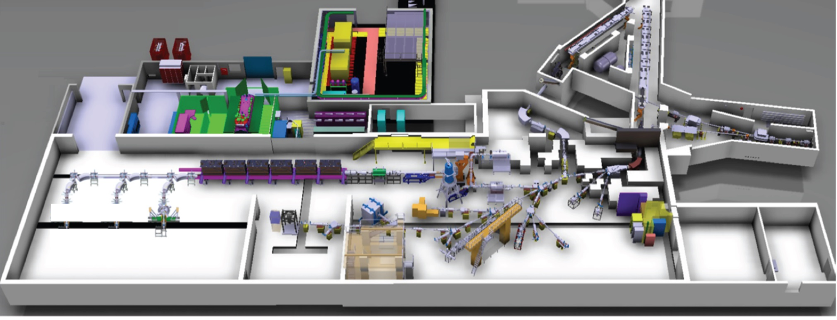
Introduction to the ISOLDE Facility:
The RIB of interest is then transported to one of the experimental stations either directly or after being accelerated in the REX/HIE-ISOLDE post-accelerator
HRS
RIB
HIE-ISOLDE HEBT lines
BTY line
REX/HIE-ISOLDE post-accelerator
RIB
p beam
GPS
ISOLDE low energy lines
High energy experimental stations:
Miniball
ISS
Scattering Chamber
Low energy experimental stations:
IDS
ISOLTRAP
CRIS
COLLAPS
SSP stations
VITO
NICOLE
WISARD
J.A. Rodriguez et al. – TTC 2022, Aomori, Japan – 2022/10/11

Slide 7
Outline:
Introduction to the ISOLDE Facility
The REX/HIE-ISOLDE Post-Accelerator
Highlights Beam Commissioning
Highlights Early Operations
Selected Issues
Summary
J.A. Rodriguez et al. – TTC 2022, Aomori, Japan – 2022/10/11

Slide 8
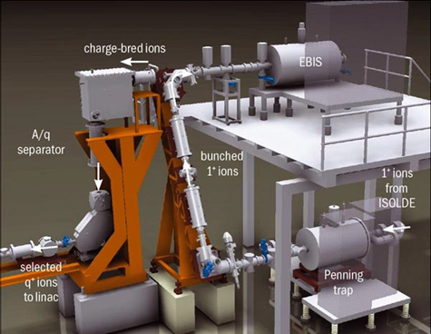
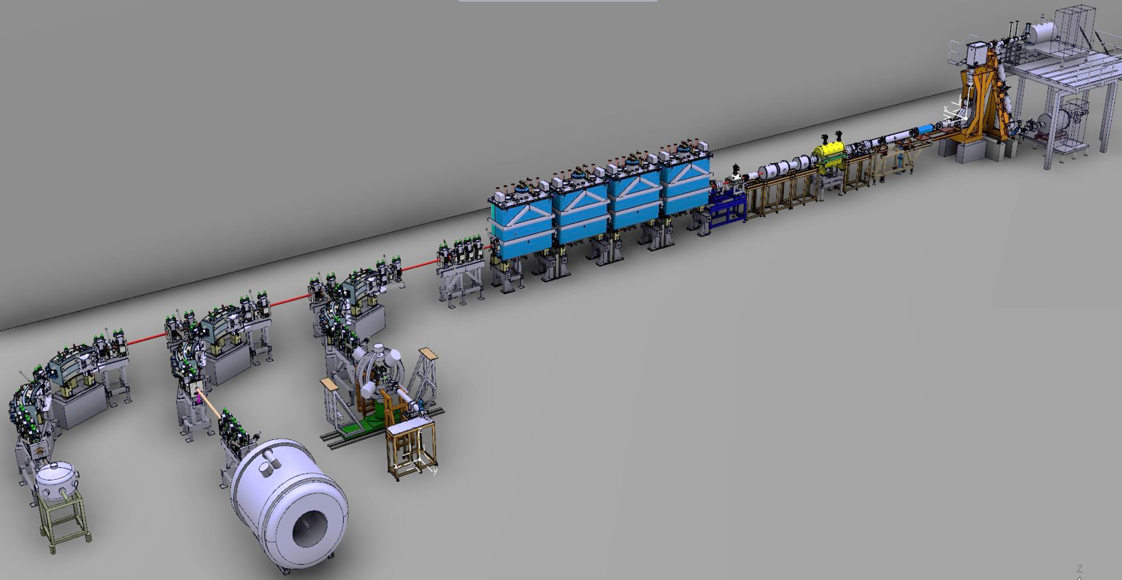
The REX/HIE-ISOLDE Post-Accelerator:
Ions are accumulated and transversely cooled in the REX-TRAP and charge bred in the REX-EBIS
The charge state of interest is selected in the REX separator before injection into the REX/HIE-ISOLDE linac for acceleration and delivery to one of the experimental stations
REX-EBIS
REX-TRAP
REX Separator
J.A. Rodriguez et al. – TTC 2022, Aomori, Japan – 2022/10/11

Slide 9
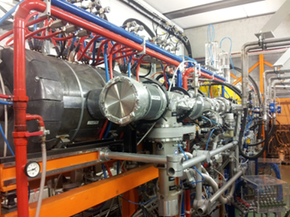
The REX/HIE-ISOLDE Post-Accelerator:
The REX normal conducting linac:
Beam from the charge breeder with 5 keV/u energy is accelerated to 2.8 MeV/u
Mass to Charge state ratio acceptance: 2.5 < A/q < 4.5
Cavities: Seven RF structures: f = 101.28 MHz (except for 9gap at 202.56 MHz) up to 10% duty cycle
Focusing: 6 triplets, 1 doublet Steering: 1 pair of horizontal/vertical steerers
Beam instrumentation: 3 diagnostic boxes (FCs, MCPs, beam attenuators and collimators)
REX-EBIS
RF structure | E_{f} [MeV/u] | β_{f} [%] | P [kW] for A/q=4.0 | A/q acceptance
RFQ | 0.3 | 2.5 | 29 | < 5.5
Buncher | 0.3 | 2.5 | 1.3 | > 2.5
IHS | 1.2 | 5.1 | 40 | < 4.5
7gap1 | 1.55 | 5.7 | 60 | > 2.5
7gap2 | 1.88 | 6.3 | 60 | > 2.5
7gap3 | 2.2 | 6.8 | 60 | > 2.5
9gap | 2.85 | 7.8 | 71 | > 2.5
REX linac
REX separator
REX-TRAP
J.A. Rodriguez et al. – TTC 2022, Aomori, Japan – 2022/10/11

Slide 10
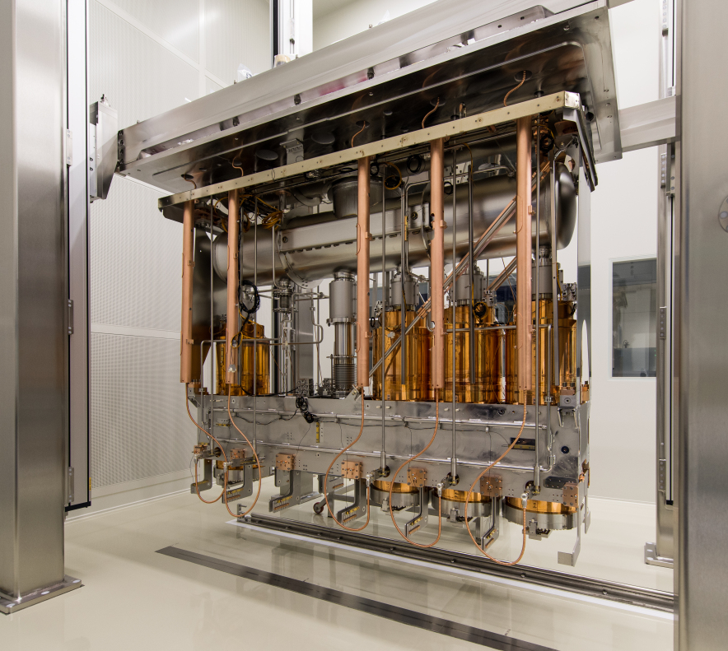
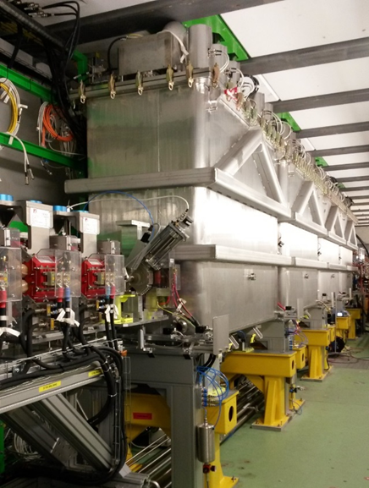
The REX/HIE-ISOLDE Post-Accelerator:
The HIE-ISOLDE superconducting linac:
Cavities: Quarter Wave Resonators (QWR) made of a copper substrate with sputtered niobium
Cryomodule: five QWR and one SC solenoid
Common insulation and beam vacuum, top plate mounted
Nominal energy: 9.2 MeV/u for A/q = 4.5, 14.2 MeV/u for A/q = 2.5
Diagnostics: Scanning slits, collimators and FCs
Focusing: SC solenoids, quadrupoles Steering: Vertical/horizontal very few meters
REX linac
HIE-ISOLDE linac
REX separator
REX-TRAP
f [MHz] | 101.28
Geometrical beta (β_{g}) | 10.3
E_{acc} [MV/m] | 6
Quality factor (Q_{o}) at E_{acc} | 5∙10⁸
Active length [m] | 0.3
Beam aperture [cm] | 2
Max. Transit Time Factor (TTF) | 0.9
J.A. Rodriguez et al. – TTC 2022, Aomori, Japan – 2022/10/11

Slide 11
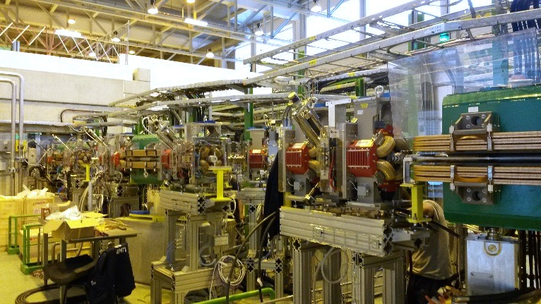
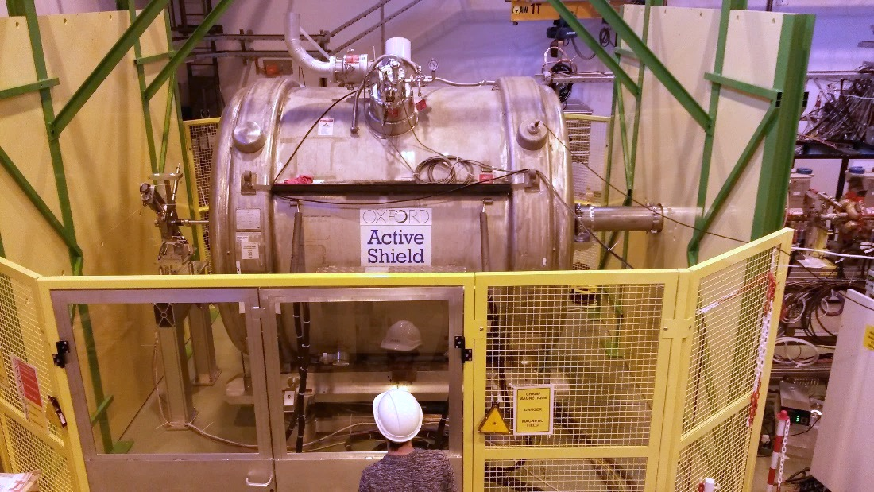
The REX/HIE-ISOLDE Post-Accelerator:
The HIE-ISOLDE High Energy Beam Transfer (HEBT) lines :
Three lines (XT01 – Miniball, XT02 – ISS and XT03 – Scattering Chamber / Travelling experiments)
Focusing: quadrupoles Steering: Vertical/horizontal very few meters
Beam instrumentation: Scanning slits, collimators, FCs and silicon detectors
Stripping foils to clean contaminants (specially useful for light beams)
REX-EBIS
REX linac
HIE-ISOLDE linac
REX separator
REX-TRAP
HEBT lines
Miniball
SEC
ISS
J.A. Rodriguez et al. – TTC 2022, Aomori, Japan – 2022/10/11

Slide 12
Outline:
Introduction to the ISOLDE Facility
The REX/HIE-ISOLDE Post-Accelerator
Highlights Beam Commissioning
Highlights Early Operations
Selected Issues
Summary
J.A. Rodriguez et al. – TTC 2022, Aomori, Japan – 2022/10/11

Slide 13
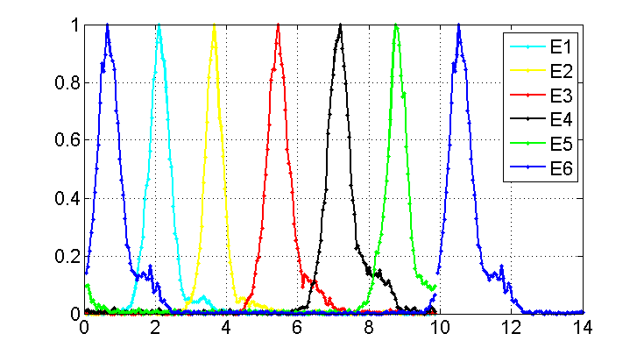
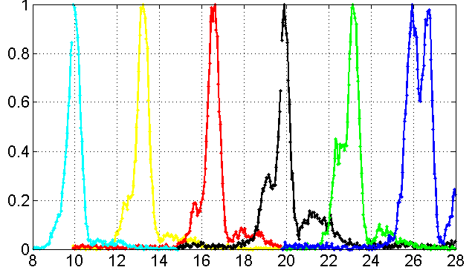

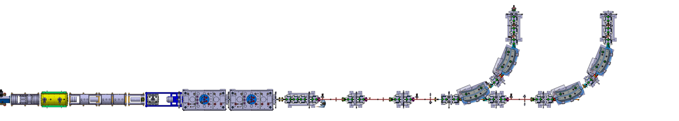
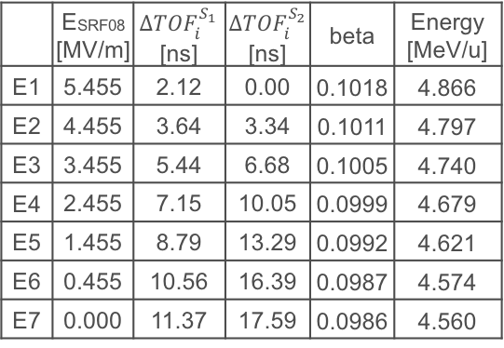
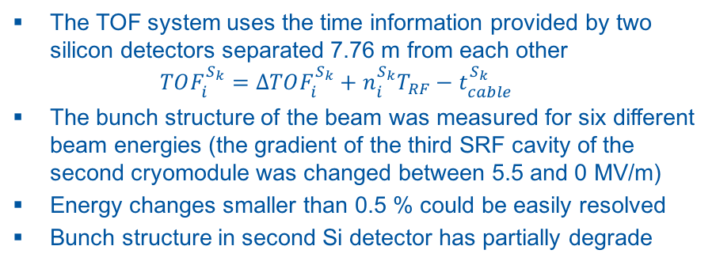
Highlights Beam Commissioning:
Energy measurements using TOF (by S. Sadovich+OP):
Bunch time structure for beams with different energies measured at XT00.1000 Si detector
The TOF system uses the time information provided by two silicon detectors separated 7.76 m from each other
$TOF_{i}^{S_{k}}=ΔTOF_{i}^{S_{k}}+n_{i}^{S_{k}}T_{RF}−t_{cable}^{S_{k}}$
The bunch structure of the beam was measured for six different beam energies (the gradient of the third SRF cavity of the second cryomodule was changed between 5.5 and 0 MV/m)
Energy changes smaller than 0.5 % could be easily resolved
Bunch structure in second Si detector has partially degrade
N / N_{MAX}
time [ns]
Bunch time structure for beams with different energies measured at XT00.1900 Si detector
 | E_{SRF08} [MV/m] | $ΔTOF_{i}^{S_{1}}$ [ns] | $ΔTOF_{i}^{S_{2}}$[ns] | beta | Energy [MeV/u]
E1 | 5.455 | 2.12 | 0.00 | 0.1018 | 4.866
E2 | 4.455 | 3.64 | 3.34 | 0.1011 | 4.797
E3 | 3.455 | 5.44 | 6.68 | 0.1005 | 4.740
E4 | 2.455 | 7.15 | 10.05 | 0.0999 | 4.679
E5 | 1.455 | 8.79 | 13.29 | 0.0992 | 4.621
E6 | 0.455 | 10.56 | 16.39 | 0.0987 | 4.574
E7 | 0.000 | 11.37 | 17.59 | 0.0986 | 4.560
N / N_{MAX}
time [ns]
7.76 m
XT00.1900 Si detector
XT00.1000 Si detector
J.A. Rodriguez et al. – TTC 2022, Aomori, Japan – 2022/10/11

Slide 14
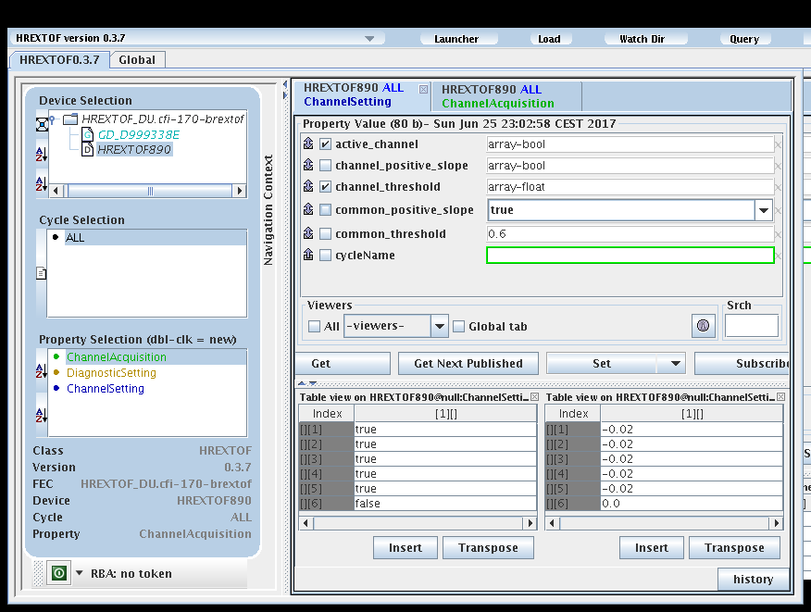
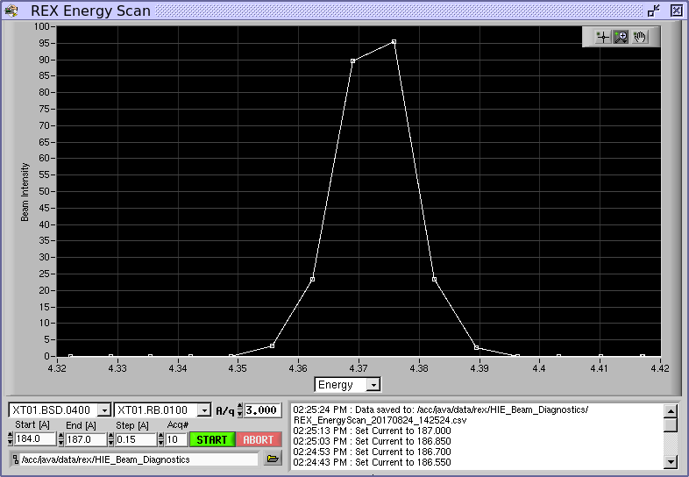
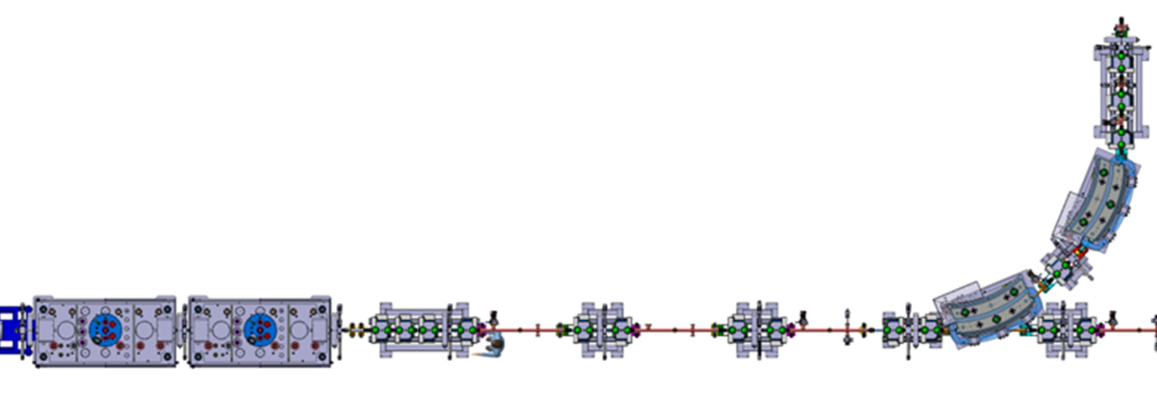
Highlights Beam Commissioning:
Energy measurements using the HEBT line as an spectrometer:
Time Of Flight FESA class, high-level applications developed and commissioned (channel settings and particle count rate)
FESA Navigator for TOF class
Energy Scan after set-up for ¹⁵C experiment completed
Energy and energy spread of the beam can be carried out using the count rate measured at the Silicon detector at XT01.0400 after the first dipole magnet
The method works very well:
  Can be used for very low intensity beams
  Can be completed in ~ 15 mins
  However, as with all measurements with Si detectors, special attention is required to avoid damaging it
1 mm vertical slits
Silicon detector
All quads and steerers off
J.A. Rodriguez et al. – TTC 2022, Aomori, Japan – 2022/10/11

Slide 15
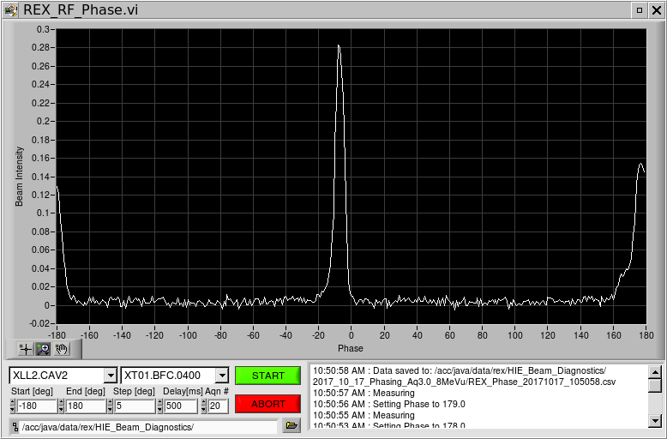
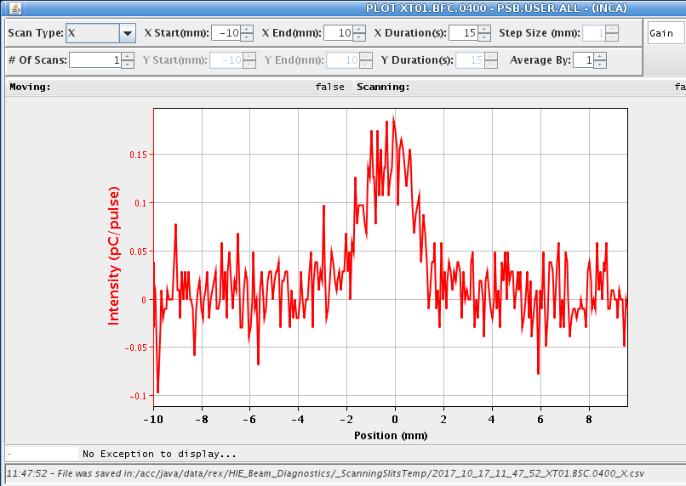
Highlights Beam Commissioning:
Semi-automatic Cavity Phasing:
Procedure to phase the SRF cavities is well defined, robust and repeatable
  Phase scan to determine zero-crossings
  Set operational phase
  Scale HEBT line
  Adjust and document settings of the machine
Software applications have been developed to automatize some of the steps
Currently, phasing 20 cavities takes ~ 8 hours
Zero-crossings of SRF02
Beam profile after first dipole magnet after SRF02 was phased
Faraday Cup
5 mm vertical slit
SRF cavity
J.A. Rodriguez et al. – TTC 2022, Aomori, Japan – 2022/10/11

Slide 16
Outline:
Introduction to the ISOLDE Facility
The REX/HIE-ISOLDE Post-Accelerator
Highlights Beam Commissioning
Highlights Early Operations
Selected Issues
Summary
J.A. Rodriguez et al. – TTC 2022, Aomori, Japan – 2022/10/11

Slide 17
Highlights Early Operations:
Project staged (one cryomodule / year since 2015). Project completed in 2018
Short Physics campaign following the commissioning of each of the cryomodules
  Close to maximum number of experiments in 2018: ~ 15 / year
Long technical Stop (LS2) for upgrade of the injectors in 2019 – 2020
  Consolidation of beam instrumentation in the REX linac and additional silicon detectors in the HEBT
  Upgrade of the REX-EBIS electron gun
  Refurbishment of REX RF amplifiers
  Repair of damaged RF coupler
  X-ray monitors for each cryomodule
  Additional control software
Restart of Physics campaigns in 2021
  Number of experiments limited because of experimental stations
REX linac
HIE-ISOLDE linac
2016
2015
REX
REX/HIE-ISOLDE
2017
2018
J.A. Rodriguez et al. – TTC 2022, Aomori, Japan – 2022/10/11
Number of High Energy Experiments at ISOLDE

Slide 18
Highlights Early Operations:
Year | Beam(s) | Energies [MeV/u] | Time [hrs]
2015 | ⁷⁴Zn^{21, 25+}, ⁷⁶Zn²²⁺ | 2.8, 4.0 | ~ 170
2016 | ¹¹⁰Sn²⁶⁺ | 4.5 | 115
 | ¹⁴²Xe³³⁺ | 4.5 | 100
 | ⁷⁸Zn²⁰⁺ | 4.3 | 130
 | ¹³²Sn³¹⁺ | 5.5 | 130
 | ⁹Li^{3+→3+} | 6.8 | 70
 | ⁶⁶Ni¹⁶⁺ | 4.5 | 140
2017 | ⁷²Se¹⁹⁺ | 4.4 | 33
 | ⁶⁶Ge¹⁷⁺, ⁷⁰Se¹⁶⁺ | 4.4 | 97
 | ¹⁴²Ba³³⁺, ¹⁴⁴Ba³³⁺ | 3.4, 4.2 | 147
 | ¹⁴⁰Sm³⁴⁺ | 4.7 | 113
 | ¹⁵C^{5+→6+} | 4.4 | 245
 | ⁹⁴Rb²³⁺ | 6.2 | 140
 | ¹⁴²Sm³³⁺, ¹⁴⁰Nd³³⁺ | 4.6 | 166
 | ¹⁰⁸Sn²⁶⁺ | 4.5 | 94
 | ⁹Li^{3+→3+} | 8.0 | 80
 | ²⁰⁶Hg⁴⁶⁺ | 4.2 | 84
 | ⁵⁹Cu²⁰⁺ | 3.6, 4, 5, 4.3, 4.7 | 134
 | ²⁸Mg⁹⁺ | 5.5 | 176
2018 | ⁹⁶Kr²³⁺ | 4.7, 5.3 | 178
 | ²¹²Rn⁵⁰⁺ | 3.8, 4.4 | 49
 | ²²²Ra⁵¹⁺, ²²⁸Ra⁵³⁺ | 4.3, 4.2 | 31
 | ^{224, 226}Rn⁵²⁺, ²²²Rn⁵¹⁺ | 5.1 | 83
 | ¹⁴²Ba³³⁺ | 4.2 | 39
 | ¹⁰⁶Sn²⁶⁺ | 4.4 | 91
 | ⁸B^{3+→5+} | 4.9 | 97
 | ¹¹Be^{4+→4+} | 7.5 | 118
 | ^{134, 132}Sn³¹⁺ | 7.4, 7.2 | 68
 | ²⁸Mg⁹⁺ | 9.5 | 116
 | ²⁸Mg⁹⁺ | 9.5 | 117
 | ²⁰⁶Hg⁴⁶⁺ | 7.4 | 98
 | ⁹Li^{3+→3+} | 8.0 | 103
 | ⁷Be^{2+→4+} | 5.0 | 135
Large variety of beams delivered over the years:
  Light isotopes (⁷Be, ⁸B, ⁹Li…)
  Heavy isotopes (²²⁸Ra, ²²⁶Rn, ²⁰⁶Hg…)
  Energies up to 9.8 MeV/u for low A/q
  Energies up to 7.4 MeV/u for high A/q
  Beam intensities between 10² – 10⁷ ion/s
  Different ionization schemes (plasma, surface, laser and molecular beams)
Stripping foils to clean contaminants (⁹Li, ^{7,11}Be , ⁸B)
Long-live isotopes from pre-irradiated targets (⁷Be)
Year | Beam(s) | Energies [MeV/u] | Time [hrs]
2021 | ³⁰Mg¹¹⁺ | 8.5 | ~ 150
 | ²¹²Rn⁵⁰⁺ | 7.6 | ~ 150
 | ⁶¹Zn¹⁶⁺ | 7.5 | ~ 150
 | ²⁰⁹Fr⁵³⁺ | 7.6 | ~ 110
2022 | ¹¹Be^{4+→4+} | 9.8 | ~ 150
 | ²⁷Na¹⁰⁺ | 9.8 | ~ 150
 | ³⁰Mg¹¹⁺ | 8.5 | ~ 150
 | ¹¹²Sn²⁹⁺, ¹¹⁰Sn²⁸⁺, ¹⁰⁹Sn²⁹⁺, ¹⁰⁸Sn²⁸⁺ | 4.9 | ~ 150
 | ¹¹⁰Sn³²⁺ | 8.0 | ~ 120
 | ⁹²Kr²²⁺, ⁹⁴Kr²²⁺, ⁹⁶Kr²³⁺ | 7.5 | ~ 150
 | ¹³⁰Sn³²⁺ | 4.4 | ~ 120
 | ¹³¹Sn³¹⁺, ¹³¹Sn³³⁺ | 4.0 | ~ 100
 | ⁶⁸Ni¹⁸⁺ | 5.0 | ~ 100
 | ¹⁸²Hg⁴³⁺, ¹⁸⁴Hg⁴³⁺ | 4.0 | ~ 120
J.A. Rodriguez et al. – TTC 2022, Aomori, Japan – 2022/10/11

Slide 19
Outline:
Introduction to the ISOLDE Facility
The REX/HIE-ISOLDE Post-Accelerator
Highlights Beam Commissioning
Highlights Early Operations
Selected Issues
Summary
J.A. Rodriguez et al. – TTC 2022, Aomori, Japan – 2022/10/11

Slide 20
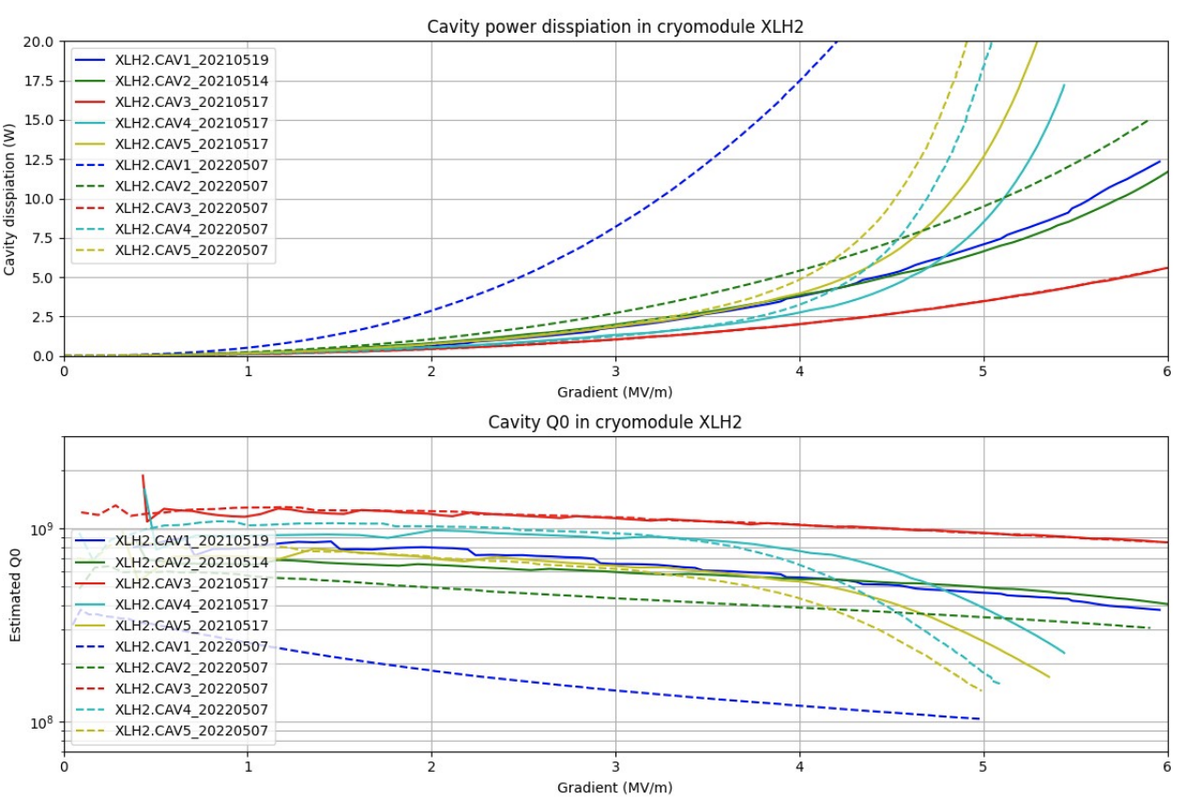
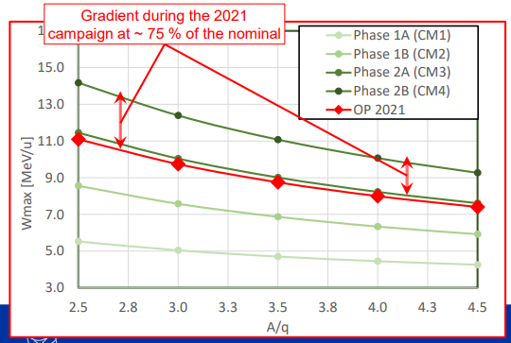
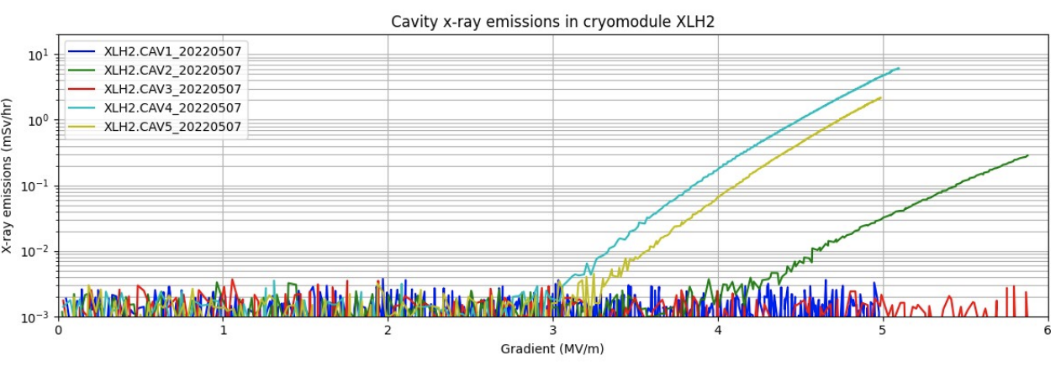
Issues: Limited accelerating gradient
SRF cavities operating at ~ 75 % of nominal gradient
  Final beam energy limited to 7.4 MeV/u for high A/q beams (nominal 9.2 MeV/u)
  Several experiments conducted over the years would have benefited from higher energies
  Situation seems to be degrading further
  Pulsed high-power RF conditioning helped
Q vs. E for CM2 in 2021 and 2022, D. Valuch
J.A. Rodriguez et al. – TTC 2022, Aomori, Japan – 2022/10/11
Field emission of cavities in CM2, D. Valuch

Slide 21
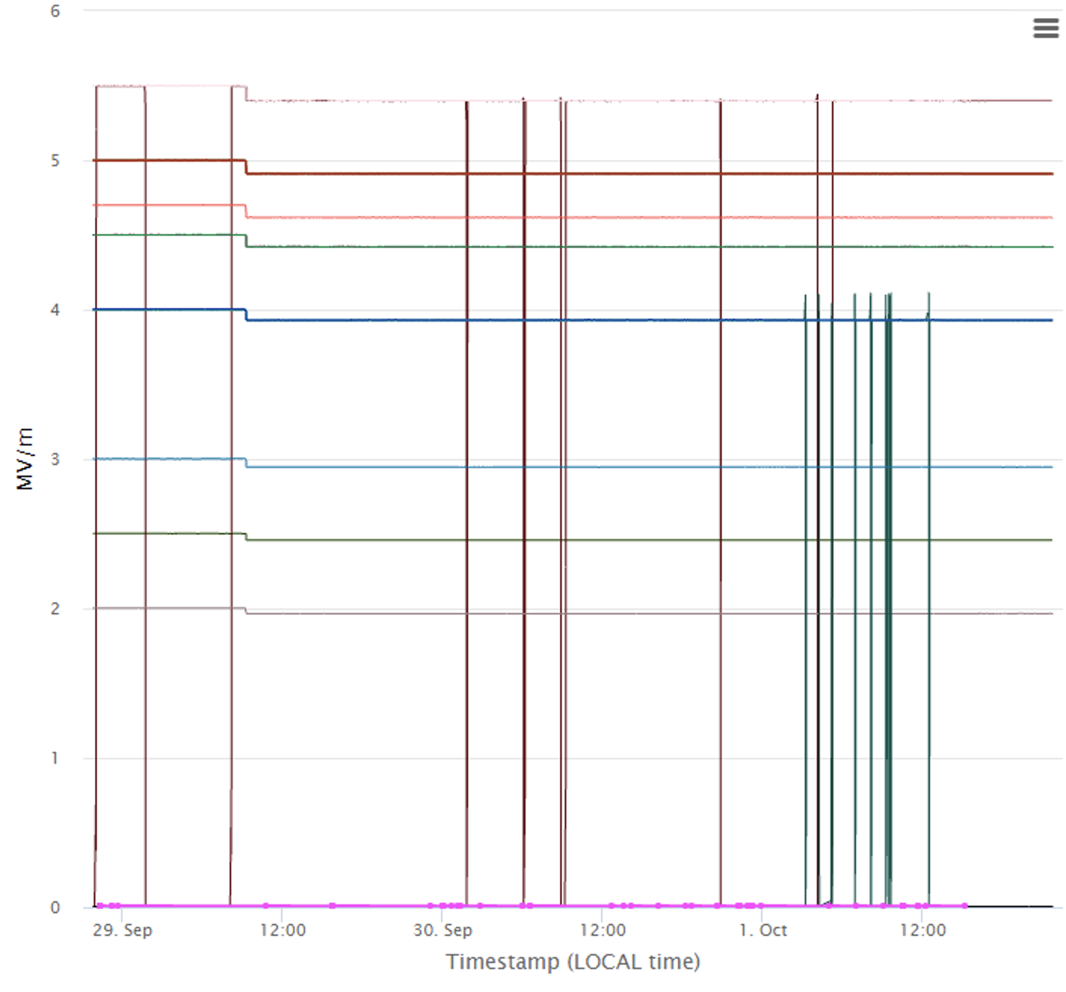
Issues: Stability of SRF cavities
Trips of some superconducting cavities result in a significant amount of downtime
Trips affects some cavities more than others. But, quiet cavities occasionally suffer the same issue
LLRF expert able to adjust feedback loops and improve the situation sometimes
Believed to be related to mechanical vibrations
Extensive investigations carried out. But, source of vibrations not identified yet (main hypothesis is sound wave generated in the cryoplant and propagated through the LHe bath)
Generally, we accept ~1 trip per hour (~ 8 % downtime)
In the worse cases, the cavity needs to be bypassed requiring the re-phasing of the downstream cavities and often a reduction of the beam energy
Trips of several SRF cavities during one of the Physics experiments
J.A. Rodriguez et al. – TTC 2022, Aomori, Japan – 2022/10/11

Slide 22
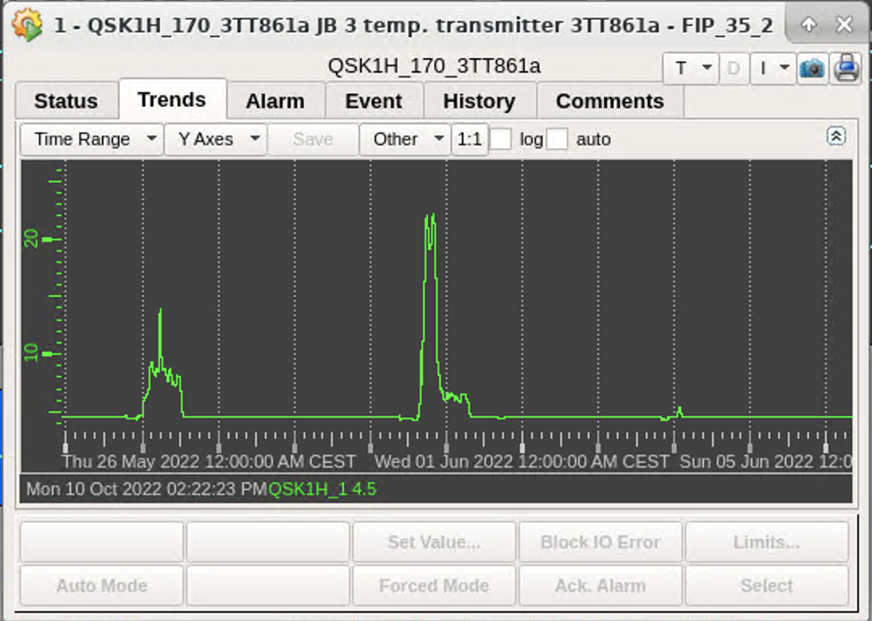
Issues: Accidental thermal cycling
Several incidents stopped the flow of LHe to the cavities:
  Failure of the station providing compressed air to the facility
  CERN-wide power cut (it can take days to recover from even ~ 100 ms voltage drops of ~ 20 %)
  Failure of the oil pump of the gear box
Temperature of the cavities raised above Tc
Cavities needed to be reconditioned
Temperature of one of SRF11 during the power cut
J.A. Rodriguez et al. – TTC 2022, Aomori, Japan – 2022/10/11

Slide 23
Issues: Short High-Energy Physics campaigns
Only ~ 4 months of high-energy physics per year
Actively looking into ways to extend the physics campaign
2022
05/01 – 18/02: Cryoplant maintenance
21/02 – 23/03: Cryoplant commissioning
January
February
04/02: Cooling water back to the facility
24/03 – 27/04: Cryomodule cooldown
March
  Commissioning RF systems
  Warm SRF conditioning
  Alignment corrections
April
27/04 – 25/05: Hardware commissioning
  Cold SRF conditioning
  LLRF tests
  Heat load measurements
25/05 – 30/06: Beam commissioning
  RFQ (0.3 MeV/u)
  Beam instrumentation
  REX RF (2.8 MeV/u)
  SRF cavities (max. energy)
  Preparation of other pilot beams
May
June
01/07: First stable beam to users
  Commissioning experimental stations
July
20/07: First radioactive beam to users
August
September
Experiments: 10 (limited by exp. stations in 2022)
Realistic maximum: ~ 15
20/07 – 28/11: High-energy physics campaign
October
November
29/11 – 16/12: Cryomodule warm-up
28/11: Last radioactive beam to users
December
16/12: Cooling water stop
J.A. Rodriguez et al. – TTC 2022, Aomori, Japan – 2022/10/11

Slide 24
Issues: Not related to SRF
Target failure and/or low RIB production
  Targets are often changed every 1 or 2 experiments
  Targets often fail after (5-10)10¹⁸ protons
  Production of a particular RIB varies significantly from target to target
  Molecular beams particularly challenging
  Strategy to set-up the post-accelerator is different for different beam
Quenches of the REX-EBIS superconducting solenoid
  Several occurrences during the 2022
  Currently operating at magnetic fields lower than nominal
Aging of the REX RF cavities and amplifiers
  Reduced field and poor field / phase stability
  Maximum A/q currently limited to 4.3 (compared to the nominal 4.5)
  Lower ionization efficiency resulting on less beam to the users of the facility
  Larger than nominal beam energy spread and additional beam losses
J.A. Rodriguez et al. – TTC 2022, Aomori, Japan – 2022/10/11

Slide 25
Outline:
Introduction to the ISOLDE Facility
The REX/HIE-ISOLDE Post-Accelerator
Highlights Beam Commissioning
Highlights Early Operations
Selected Issues
Summary
J.A. Rodriguez et al. – TTC 2022, Aomori, Japan – 2022/10/11

Slide 26
Summary:
Phase 2B of the HIE-ISOLDE project (4 cryomodules, 20 QWR) completed in 2018
One cryomodule installed and commissioned every year 2015 – 2018
Physics programs following the commissioning generally successful (2015 – 2022)
Main SRF issues during these years:
  Cavities operating at ~ 75 % of nominal gradient
  Trips of the cavities is the main source of downtime during high-energy experiments
  Robustness of the cryoplant needs to be improved
Physics campaigns only ~ 4 months long due to the need to warm up every year to complete the maintenance of the cooling towers and the cryoplant
J.A. Rodriguez et al. – TTC 2022, Aomori, Japan – 2022/10/11

Slide 28
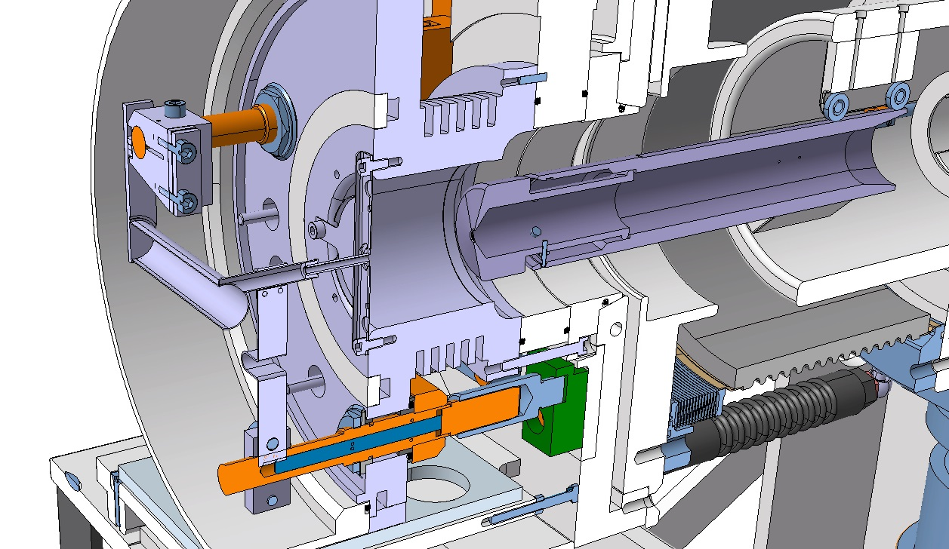
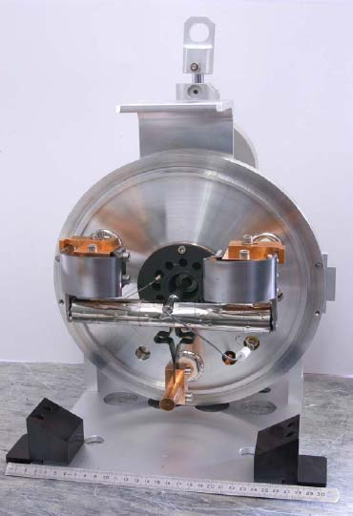
Introduction to the ISOLDE Facility:
RIBs are produced when protons from the PS Booster impinge in one of the two targets in the facility
Radioactive isotopes diffuse out of the target when it is heated
They are ionized using different mechanisms (surface, plasma, laser)
They are pulled out of the floating target front-end biased at 30-60 kV
Protons
Radioisotopes
Ions
Vacuum
Air
J.A. Rodriguez et al. – TTC 2022, Aomori, Japan – 2022/10/11

Slide 29
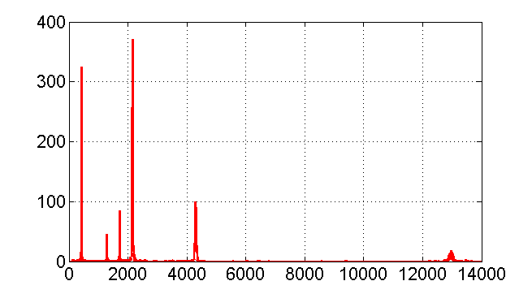
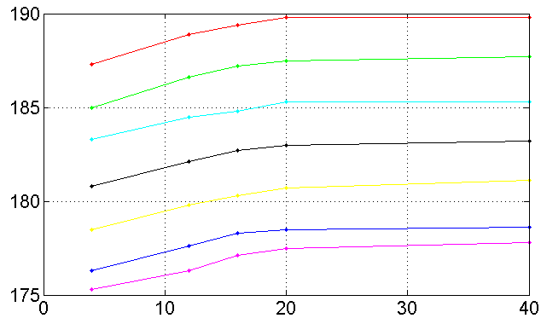
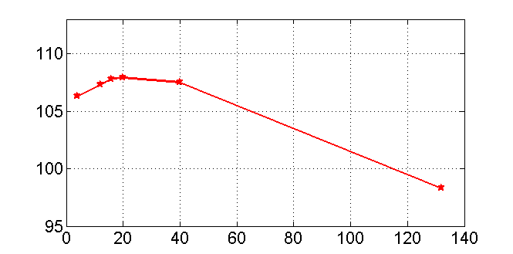
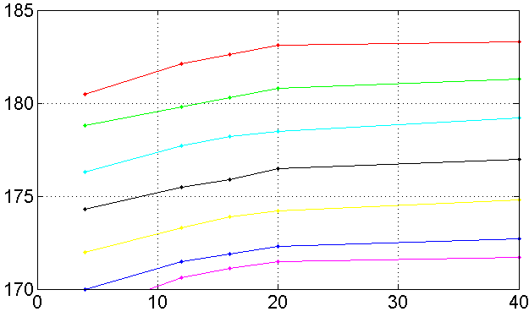
Highlights Beam Commissioning:
Energy measurements using silicon detectors:
Cocktail of beams (EBIS and Xe from GPS target) sent to the XT00.1000 silicon detector
⁴He¹⁺
Energy spectrum for a beam with A/q = 4.0 and REX energy
XT00.1000 deviation from linearity
²⁰Ne⁵⁺
# Counts
Ebin# / A
¹⁶O⁴⁺
⁴⁰Ar¹⁰⁺
¹³²Xe³³⁺
¹²C³⁺
Energy bin #
Mass Number (A)
Deviation from linearity as a function of mass number
XT00.1900 deviation from linearity
Ebin# / A
Ebin# / A
Mass Number (A)
Mass Number (A)
J.A. Rodriguez et al. – TTC 2022, Aomori, Japan – 2022/10/11

Slide 30
Outline:
Introduction to the ISOLDE facility
The REX/HIE-ISOLDE Linac
  Description of the linac
  Project timeline (including list of beams delivered since 2015, L2 stop)
Commissioning
  Typical plan
  Preparation of pilot beams
  Phasing of superconducting cavities
  Beam energy measurements
Typical Operations year
The 2022 timeline (emphasis on the short physics campaigns asking how does this compare to other facilities, physics program for 2022)
Issues
  Not related to SRF but impacting the operations of the linac
    Target production
    REX-EBIS superconducting solenoid
    REX RF cavities and amplifiers
  Linked to the SRF performance
    Operation at ~ 75% of nominal gradient
    Degradation over the years
    Coupler repair
    Planned thermal cycles every year / unplanned stops of cryogenics
    Short physics campaigns
    Stability of the SRF cavities
Summary
J.A. Rodriguez et al. – TTC 2022, Aomori, Japan – 2022/10/11

Slide 31
Highlights of the Beam Commissioning:
Development of Slow Extraction from the REX-EBIS (N. Bidault)
Measurement of the axial energy distribution of the ions of interest after extraction from the REX-EBIS.
Calculation of the inverse function and application to the trap barrier.
Measurement of the resulting time structure by a Silicon detector or from MINIBALL.
Adjustments of the ion pulse shape (± stretch, ± flatten) / Adapt to new operational conditions.
Results:
Scaling of the ion pulse length with the barrier voltage distribution length, from 0.2 ms to 5 ms.
Ion pulse shaping achieved for various RIBs with A/q in the range [2.5 - 4.5].
Measures of the influence of the breeding time and the electron beam intensity and energy on the time structure.
J.A. Rodriguez et al. – TTC 2022, Aomori, Japan – 2022/10/11

Slide 32
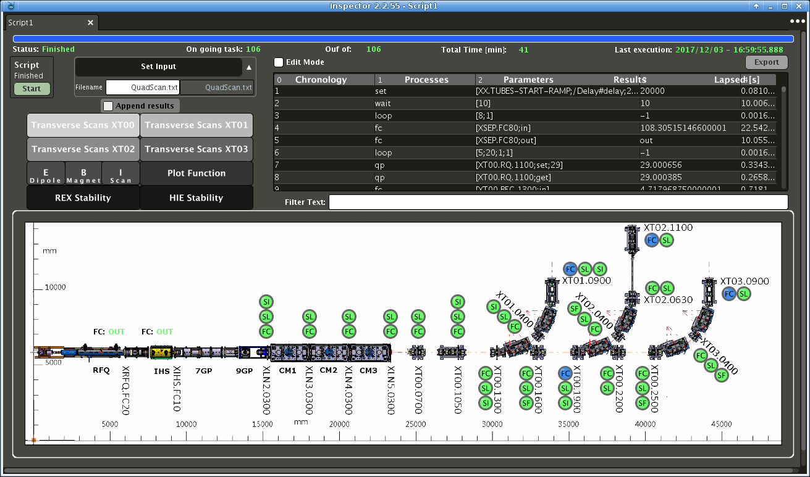
Highlights of the Beam Commissioning:
Automated measurements by N. Bidault
Automate repetitive measurements.
Flexible scripting without having to modify the application.
Include all REX/HIE-ISOLDE devices (optics and diagnostics) and all «types» of measurements.
Method:
Write the script in a text file, which is a sequence of instructions to achieve (get value, set value, slit scan, magnet scan, bunch structure measurement…).
Use algorithmic tools («loop», «if», «load»,…) if necessary.
Write the script file name on the Inspector-based application and start the measurements.
Visualize and retrieve information during the on-going automation.
Plots of scans
List of instructions
Diagnostic box indicators
Examples:
Transverse beam profiles and total current measurements in all diagnostic boxes.
Multiple quad-scans or energy measurements, with Silicon detectors or Faraday Cups.
  Numerous possibilities of combination
J.A. Rodriguez et al. – TTC 2022, Aomori, Japan – 2022/10/11

Slide 33
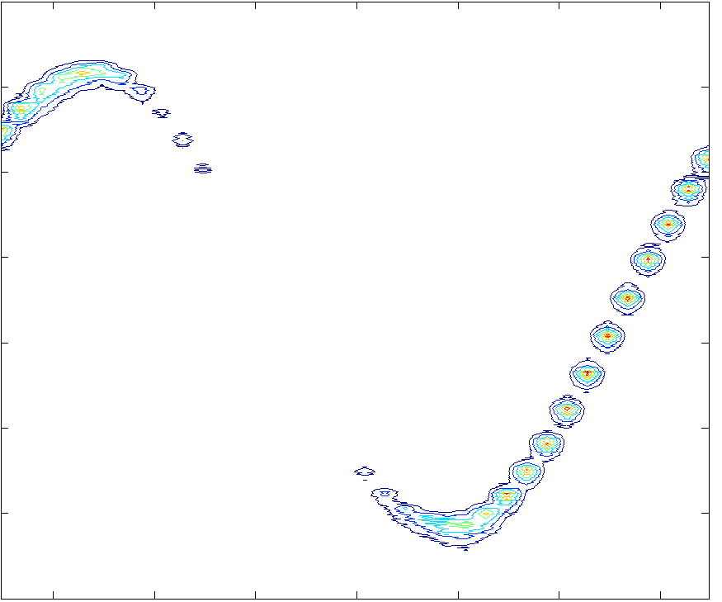
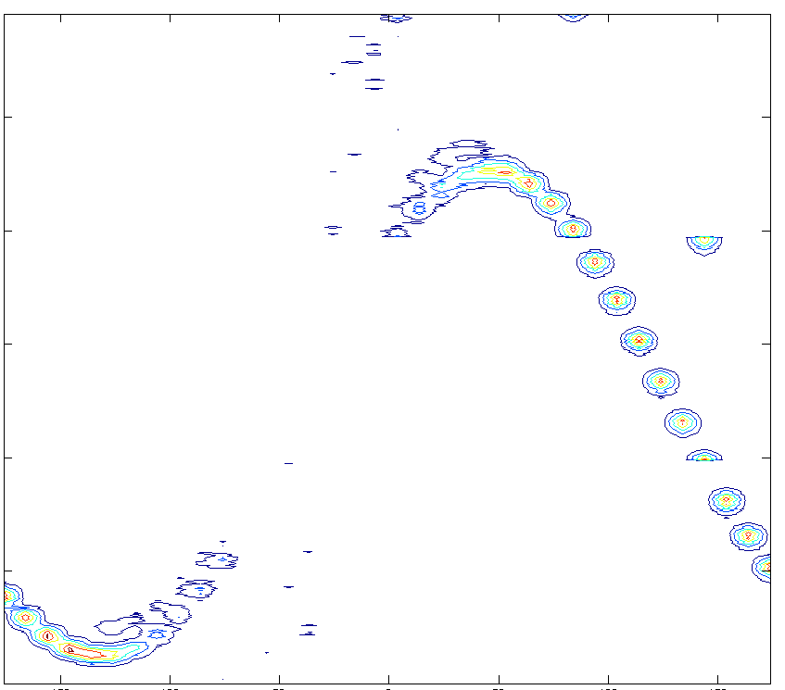
Highlights of the Beam Commissioning:
Using TOF information to phase SRF cavities (S. Sadovich):
Using TOF information can be used to phase the SRF cavities
This method is faster than using the information on the energy since beam currents can be higher (i.e. less saturation constrains) and all the events can be used to build up the statistics in multi-ion beams
Change in energy when the phase of a SRF cavity is changed
Change in TOF when the phase of a SRF cavity is changed
3800
25
3700
20
dE [bin]
3600
dTOF [ns]
15
3500
10
3400
3300
5
-150
-100
-50
0
50
100
150
-150
-100
-50
0
50
100
150
Phase [deg]
Phase [deg]
J.A. Rodriguez et al. – TTC 2022, Aomori, Japan – 2022/10/11

