Slide 1
Testing of PIP-II HWR and SSR1 Cryomodules at PIP2IT
Donato Passarelli
TTC meeting
WG-2 talk
October 11-14, 2022

Slide 2
Outline
PIP-II Injector Test facility
  Scope and cryomodules test plan
Performance and Lessons learned
  Half Wave Resonator Cavities and Cryomodule
  Single Spoke Resonator Cavities and Cryomodule

Slide 3
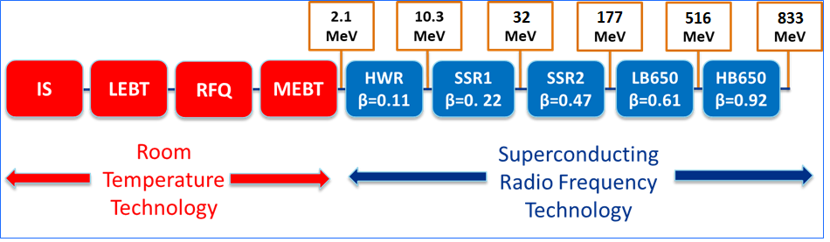
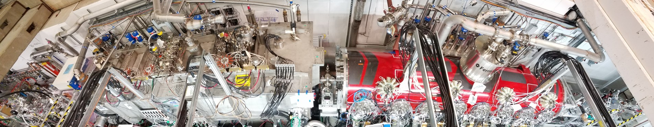
PIP-II Injector Test
Validate structural and thermal performance of the SRF cryomodules
Demonstrate performance of critical components
Show that HWR and SSR1 can provide acceleration of H- beam with parameters required PIP-II physics program
PIP2IT
10
PIP-II technology map

Slide 4
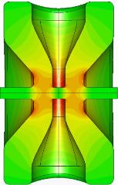
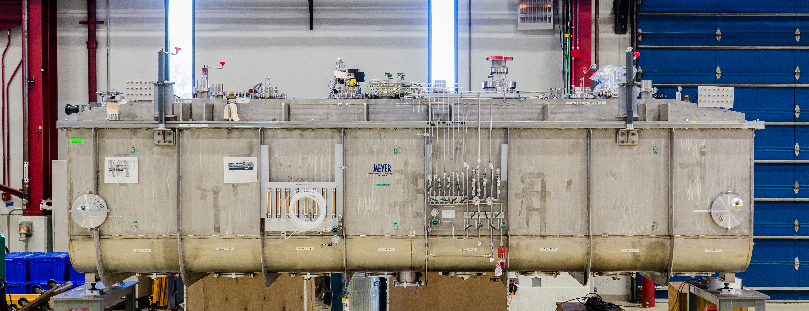
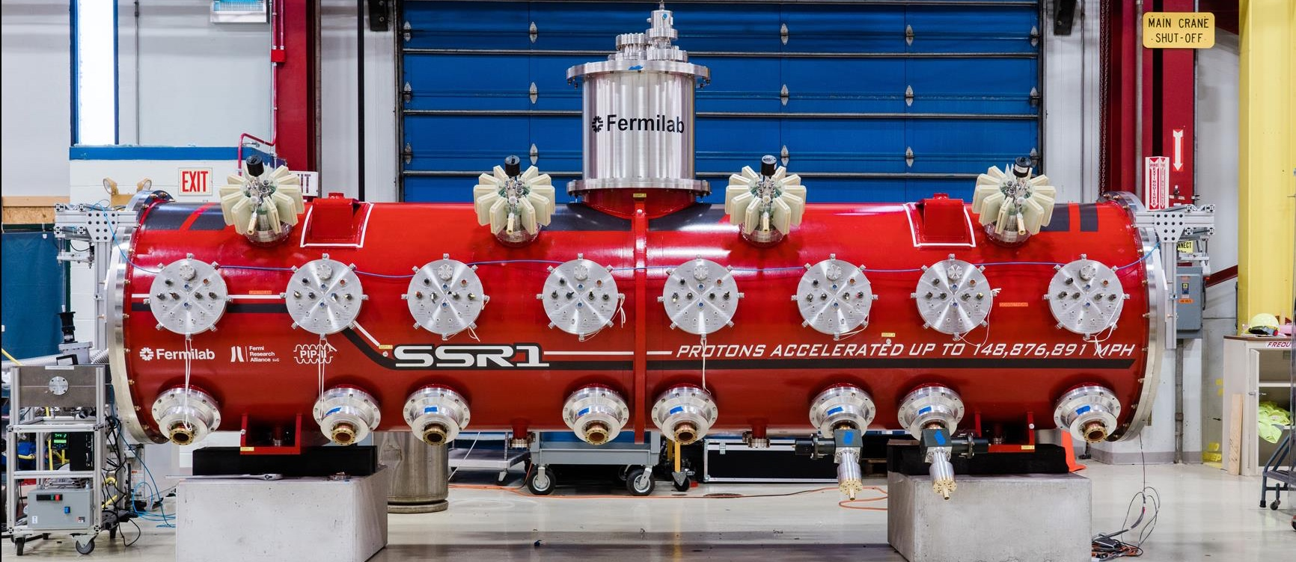
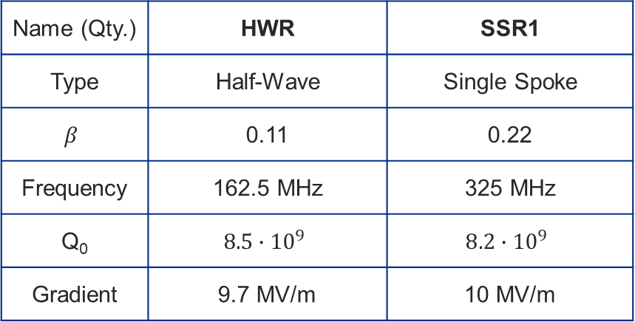
HWR and SSR1 Cavities and Cryomodules
Argonne National Laboratory (ANL) was responsible for design, procurement, sub-component testing, assembly of HWR CM and subcomponents. Final testing was done at Fermilab.
The SSR1 CM was designed based on the Fermilab style cryomodule. It was fully assembled and tested at Fermilab.
The HWR and SSR1 cryomodules operate CW with a beam current of 2 mA to accelerate the H– beam.
Name (Qty.) | HWR | SSR1
Type | Half-Wave | Single Spoke
$$β$$ | 0.11 | 0.22
Frequency | 162.5 MHz | 325 MHz
Q₀ | $$8.5∙{10}^{9}$$ | $$8.2∙{10}^{9}$$
Gradient | 9.7 MV/m | 10 MV/m
 | Cavity # | String Assy. | CM Length [m] | Q₀ @ 2K [x10¹⁰] | R_{s} [Ω] | Q_{L} [x10⁶]
HWR | 8 | 8 x (SC) | 5.93 | 0.85 | 5.6 | 2.3
SSR1 | 8 | 4 x (CSC) | 5.3 | 0.82 | 10.2 | 3.0
HWR Cryomodule
SSR1 Cryomodule

Slide 5
Test Plan Outline for the HWR and SSR1 cryomodules
Warm Pre-Test Checkout
  Instrumentation, signal integrity, vacuums, cavity & tuner checks, HBCAM for alignment monitoring
Cooldown to 4K
  SSR1 Constraints: Thermal shield (T_{max}-T_{min} < 50K); Strongback (283K < T < 315K, T_{max}-T_{min} < 5K); Coupler warm window (T > 275K)
  HWR Constraints: none
Cooldown to 2K
  Achieve stable cryo operation, control loops, LL control
Individual Cavity RF Testing @ 2K
  Gradient, FE/MP, cavity frequency, coupler Q_{ext}, tuner range
Magnet Testing at 2K
  Full field operation of solenoids and X/Y correctors
Ensemble Cavity Testing @ 2K
  Total 2K heat loads, average Q₀
LLRF Control @ 2K, Microphonics
  Simultaneously operate cavities in GDR (Generator Driven Resonator) mode (as needed for beam operation), demonstrate control with microphonics

Slide 6
HWR Cryomodule

Slide 7
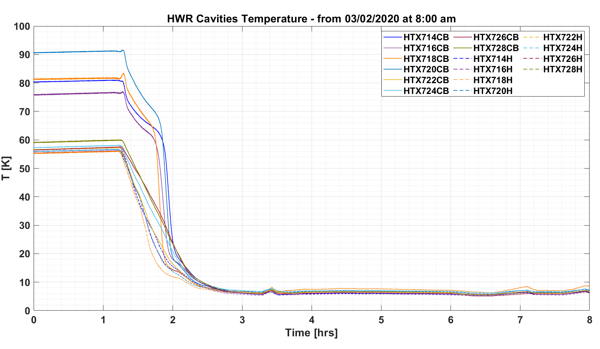
HWR Cryomodule: Cooldown and Static Heat Load
Cavities and solenoids were successfully cooled down to 2K.
Stable 2K operation was maintained for several months. ✓
Alignment of cold mass and warm/cold shift within specifications ✓
Measured 2K static heat load (upper limit): 44W
  The lower thermal shield was not operable due to a leak
    If lower thermal shield operable the expected 2K static heat load is 30W (27W specification)

Slide 8
HWR cavities performance
Cavities were tested individually first. Power raised until gradient limit reached
(admin = 11.2MV/m, nom op = 9.7MV/m)
No Field Emission observed during initial operation at maximum test gradients
Minimal MP at 3-5 MV/m, processed within minutes.
All tuner ranges exceed requirements (100kHz).
Cavity 3 had coupler HV Bias failure when at 6 MV/m, could not test further
Total dynamic heat load of 8.1 ± 0.8 W (1.16 W/cavity) with 7 cavities operated at 9.7 MV/m
  Q_{0(avg)} = 1.3 ± 0.1 x 10¹⁰
Cavities (except 3) operated in GDR (field feedback) mode demonstrating LLRF control

Slide 9
HWR cavities performance
Increased dynamic heat loads (10%-15%) from single cavity cold testing to CM configuration, however still exceeding project requirements of Q₀ ≥ 8.5 x 10^{9.}
  In CM configuration Q_{0(avg)} = 1.3 ± 0.1 x 10¹⁰
  Single cavities in VTS at ANL Q₀ = 1.5 x 10¹⁰ @9.7 MV/m
Cavity 1 & 2 did not meet the target frequency (162.5 MHz) at 2K with the tuner fully engaged:
  Cavity 1: 162.776 MHz; Cavity 2: 162.755 MHz
  Can’t be used for beam acceleration
  Root cause unclear, prototype cavities tested at ANL were reported to have “opposite” cold/warm freq shift
  Will be re-tuned, without disconnecting them from the beamline, during the next CM repair opportunity
Cavity 3 - coupler warm window
  While testing cavity 3 (first one), RFPI failed to trip off RF when HV Bias was lost
  RF stayed on ~ 2.5kW (6.5MV/m) for few seconds before it was manually turned. Heavy MP w/out bias HV; 5K coupler temperature rose to 24K from (nominal) 7K
  Coupler resistance down to 22 kΩ - suspect sputtering of window from Ag-plated bullet (this already happened at ANL during one test)
  Will be replaced, without disconnecting the cavity from the beamline, during the next CM repair opportunity

Slide 10
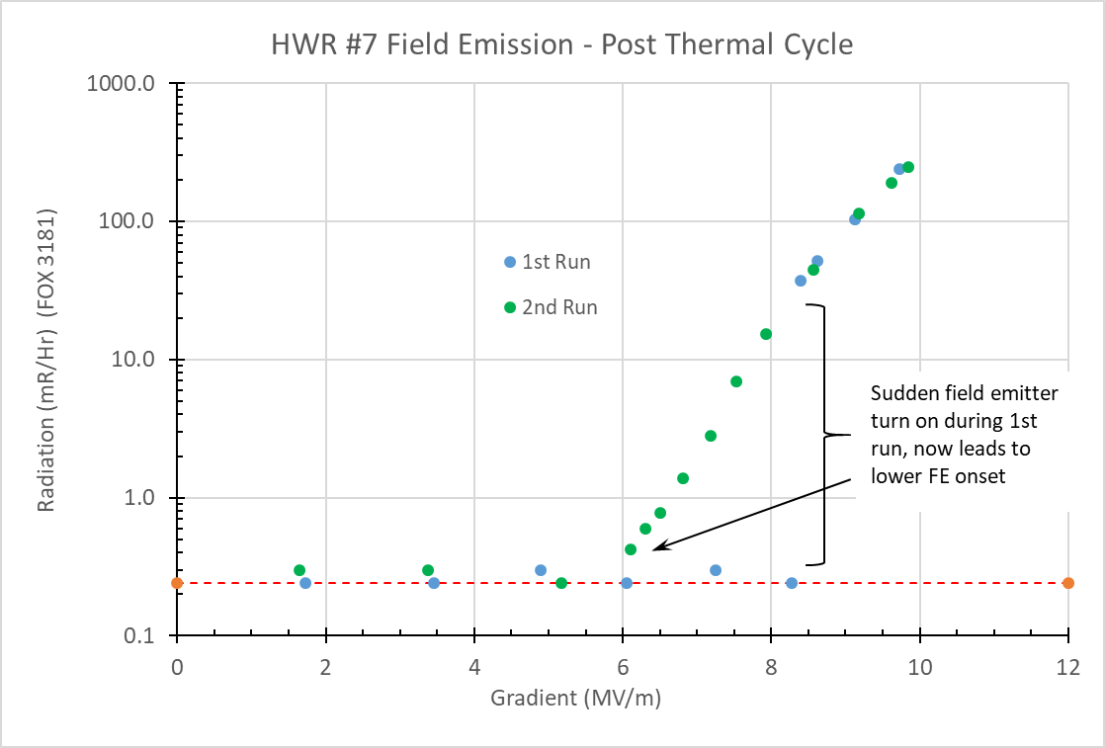
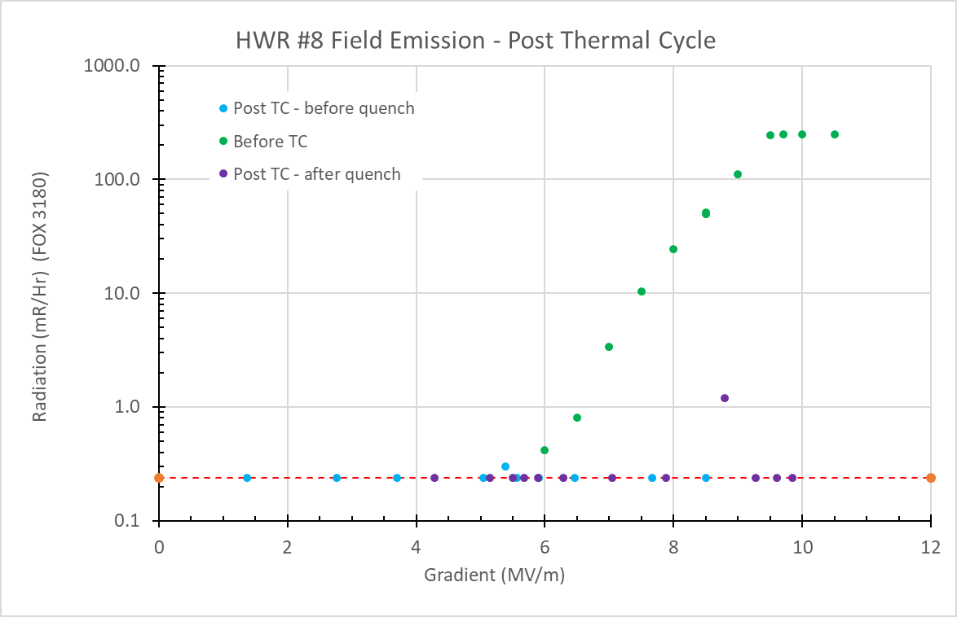
HWR cavities performance
FE increases/changes after thermal cycle
  During a cryoplant shutdown/thermal cycle, cavities reached ~90K and there was insufficient active pumping on the beamline to deal with the desorbed gas load
    Concern about FE in cavities due to potential particulate transfer
  Re-qualified all cavities for FE/Quench performance
    Cavities 1, 2, 4, 5, & 6 remained FE-free
  Cavity 7 now had FE
    FE onset of ~5.5MV/m after initial onset at 8.5 MV/m,
    250 mR/hr @ 9.7 MV/m (nominal operating gradient) – now limited to 8 MV/m
  Cavity 8 quenched when going from 8.5 to 9.8 MV/m, with FE present;
    subsequent power rise showed no more FE
    Quench at ≥ 9.9 limits operating gradient to 9.3 MV/m

Slide 11
SSR1 Cryomodule

Slide 12
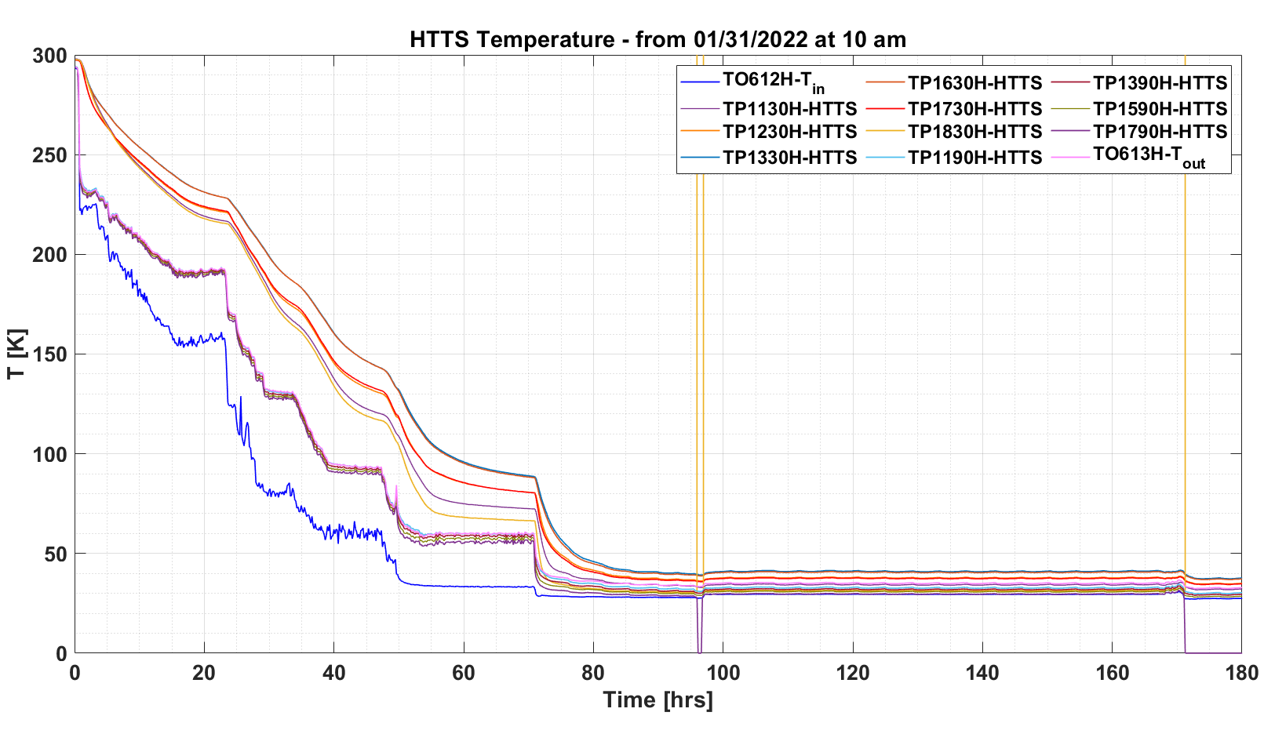
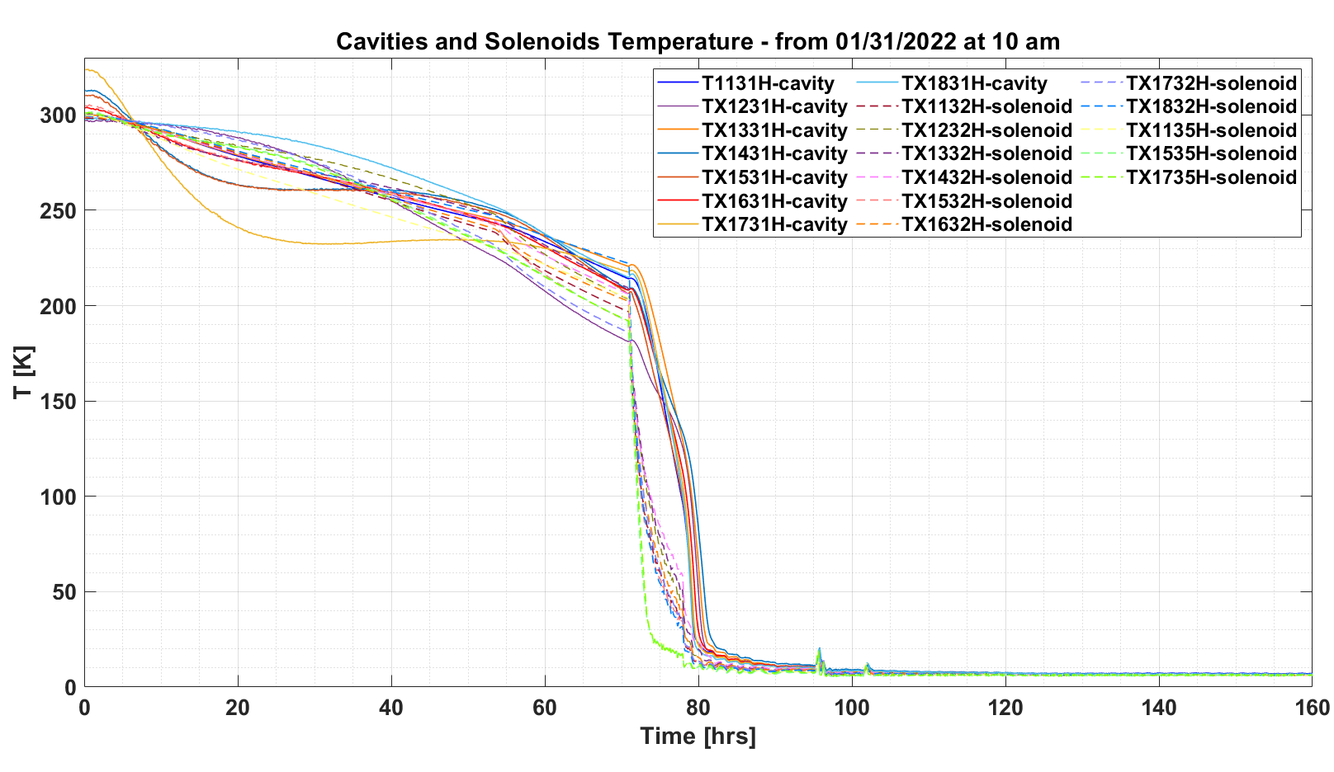
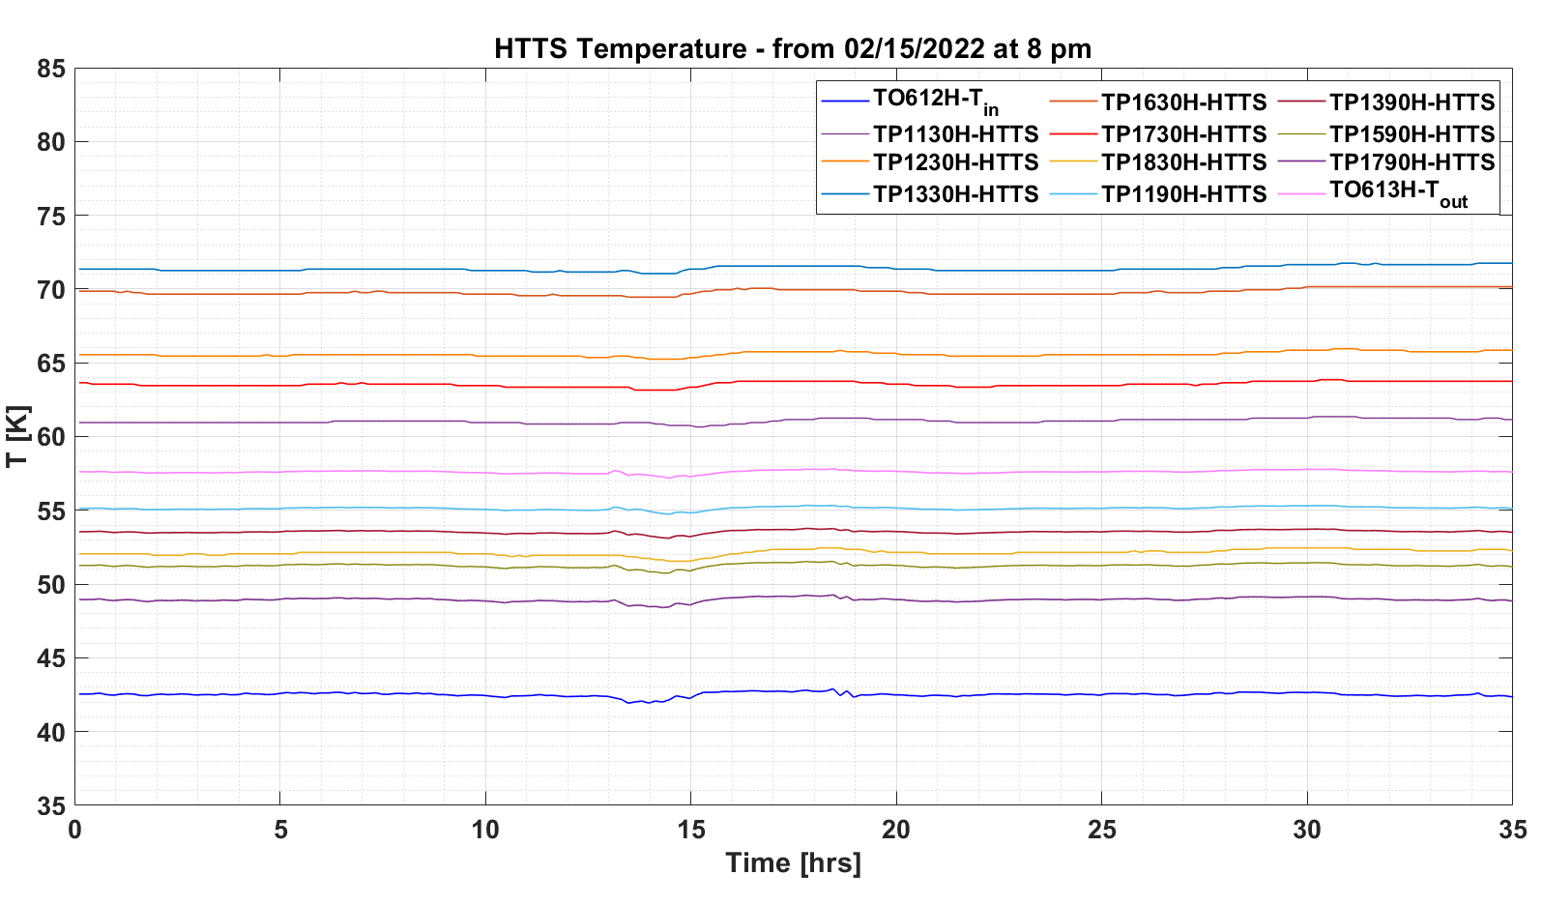
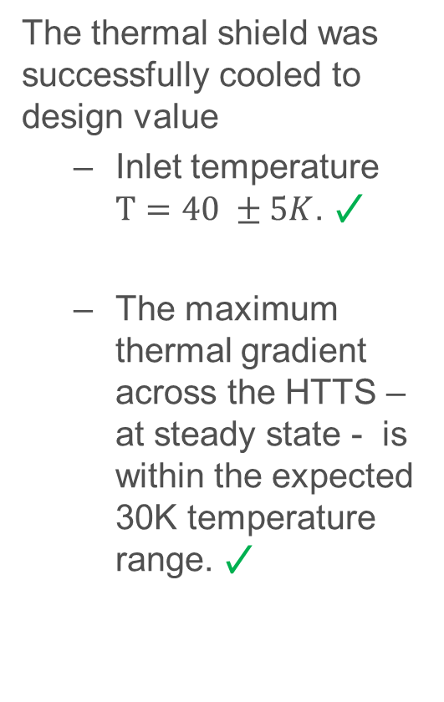
Cooldown performance
The thermal shield was successfully cooled to design value
  Inlet temperature $T=40 ±5K$. ✓
  The maximum thermal gradient across the HTTS – at steady state - is within the expected 30K temperature range. ✓
Cavities and solenoids were successfully cooled down to 2K. Stable 2K operation was maintained for several months. ✓

Slide 13
SSR1 CM Static Heat Loads
Prototype SSR1 CM | Static Heat Loads
Proto SSR1 CM | 2K | LTTS | HTTS
Estimated values [W] | 25.4 | 44.2 | 150.3
Measured values [W] | 27.8 ±2.5 | 58.4 ±4.5 | 222.1 ±8.0
New design of the solenoid and current leads
Improved design of thermal shield/intercepts, configuration of MLI
Production SSR1 CM | Static Heat Loads
Proto SSR1 CM | 2K | LTTS | HTTS
Estimated values [W] | 13.2 | 20 | 270

Slide 14
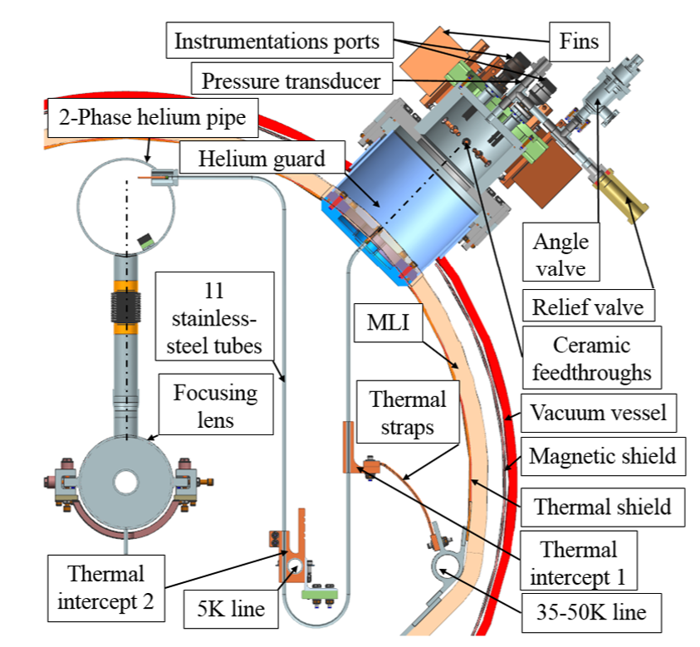
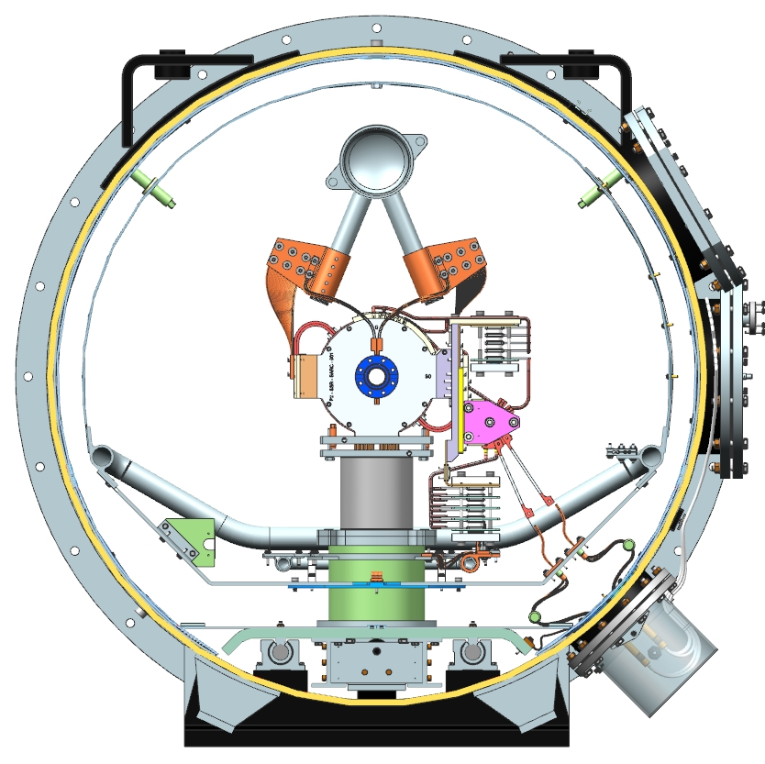
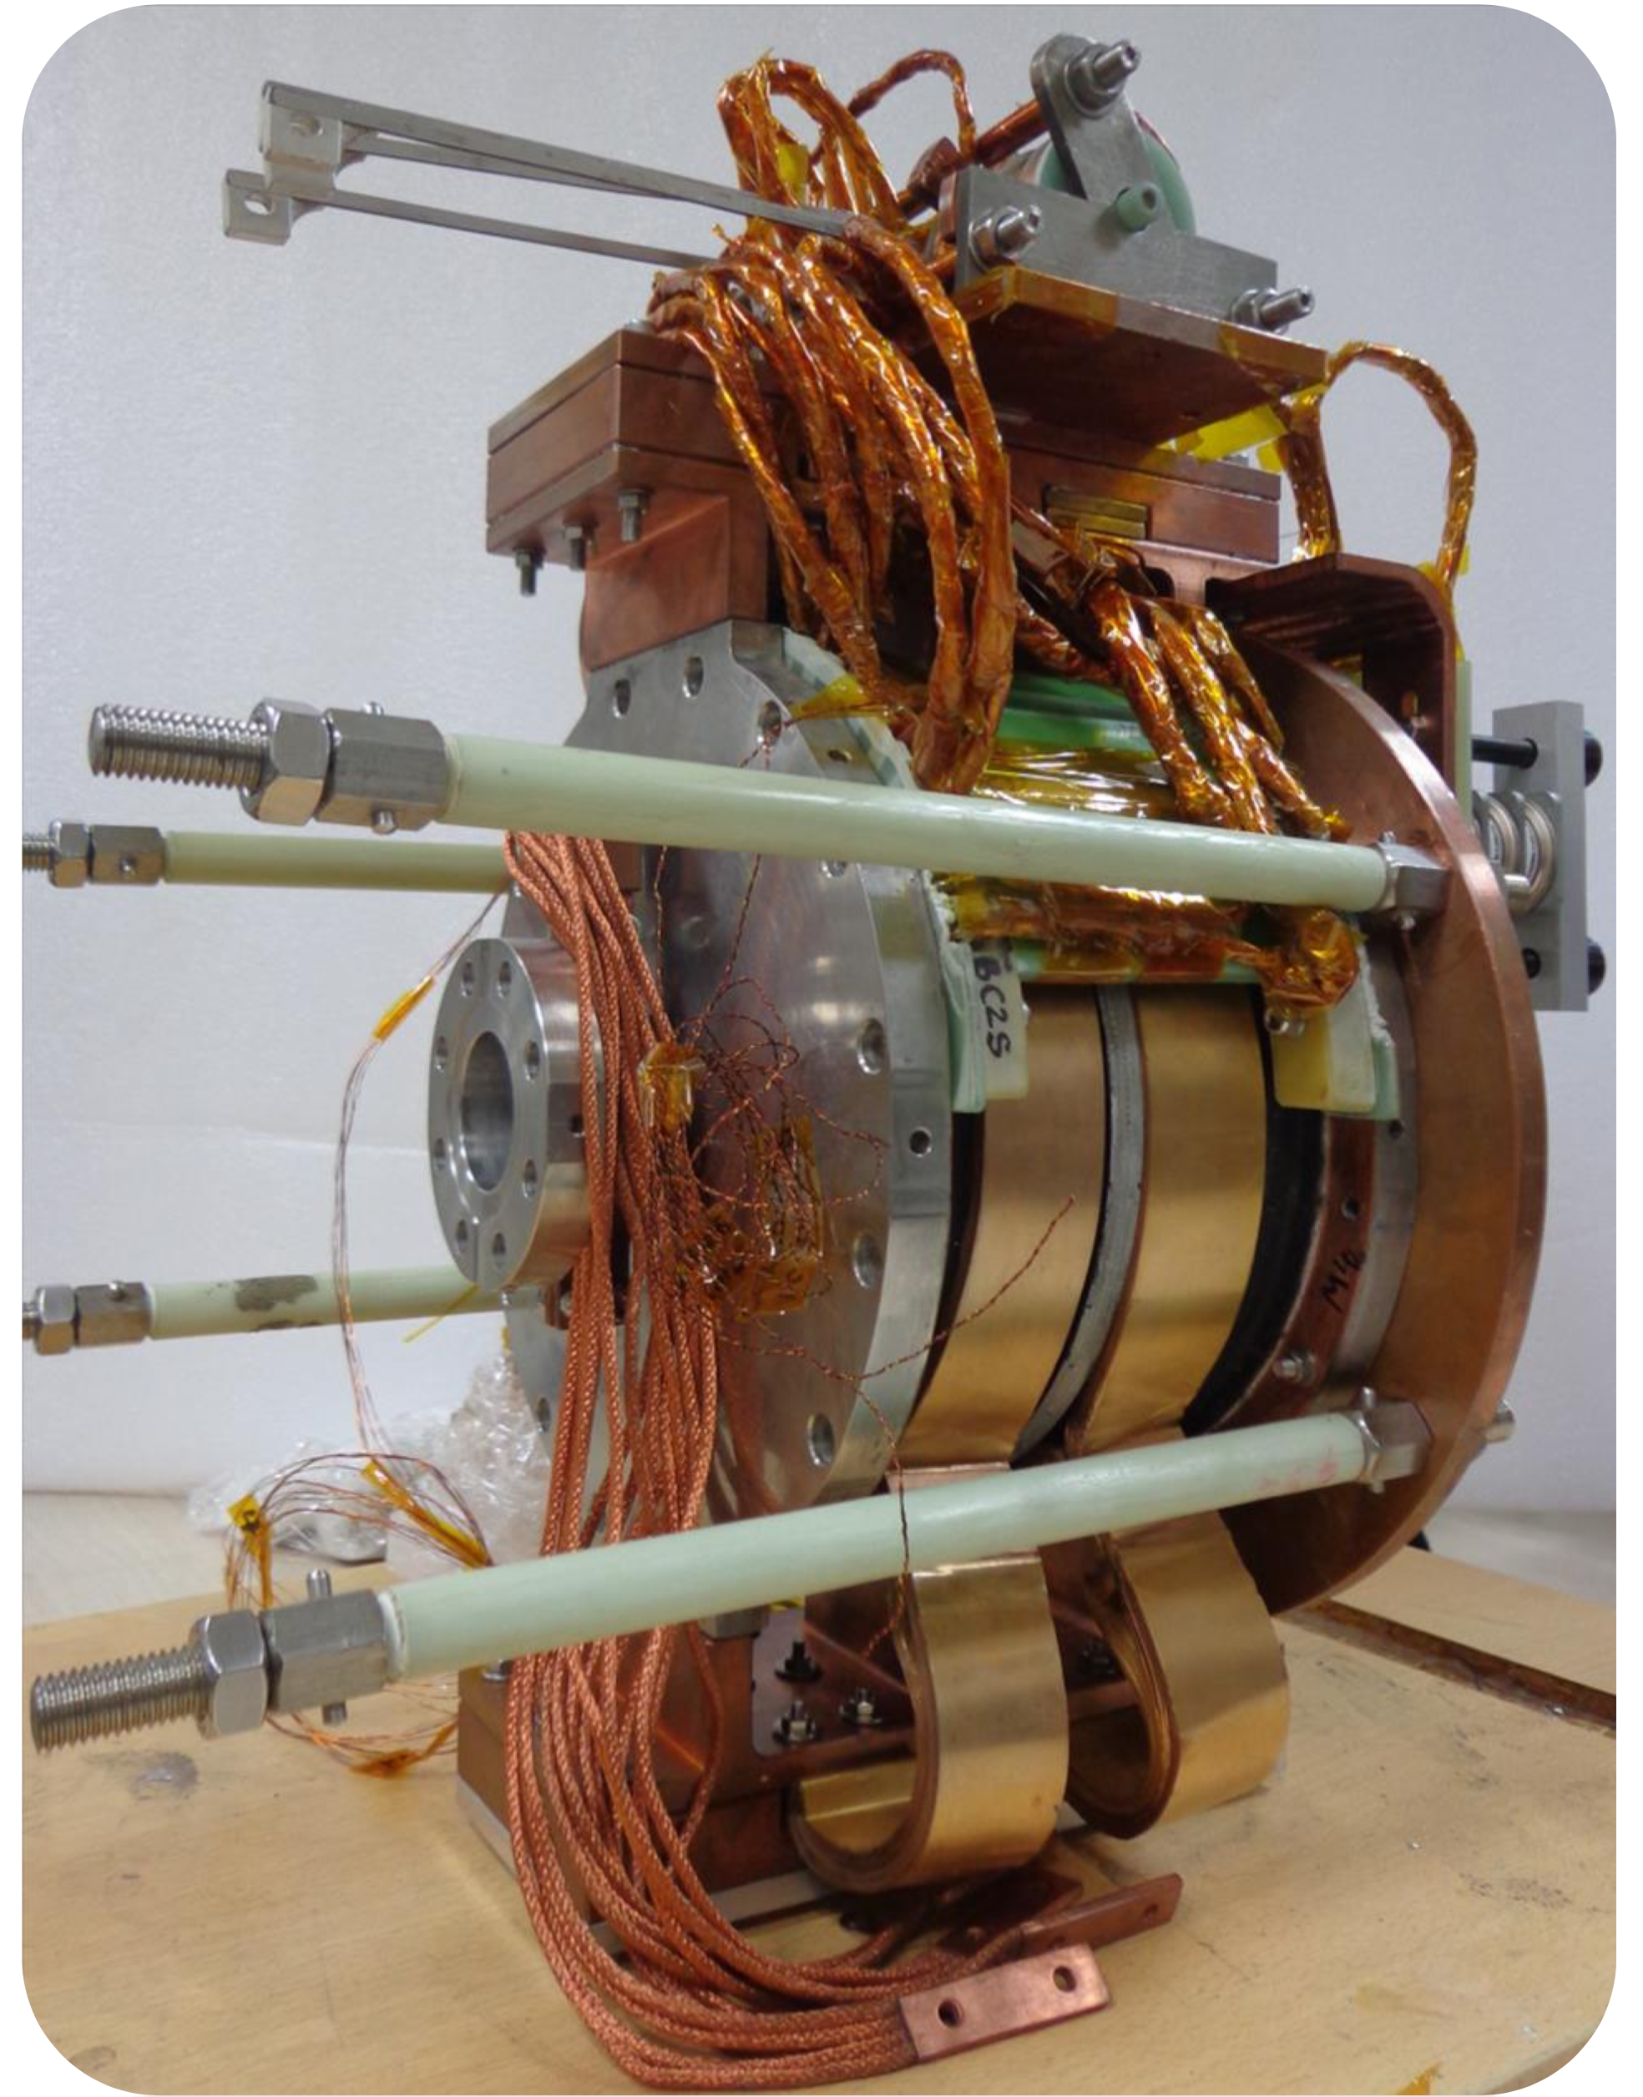
SSR1 CM Static Heat Loads Improvement
Conduction cooled type of solenoid was chosen for future SSR1 and SSR2 CMs based on the performance in terms of static heat loads (SHL) of the He-bath cooled units used for prototype SSR1 cryomodule.
  Estimated SHL at 2K of the SSR1 He-bath cooled solenoids and current leads: 14.2 W
  Estimated SHL at 2K of the new SSR conduction cooled solenoids and current leads: 1.3 W
  10x reduction of the Solenoids/Current lead SHL at 2K contributes to reduce about 2x the total CM SHL at 2K (25.4W → 13.2 W)
He-bath cooled SSR1 solenoid
Conduction cooled SSR solenoid

Slide 15
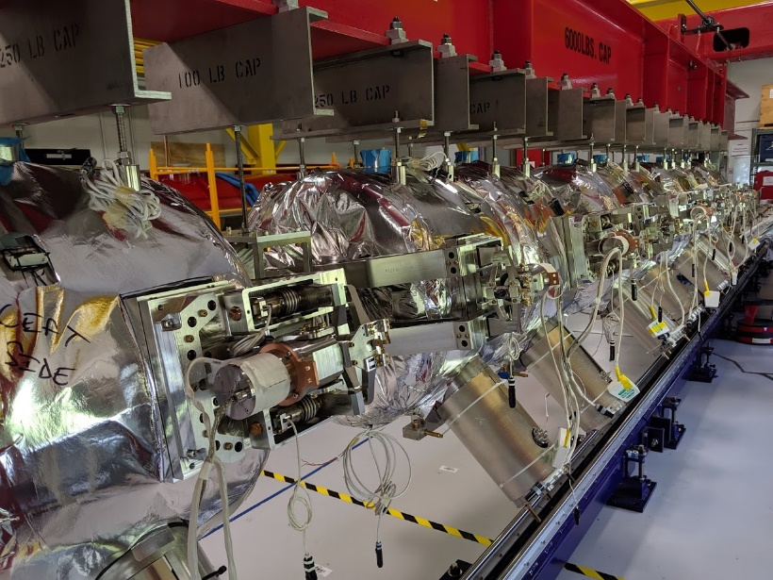
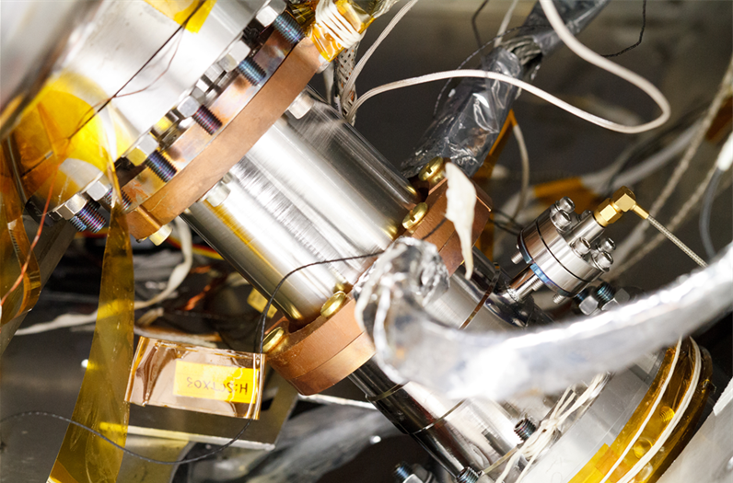
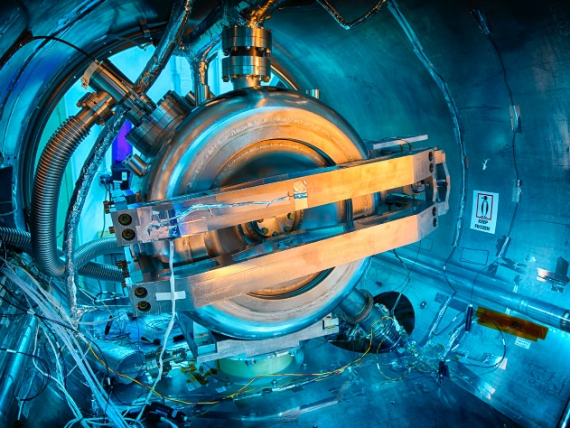
RF frequency of Cavities, Couplers and Tuners Performance
Resonance frequency and Q_{L} measurements of cavities at RT, 4K, 2K.
  Results are within the expected ranges. ✓
All eight tuners fully met acceptance criteria, confirming also measurements previously done in the Spoke Test Cryostat. ✓
  All cavities were successfully tuned to 325.000 MHz at 2K.
  Microphonics are better than 10 Hz (LLRF group)
All eight couplers reliably worked to process multipacting barriers, and to increase cavities fields and accelerate beam (Maximum power: 5kW) ✓
  Couplers successfully conditioned off resonance at pulsed 2-16% DF, then CW
Couplers thermal performances were monitored during cooldown. ✓
  The temperature of single ceramic window was maintained into the range
  283𝐾 ≤ 𝑇 ≤ 310𝐾 using heaters with an average power of 8W/coupler
  HTTS and LLTS intercepts were used to minimize HL to 2K

Slide 16
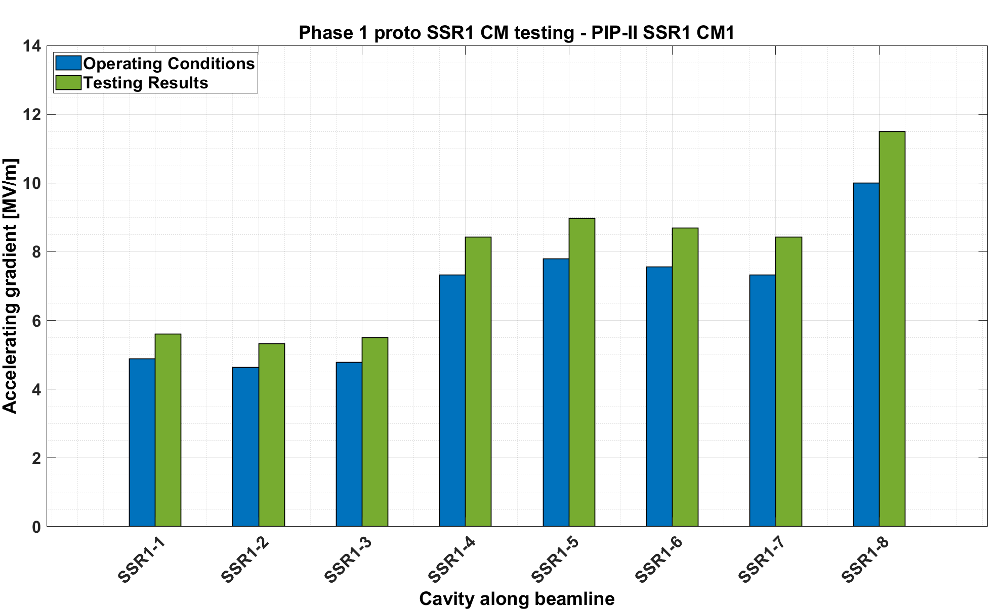
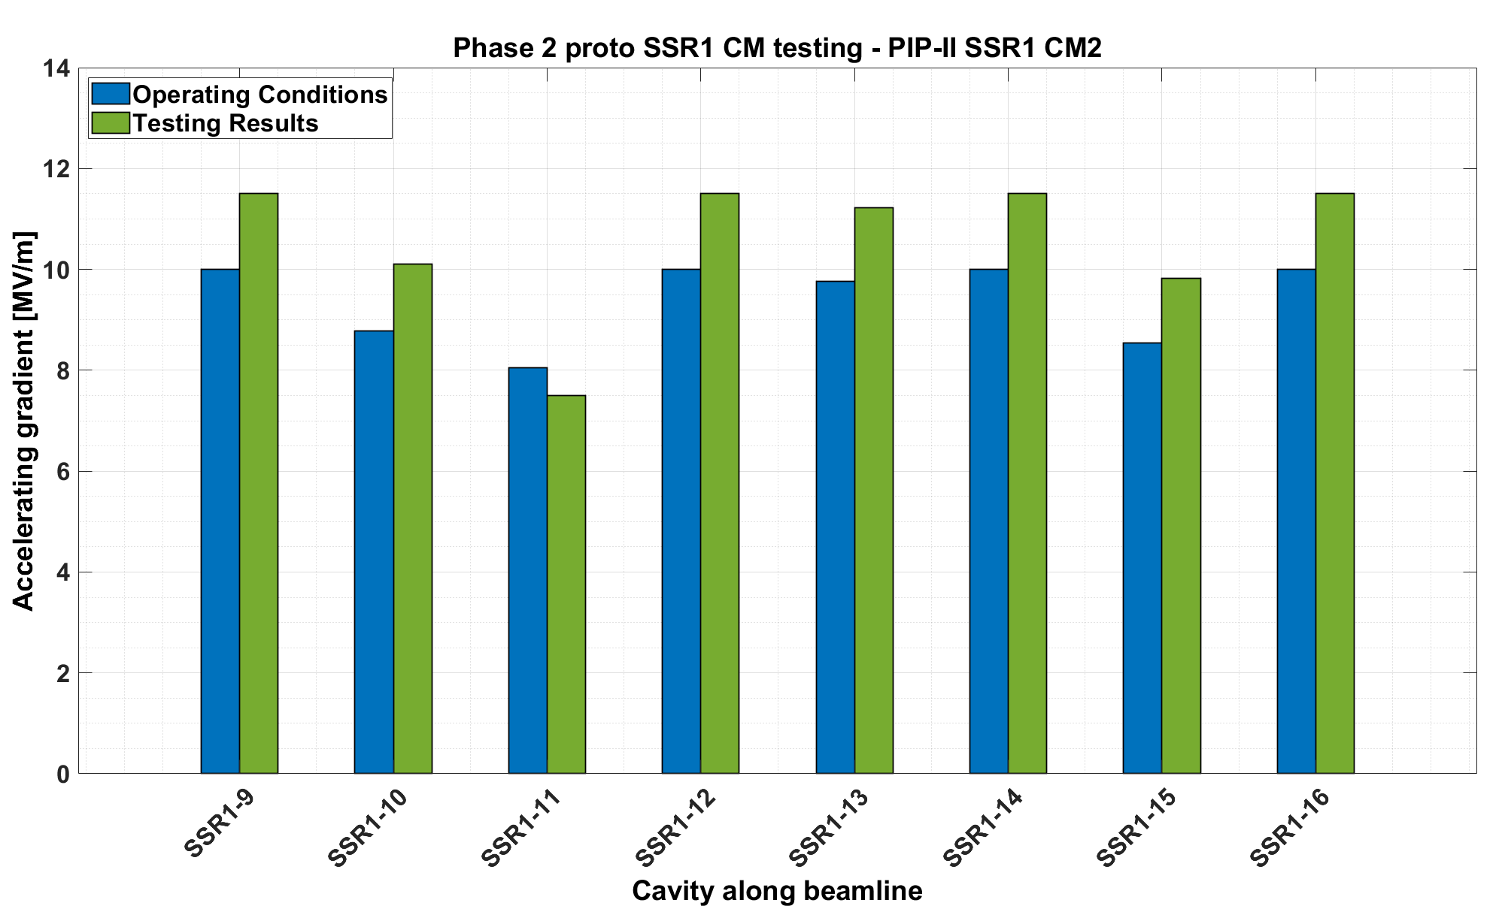
SSR1 cavities performance
Phase 1: All cavities successfully reached the gradient set as acceptance criteria (= 1.15 · operating E_{acc}) and no FE detected (<3 mR/h).
3 MP barriers 4-7.5 MV/m. Avg. time to condition: 16 hours
Phase 2: 7 out of 8 cavities successfully reached the gradient set as acceptance criteria.
Cavities 3 & 4 have FE (>250 mR/h) at operating gradients.
Cavity 3 has soft quench above 8 MV/m at rate 1/15 minutes due to high FE. Operable at 7.5 MV/m.
Dynamic Heat Load: 12.8 W (Req. DHL_{SSR1 CM1} <8.2W)
Q₀ = 5.33 ±0.50·10⁹ (Req. Q₀ > 8.2 ·10⁹)
Dynamic Heat Loads: 35.5 W (Req. DHL_{SSR1 CM2} <14.7 W)
Q₀ = 3.43 ±0.69·10⁹ (Req. Q₀ > 8.2 ·10⁹)

Slide 17
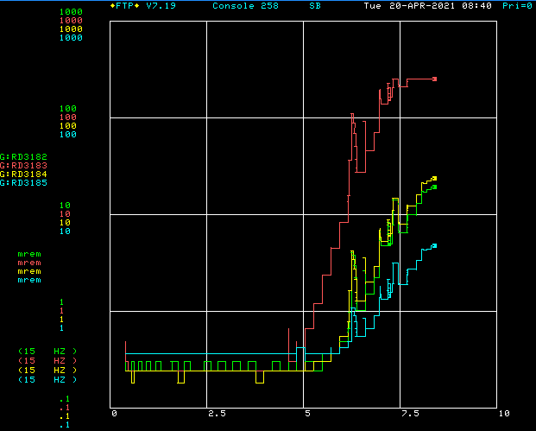
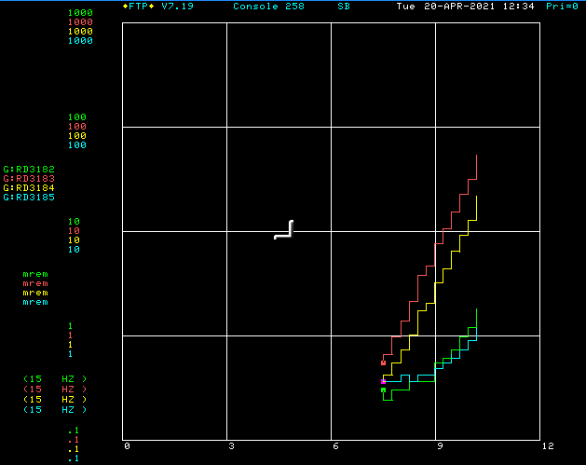
SSR1 cavities performance: field emission
FE increases/changes after thermal cycle (between Phase 1 and Phase 2 testing)
  As already described earlier for the HWR, during a cryoplant shutdown/thermal cycle, cavities reached ~90K and there was insufficient active pumping on the beamline to deal with the desorbed gas load.
  Concern about FE in cavities due to potential particulate transfer, and not to cleanroom assembly procedures.
Cavity 3 was FE free up to 5.50MV/m during Phase 1 testing (before warmup)
Cavity 4 was FE free up to 8.42MV/m during Phase 1 testing
Cavity 3
Cavity 4
FE onset 5 MV/m
FE onset 7.5 MV/m

Slide 18
SSR1 cavities performance
Operating Cavities | Measured Q₀ | Requirement | Comments
All eight cavities at Phase 1 operating accelerating fields | 5.33 ±0.50 · 10⁹ | > 8.2·10⁹ | With all cavities successfully (no field emission, no Multipacting) running at Phase 1 operating accelerating fields the measured Q₀ is 54% below requirement.
All eight cavities at Phase 2 operating accelerating field, except for cavity 3 at 0.5 MV/m below | 3.43 ±0.69 · 10⁹ | > 8.2·10⁹ | With 7 out of 8 cavities running at Phase 2 operating accelerating fields, and cavity #3, the measured Q₀ is 1.4x below requirement.
Cavities 2,5,6,7,8 at Phase 2 operating accelerating field | 7.41 ±0.70 · 10⁹ | > 8.2·10⁹ | Excluding cavities #1, 3, 4 at Phase 2, the measured Q0 is (only) 10% below the requirement.
Cavity 1 at Phase 2 operating accelerating field | 3.70 ±0.75 · 10⁹ | > 8.2·10⁹ | Cavity 1 had Q₀= 8.1·10⁹ at STC at the same Phase 2 E_{acc} (10MV/m).
Cavity 4 at Phase 2 operating accelerating field | 2.23 ±0.46 · 10⁹ | > 8.2·10⁹ | Cavity 4 had Q₀= 6.4·10⁹ at STC at the same Phase 2 E_{acc} (10MV/m). 3x Q₀ drop.
The high residual magnetic fields surrounding cavities 1 & 4 (>150mG), causing significant increase in cavity residual resistance, and FE (>250 mR/h) are the main sources of Q₀ degradation and below expectations.
FE in cavities is due to potential particulate transfer during partial warmup of the CMs.
High residual magnetic field is due to components surrounding the cavities made of ferromagnetic material that are prone (high magnetic permeability) to magnetize when solenoids are powered up.

Slide 19
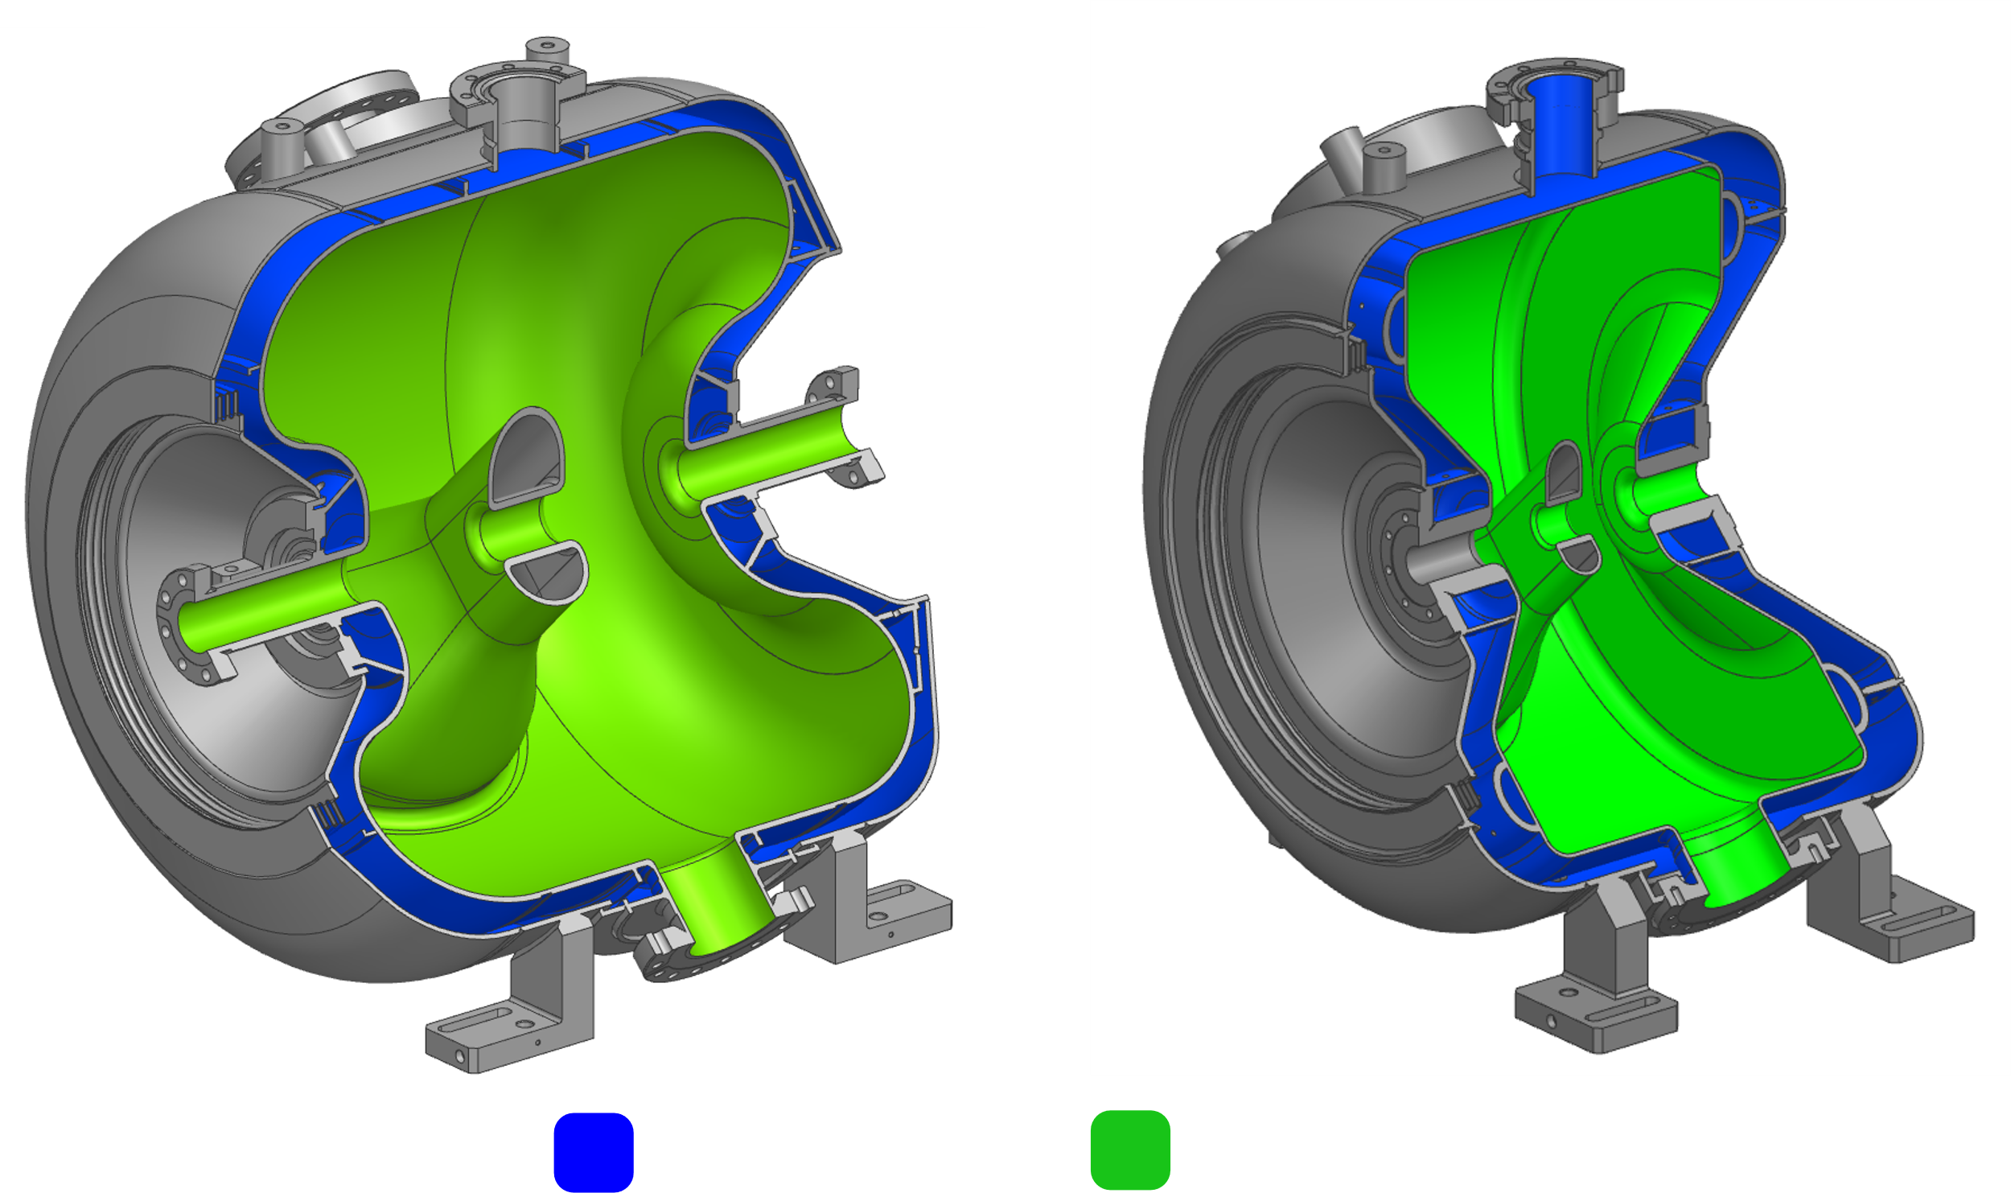
Q₀ degradation: residual magnetic field
More stringent requirements to limit remnant magnetic field at the SRF cavity surface to avoid Q₀ degradation are specified, and multiple actions are currently being taken:
  Design phase:
    Use non-ferromagnetic material whenever possible in the CM
    Helium vessel of all future PIP-II SSRs cavities will be made of Titanium
    Local shielding of cavities and/or solenoids are currently being explored.
  Quality Controls
    Check magnetic permeability and residual magnetic field of all parts and welded joints made of ferromagnetic material (i.e. SS316L) within the volume of the global magnetic shield.
      Annealing process (to lower magnetic permeability) and magnetic hygiene (to lower residual magnetic field) will be applied as needed.
  Testing
    Demagnetization procedures of solenoids shall be developed.
    Cold testing of one SSR2 cavity with a conduction cooled solenoid is being planned to validate performance before their final integration into string assembly.
Helium vessel is made of titanium
SSR1 Cavity
SSR2 Cavity

Slide 20
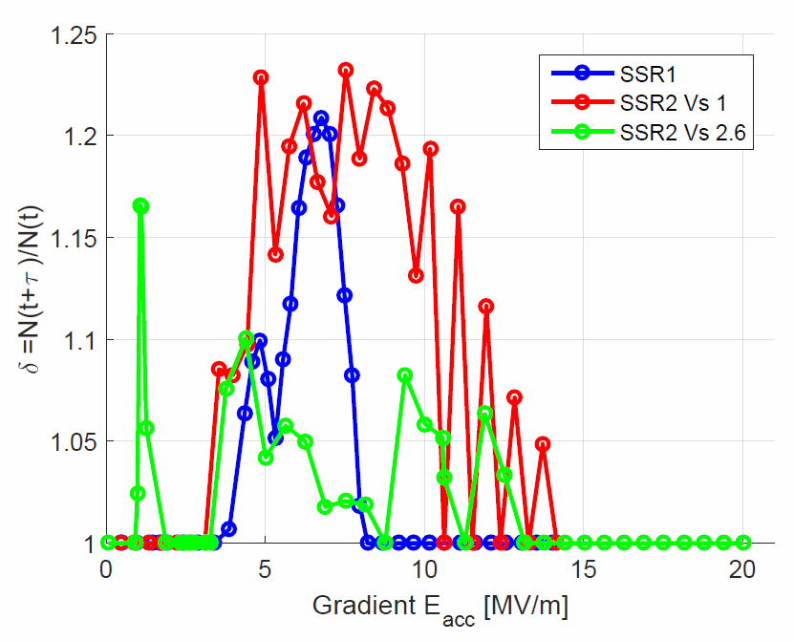
Multipacting mitigation
SSR1 cavities were kept under vacuum and N purged during the string assembly, but still the MP barriers that were previously processed during the cold testing of each individual cavity had to be processed again during cryomodule testing with an avg. of 16 hrs/cavity.
  SSR2 cavities were (re)designed to include features of Balloon Spoke Cavities to reduce MP
    Comparison with SSR1 cavity demonstrates that multipacting in the modified SSR2 cavity version 2.6 can be processed way easier than in SSR1 cavity (cold testing of the first SSR2 cavity is currently ongoing)
SSR2 Cavity v 2.6
  The RF volume of production SSR1 cavities for PIP-II won’t be changed and techniques such as plasma processing will be studied.
SSR1 Cavity

Slide 21
Summary of HWR and SSR1 CM test results
Both cryomodules were successfully cooled down to 2K, tested, and operated in PIP2IT with beam.
HWR Cryomodule
  Cavities, couplers, tuners passed all the checkouts and met RF requirements at 2K, except
  cavities 1&2 and coupler 3 for which repair activities are planned.
  The HWR qualifies to be operable in the PIP-II linac with a projected total 2K heat loads of 40W.
SSR1 Cryomodule
  Cavities, couplers, tuners passed all the checkouts and met RF requirements at 2K. Improvements and lessons learned were implemented in the design of production units.
  The proto SSR1 CM qualifies to be operable as SSR1-CM1 in the PIP-II linac with a measured total 2K heat loads of 40.4W.
  The proto SSR1 CM qualifies to be operable as SSR1-CM2 for PIP-II linac with a measured total 2K heat loads of 63.3W and cavity #3 running slightly (0.5 MV/m) below the required operating gradient.
The qualification of several structural components (i.e. strongback) of the prototype SSR1 CM validated the CM layout - “The Fermilab style cryomodule” - that was the choice for all future SRF CMs for PIP-II project at Fermilab.

