Slide 1

Status of RAON heavy ion accelerator facility
M. KWON on behalf of RISP
IBS, Daejeon, Korea
October 12, 2022
Aomori, JAPAN

Slide 2
001. Project Overview
002. SRF Accelerator Systems
003. Beam Commissioning
004. Summary and Outlook

Slide 3
Part 1.
Project Overview

Slide 4

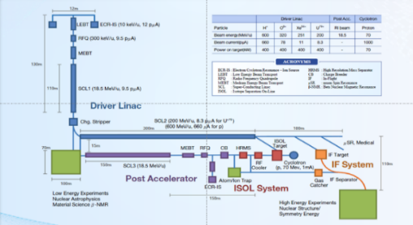
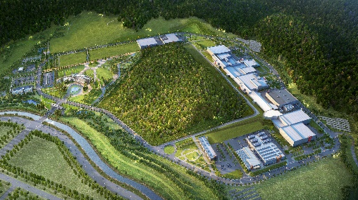
Rare Isotope Science Project (RISP)
Goal: To build a heavy ion accelerator complex RAON,
for rare isotope science research in Korea.
* RAON - Rare isotope Accelerator complex for ON-line experiments
Budget: KRW 522.8 billion (US$ 420 million)
for accelerators and experimental apparatus
Period: 2011.12 ~ 2022.12 (1st Phase)
System Installation Project
Providing high intensity RI beams by ISOL and IF
ISOL: direct fission of ²³⁸U by 70 MeV proton
IF: 200 MeV/u ²³⁸U (intensity: 8.3 pμA)
Providing high quality neutron-rich beams
e.g., ¹³²Sn with up to 250 MeV/u,
up to 10⁹ particles per second
Providing More exotic RI beam
production by combination of ISOL and IF
Development, installation, and commissioning of the accelerator systems that provides high-energy (200MeV/u) and high-power (400kW) heavy-ion beam
Facility Construction Project
Construction of research and support facility to ensure the stable operation of the heavy-ion accelerator, experiment systems, and to establish a comfortable research environment
※ Accelerator and experiment buildings, support facility, administrative buildings, and guest house, etc.

Slide 5
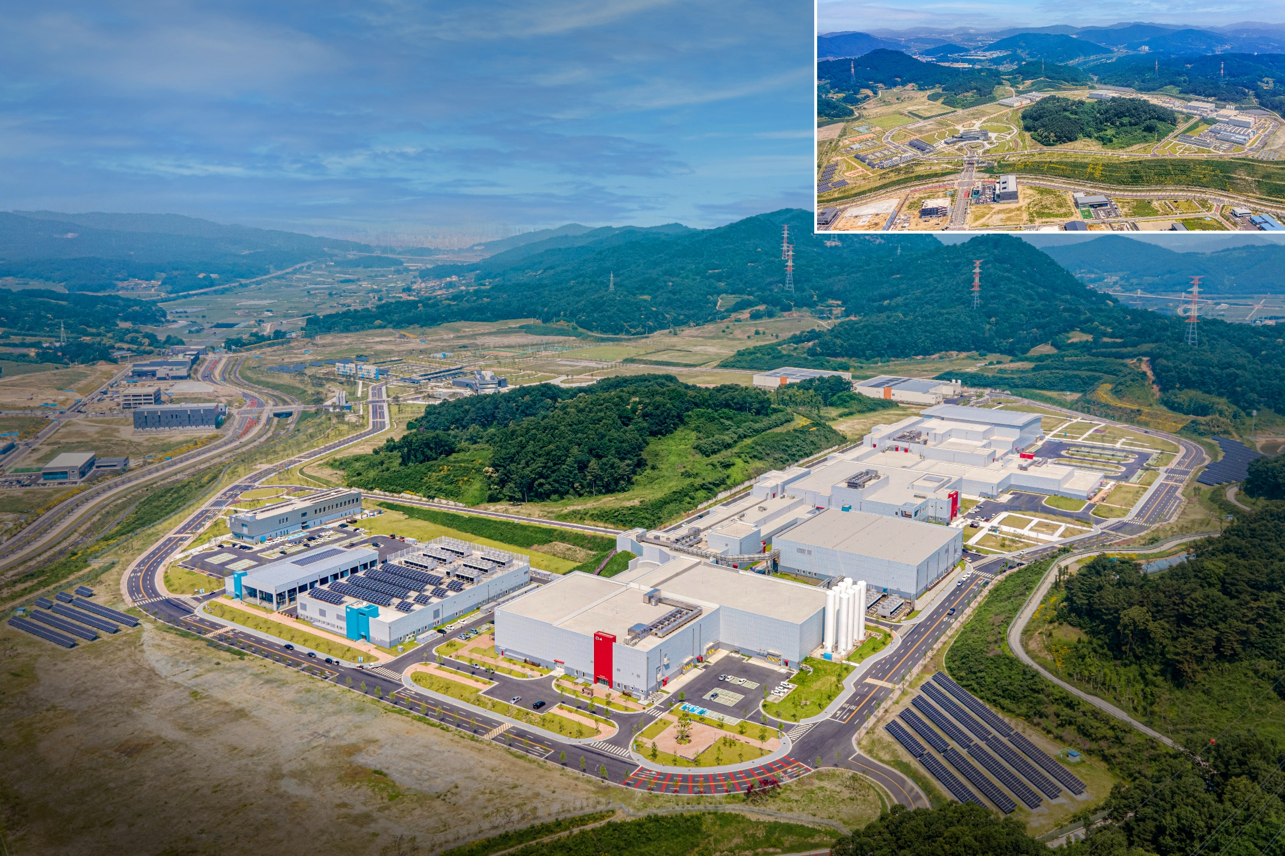
RAON Layout
● Accelerator System
● RI producing System
● Conventional Utilities
● Experimental System
Waste Storage
Guest House
Assembly Bd.
SRF Test Bd.
High Energy B
IF
HQ Office
Accelerator
ISOL
Control Center
SCL2
SCL3
High Energy A
Low Energy B
Low Energy A
Cryogenics Bd.
Utility Bd.
Electricity Bd.
Campus Area : 952,066㎡ (including the reservation area of 144,640㎡)
Building Area : 76,259㎡(11 bldgs) with total bldgs. Area of 116,252㎡

Slide 6
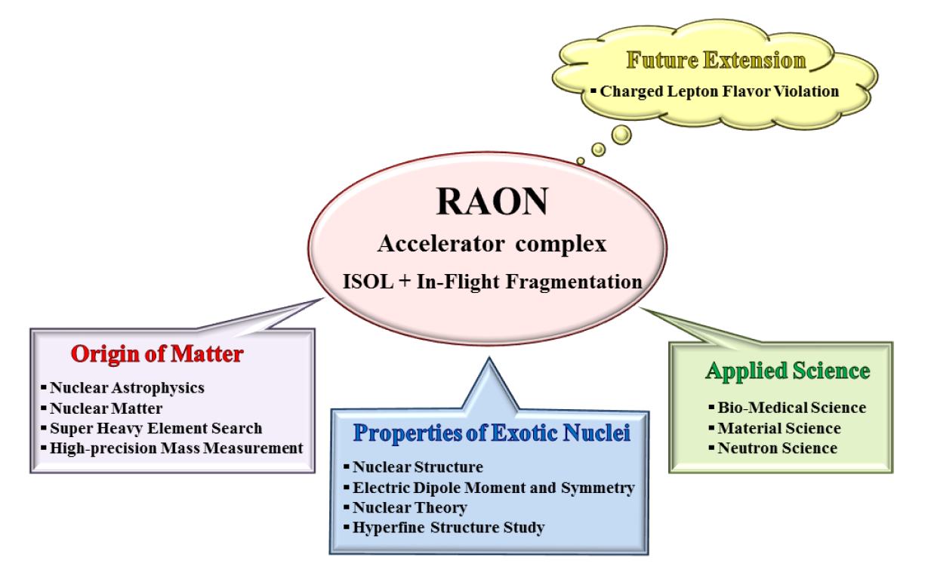
Science Goal of RAON

Slide 7
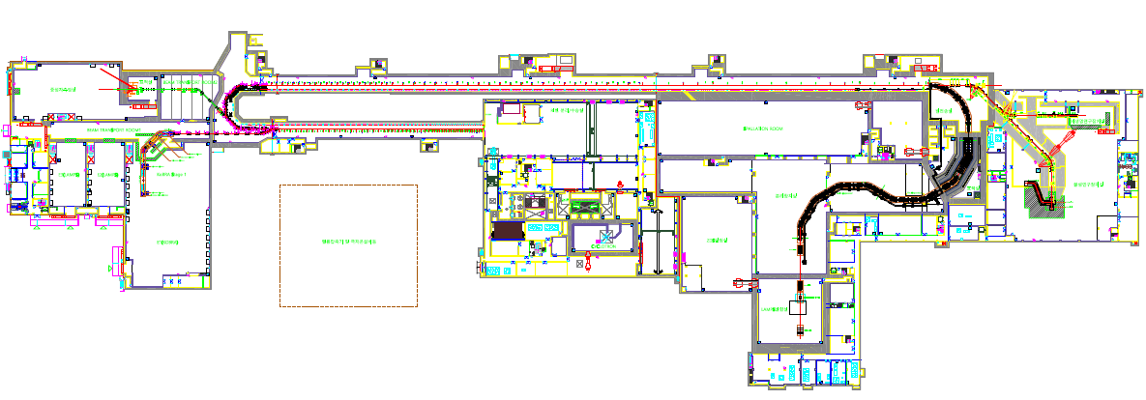
RIB production at RAON
 | KoBRA | ISOL | IF Separator
Driver | SCL3(ECR/ISOL) | Cyclotron | SCL3(ECR/ISOL)->SCL2
(Post) Acceleration |  | SCL3 or SCL3->SCL2
Production Mechanism | Direct reactions Multi Nucleon Transfer | P induced U fission | PF, U fission
RIB Energy | < a few tens of MeV/u | > a few of keV/u | < a hundreds of MeV/u
SCL2
ECR
SCL3
IF Separator
High energy Experiment Hall
KoBRA
ISOL
Low energy Experiment Hall

Slide 8
Part 2.
SRF Accelerator Systems

Slide 9




Simple Diagram of RAON SRF Accelerator
Injector
0.5 MeV/u
SCL11
ECRIS
SC LINAC 1
18 MeV/u
(in future)
LEBT
RFQ
MEBT
SCL12
Cyclotron
ISOL
Very low-energy
experiments
2nd Phase
Ion sources
SC LINAC 3
18 MeV/u
Transport
SC LINAC 2
200 MeV/u
P2DT
SCL31
SCL32
SCL21
SCL22
HEBT
IF
QWR
β=0.047
HWR
β=0.12
SSR1
β=0.3
SSR2
β=0.51
KoBRA
Low-energy
experiments
High-energy
experiments

Slide 10
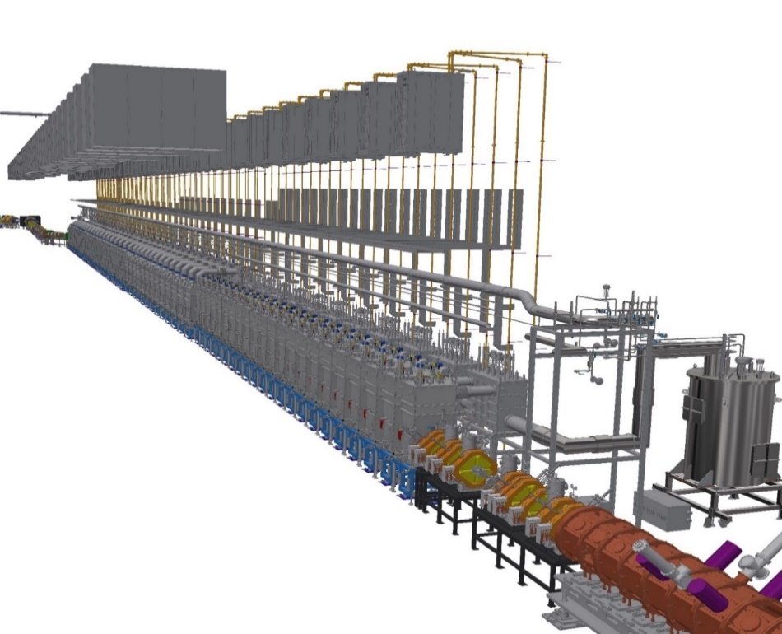
Phased Installation
Phase 1(~2022)
Injector, SCL3, ISOL beam commissioning
All experimental systems including IF separator system to be installed and machine commissioned
Phase 2(~2029)
High energy Linac, SCL2
SCL3
SCL3 & Injector
SCL2
ECR
IF Separator
KoBRA
SCL3
ISOL
Low energy
Experiment Hall
Very Low energy Experiment Hall
High energy Experiment Hall
SCL3 → installation done on 2021 & commissioning on Oct 2022

Slide 11
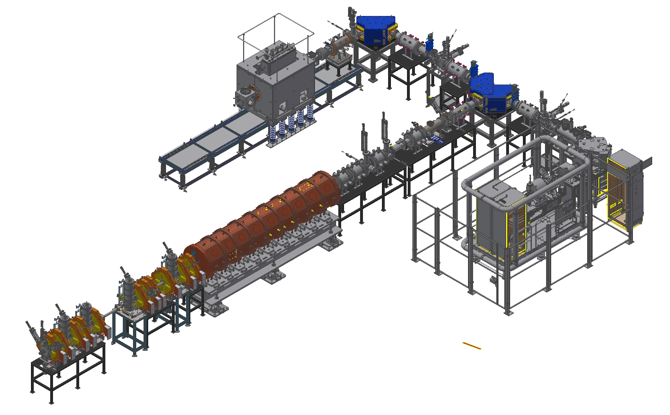
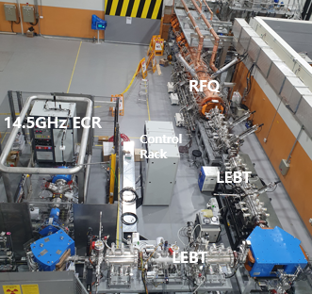
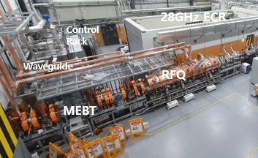
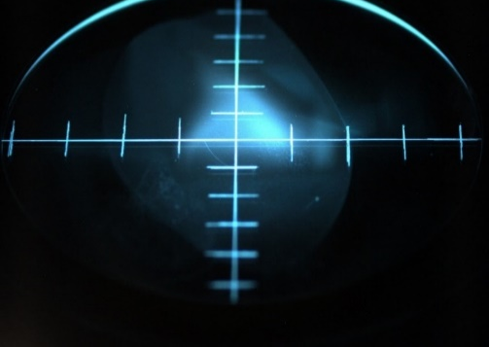
RAON Injector System
Two ECR-IS on high voltage platforms
14.5 GHz ECR ion source
28 GHz superconducting ECR ion source
LEBT (E = 10 keV/u)
10 keV/u, Dual bending magnet
Chopper & Electrostatic quads, Instrumentation
RFQ (E = 500 keV/u)
81.25 MHz, Transmission Eff. ~98%
CW RF Power 94 kW (SSPA: 150 kW)
MEBT (E = 500 keV/u)
Four RF bunchers (SSPA: 20, 15, 4×2 kW)
Simple quadrupole magnets, Instrumentation
SC ECRIS
LEBT
ECRIS
MEBT
RFQ
Ar⁸⁺ 10uA @ Beam Viewer(‘21)
Installation completed and beam commissioning from October, 2020

Slide 12
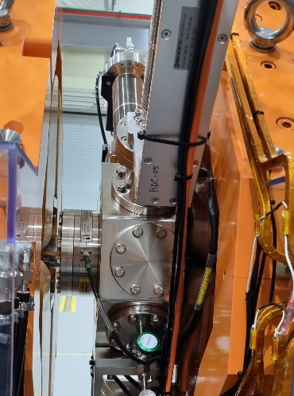
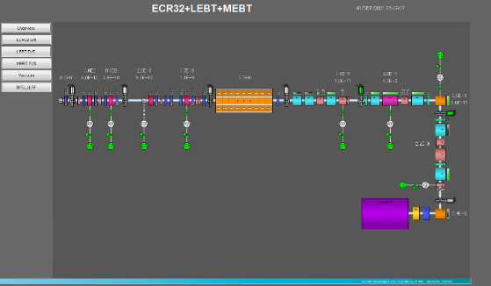
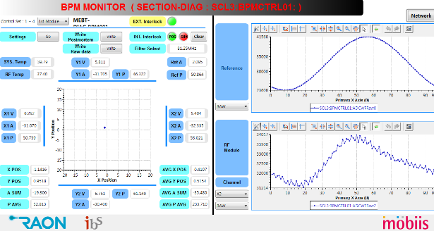
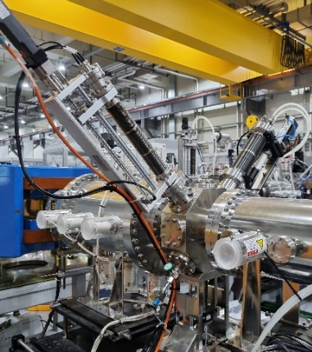
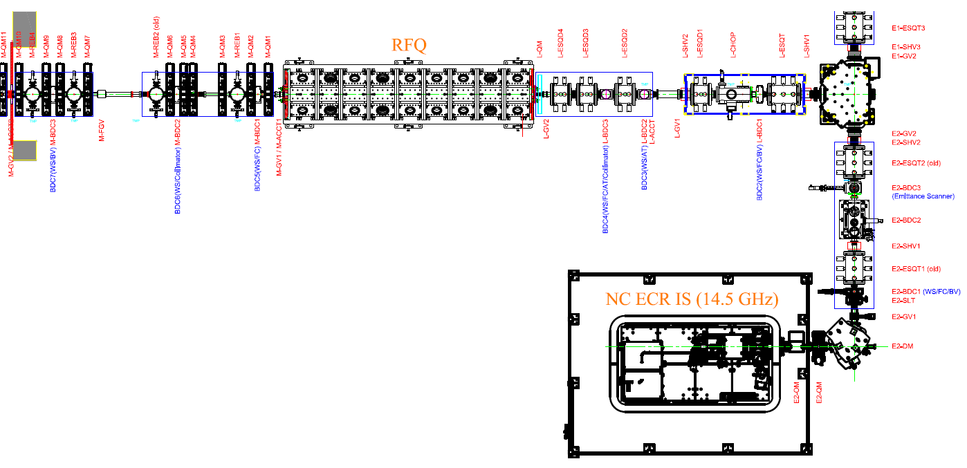
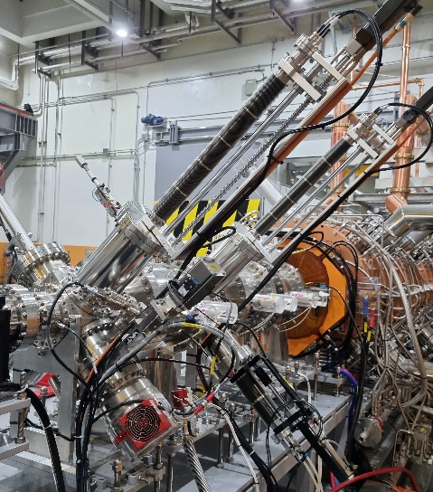
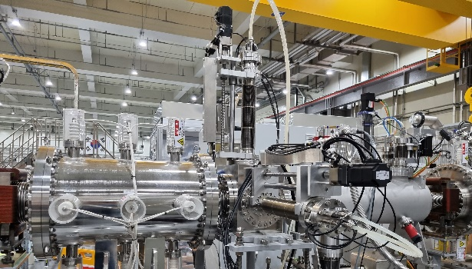
Beam Diagnostic System
LEBT
Wire scanner - 5 sets (4 installed)
Beam Viewer – 3 sets (2 installed)
Bergoz ACCT – 1 set
Faraday Cup – 5 sets (4 installed)
beam Attenuator – 2 sets
2-D Allison Scanner – 2sets (1 installed)
MEBT (Installed)
Wire scanner - 4 sets
Beam Viewer – 1 set
Bergoz ACCT – 2 sets
Faraday Cup – 2 sets
Stripline FFC – 1 set
BPM – 6 sets
Ar⁸⁺ 10uA @ Beam Viewer(‘21)

Slide 13
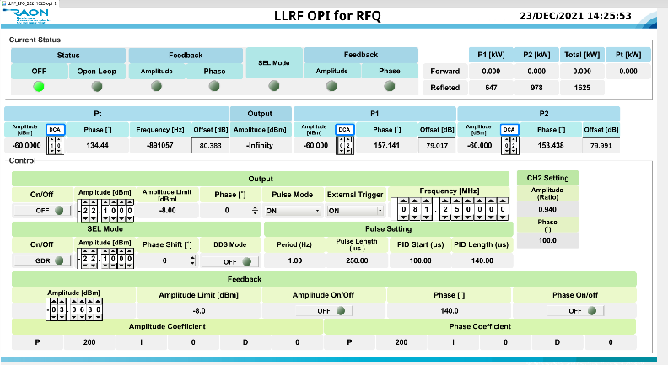
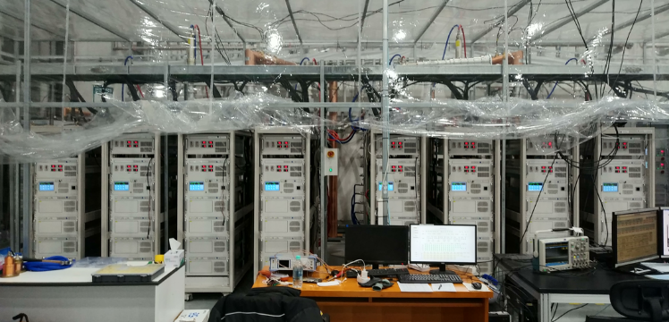
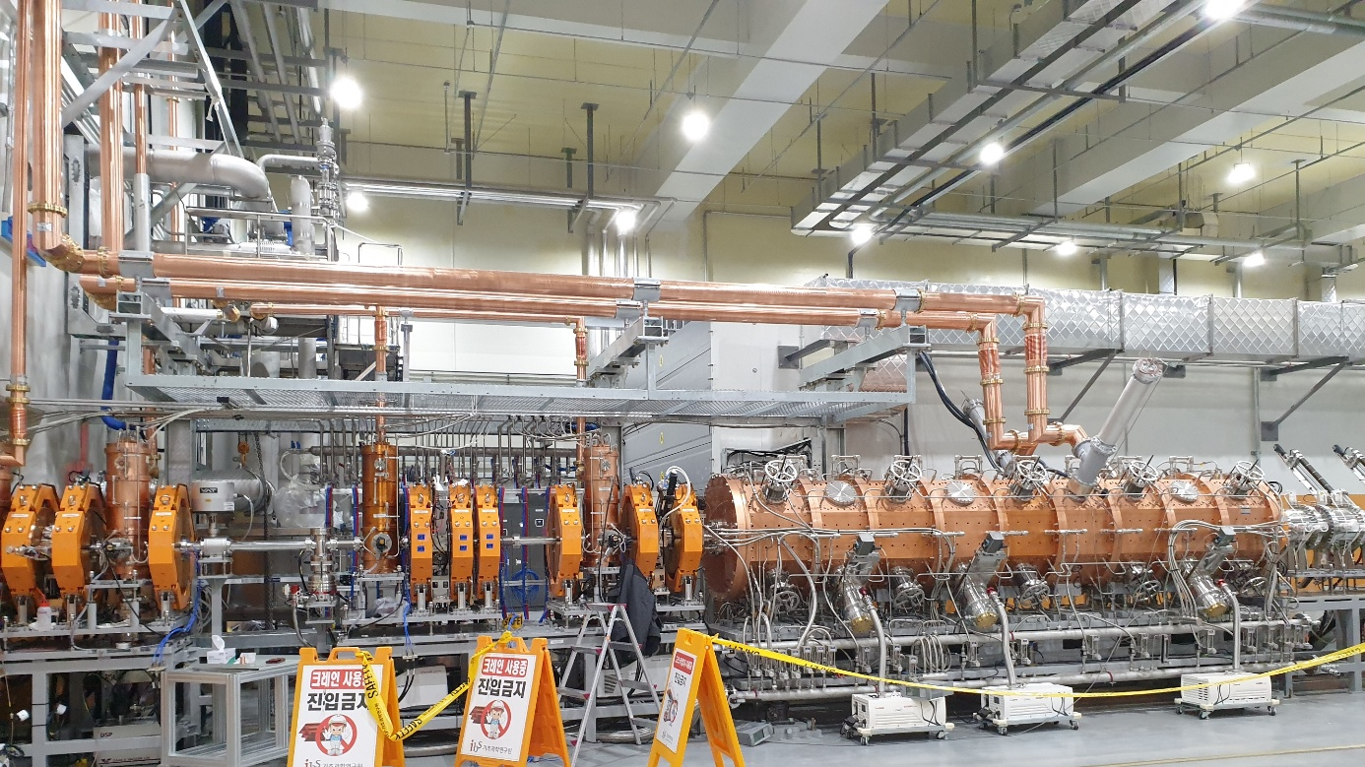
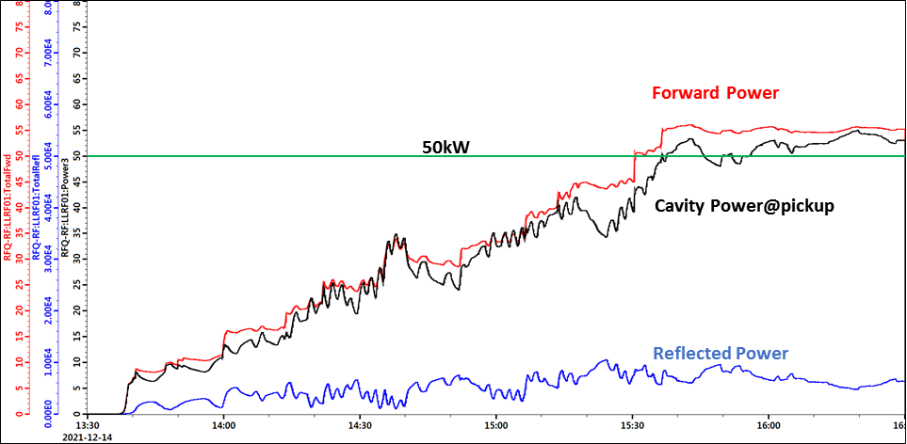
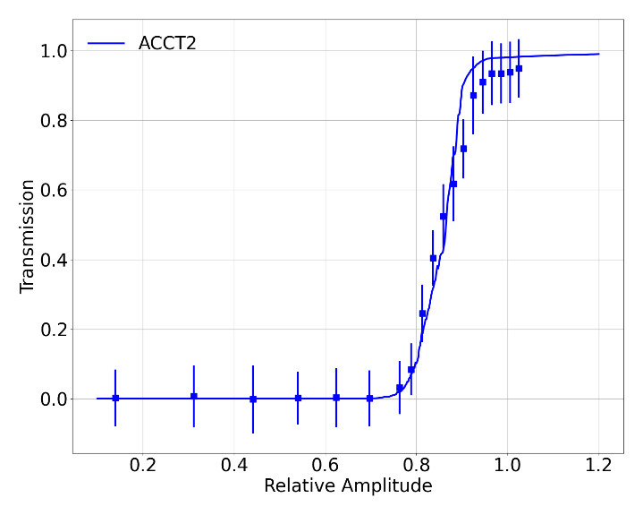
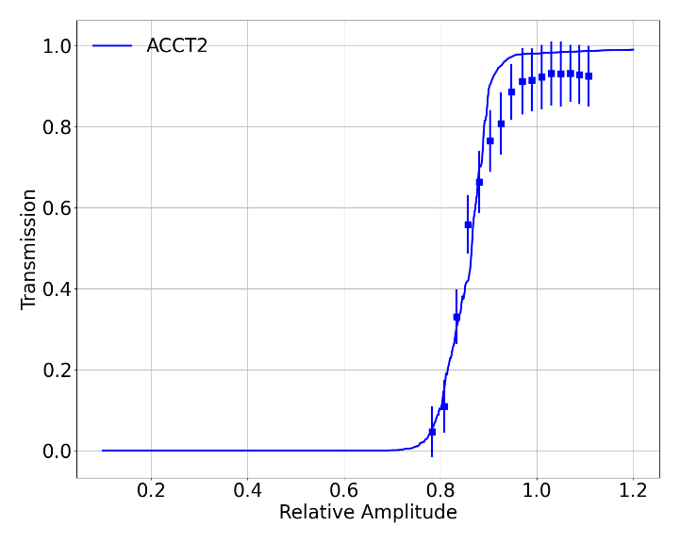
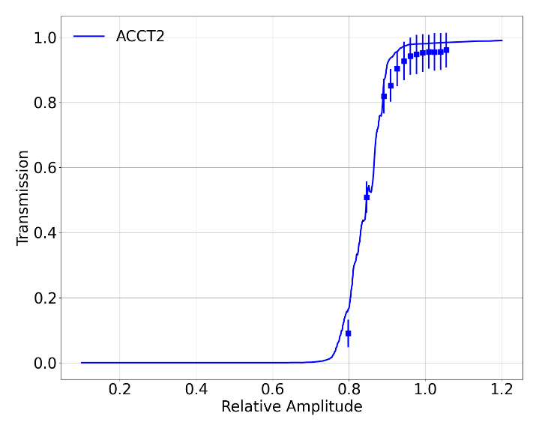
RFQ and MEBT
PARAMETER | VALUE
Beam Properties:
Frequency | 81.250 MHz
Particle | H⁺¹ to U₂₃₈⁺³³
Input Energy | 10 keV/u
Input Current | 0.4 mA
Input Emittance | 0.012 .cm. mrad
Output Energy | 0.507 MeV/u
Output Emittance | 0.0125 .cm. mrad ~26 keV/u-Degree
Transmission | ~98 %
Duty Factor | 100%
SSPA(60kW*2EA)
[ Ar9+, 2021]
[ Ar9+, 2022]
[ Ar8+, 2022]
[ RFQ transmission (error bar: 3σ) ]

Slide 14
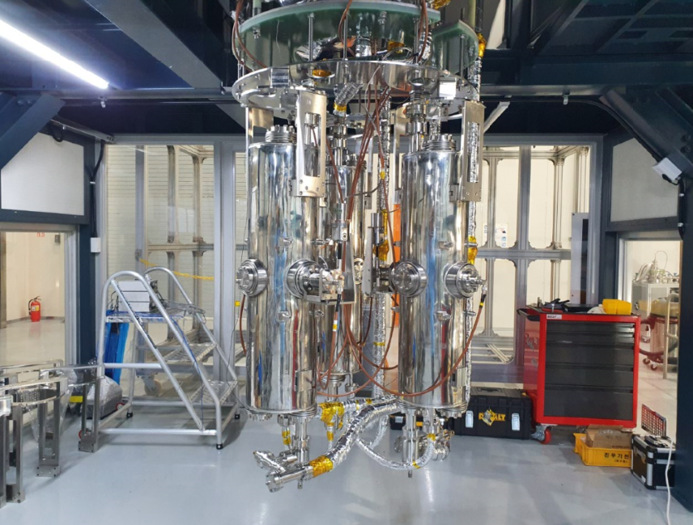
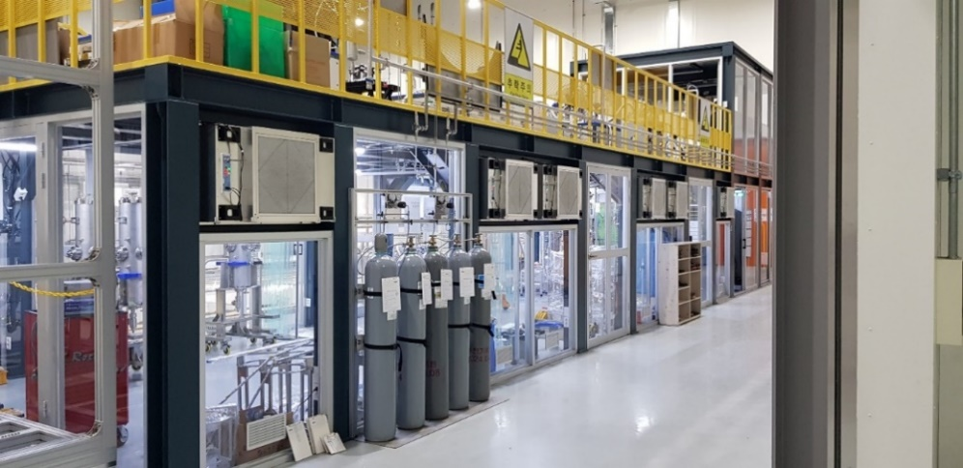
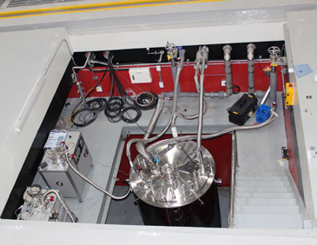
SRF Cavity Development
On-site (Shin-Dong) test facility
1 onsite - 3 VT pits and 3 cavities per pit, 3 HT bunkers
1 offsite (15 Km from site) - 2 VT pits and 2 cavities per pit
Cover all RAON cavities - QWR (82.125 MHz), HWR (162.5 MHz) and SSR1 & 2 (325 MHz)

Slide 15
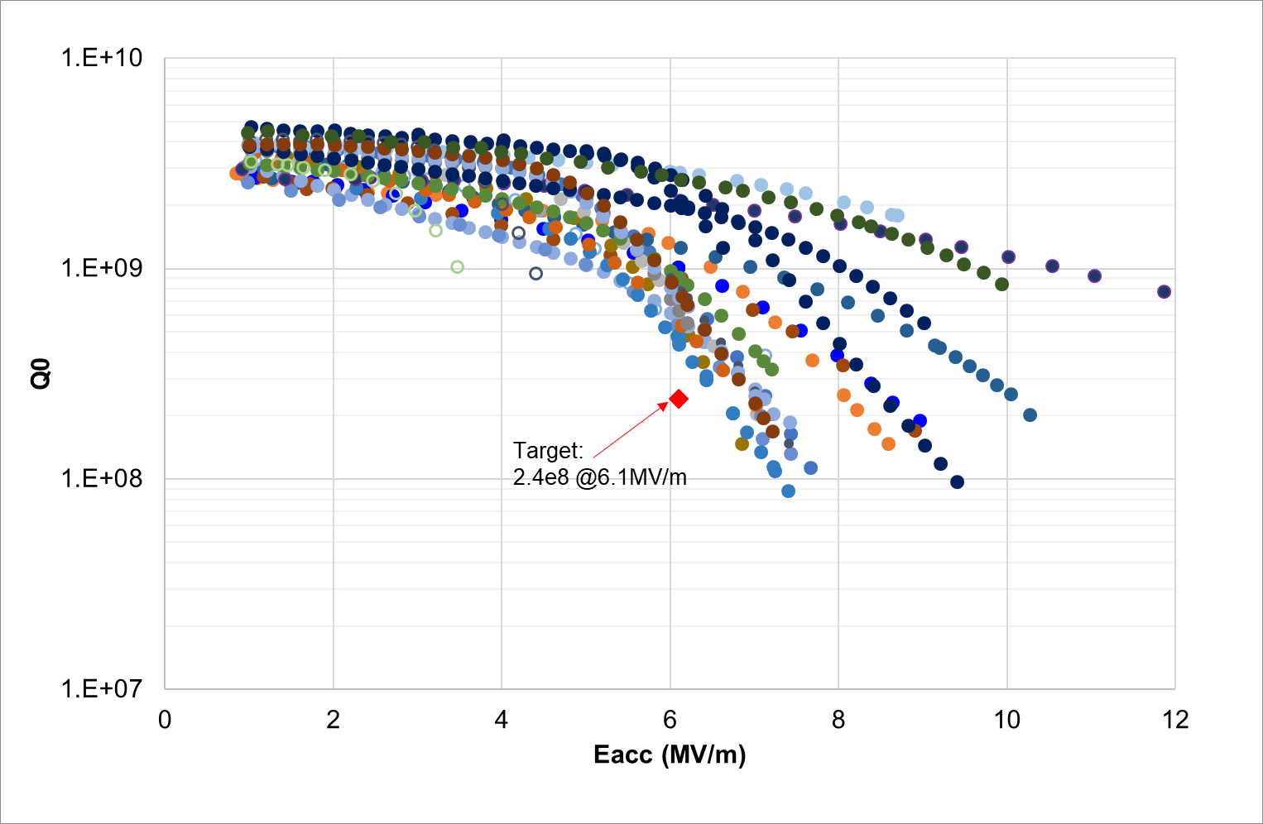
SRF Cavity Development-QWR
Frequency (MHz) | Optimum 𝛽 | Eacc (MV/m) | Q0 | # of cavity | # of module
81.25 | 0.047 | 6.1 | 2.4 e+8 | 22 | 22

Slide 16
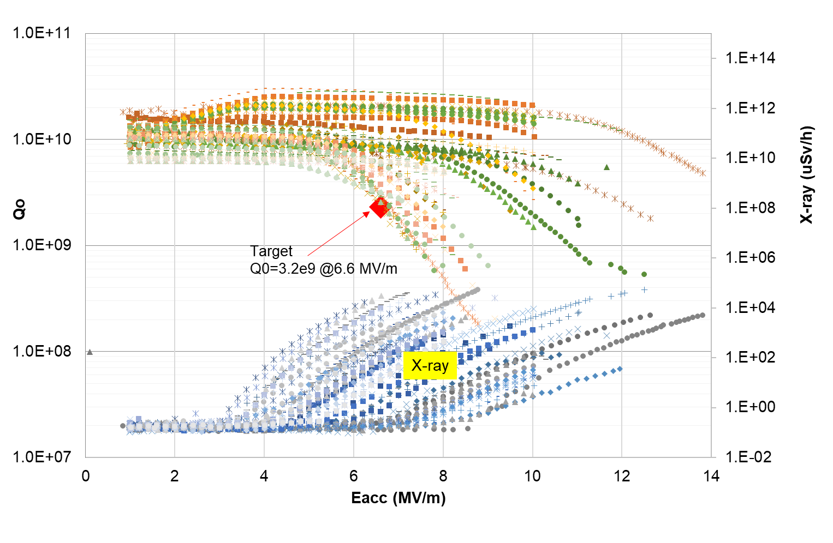
SRF Cavity Development-HWR
Frequency (MHz) | Optimum 𝛽 | Eacc (MV/m) | Vacc (MV) | Q0 | # of cavity | # of modules | Op. temp (K)
162.5 | 0.12 | 6.6 | 1.46 | 2.3e+9 | 106 | 35 | 2

Slide 17
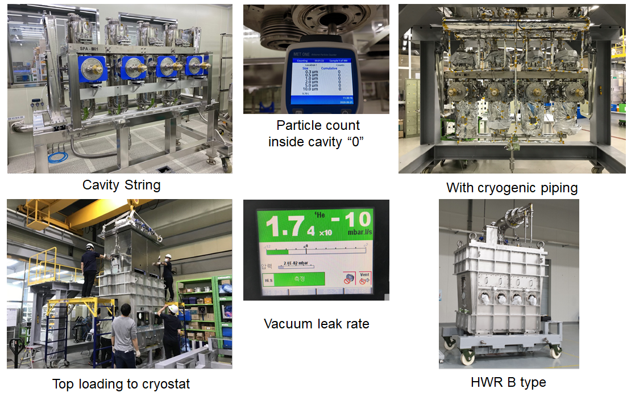
SRF Cavity Development
Assembly of the HWR Cryo-module

Slide 18
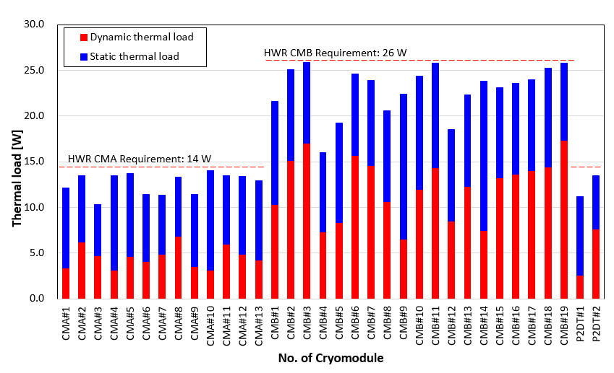
SRF Cavity Development
Thermal load of the HWR Cryo-module

Slide 19
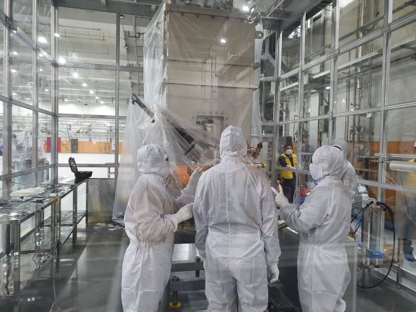
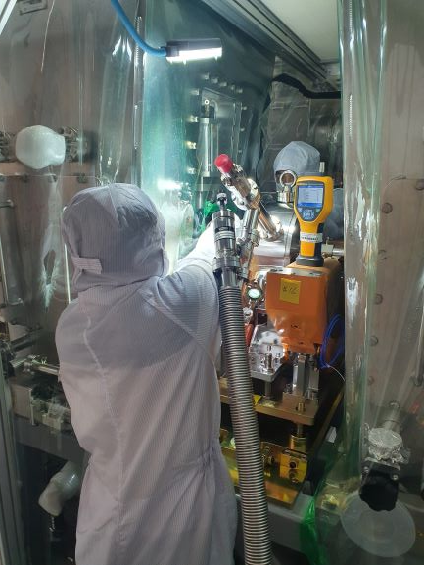
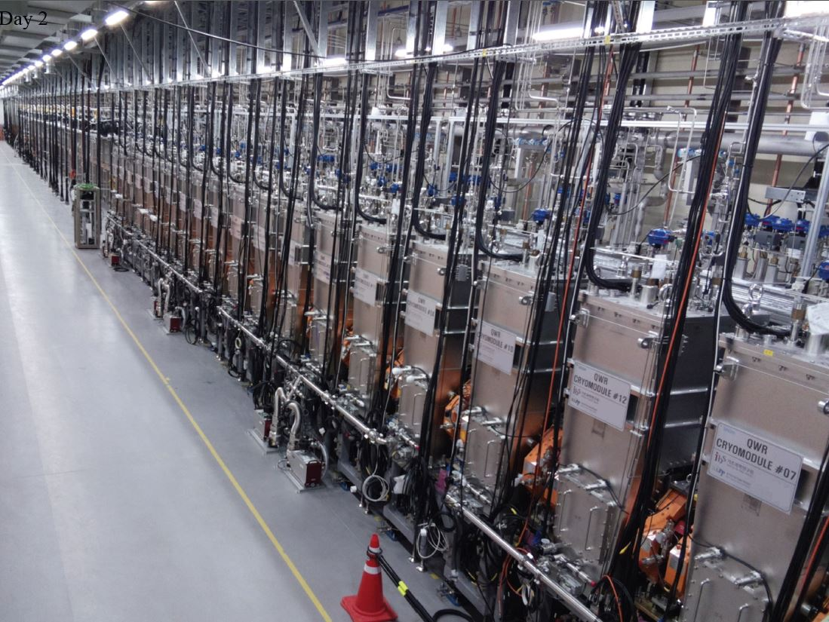
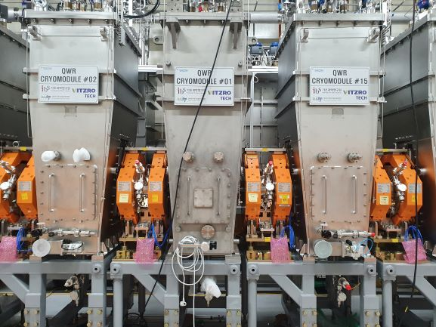
SRF Linac Assembled and Installed
SCL3 and Cryo-plant Installation completed 2021 & Beam commissioning just started
-Cryomodule(CM) & Warm section is clean assembled in the clean booth@tunnel
-Total Particle counts(size=0.5um above/10 mins) were less than 30 counts
CM
CM
CM
Warm section
SCL3 LINAC installed on 2021

Slide 20
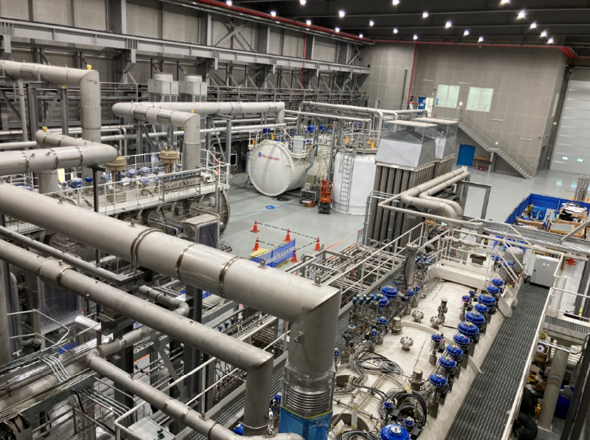
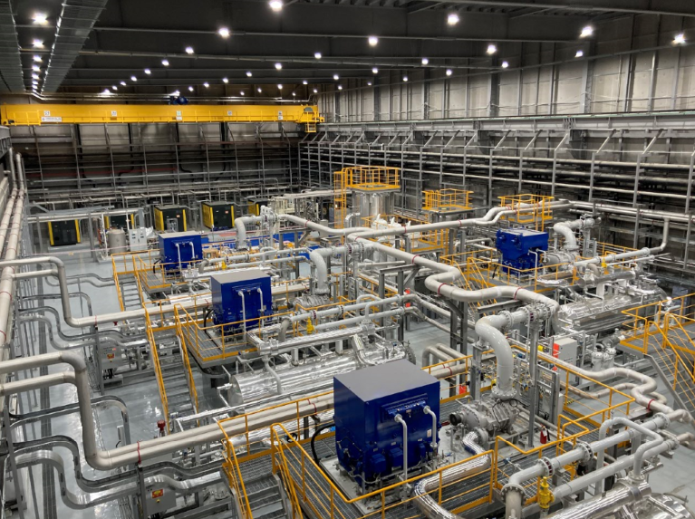
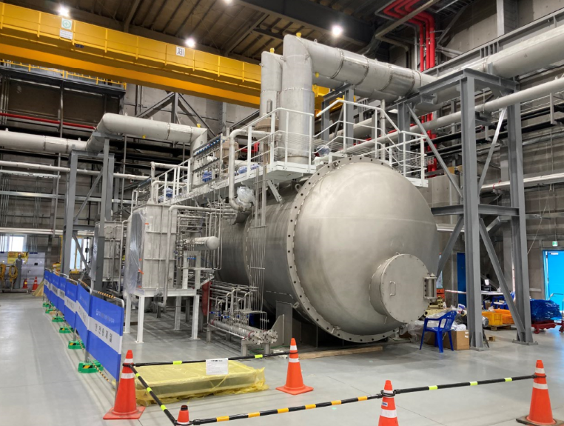
Cryo-plants are ready
Plant configuration
  SCL3 cryoplant (4.2 kW @4.5K) for SCL3
  SCL2 cryoplant (13.5 kW @ 4.5 K) for SCL2
  To combine two plants through the distribution box. If one plant down, the other can maintain cold SCL 2&3 together or only one.
Cold box
Warm compressors
LHe distribution box
Plant status
  Mechanical installation and commissioning was done in July, 2022
  Cold box was connected to the Main distribution box.
  First cool down begins September 7, 2022.

Slide 21
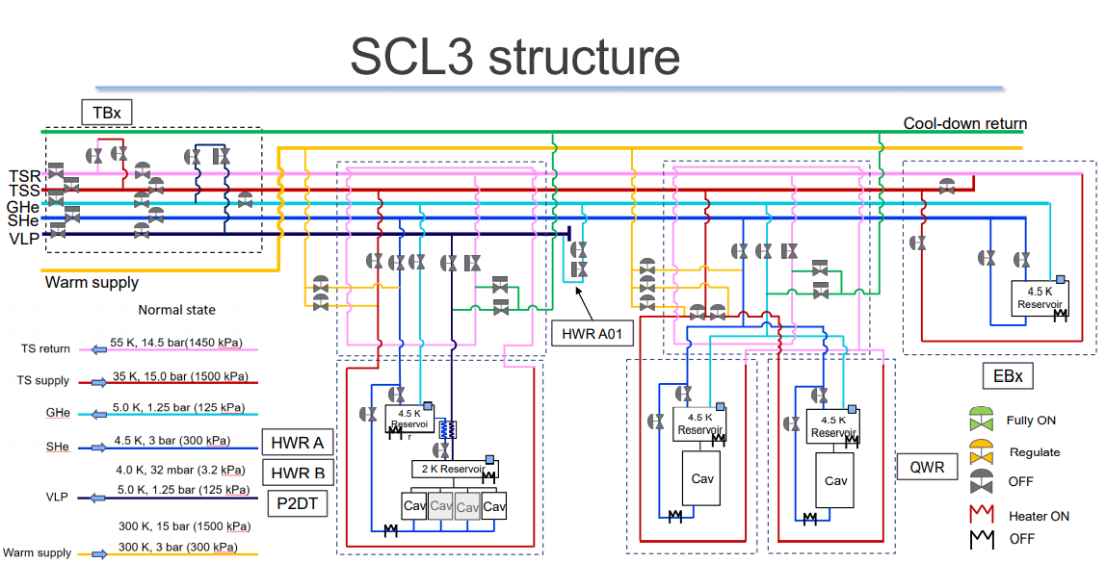
Simple Diagram of the SCL3 Cryo-system

Slide 22
Part 3.
Beam Commissioning Status

Slide 23
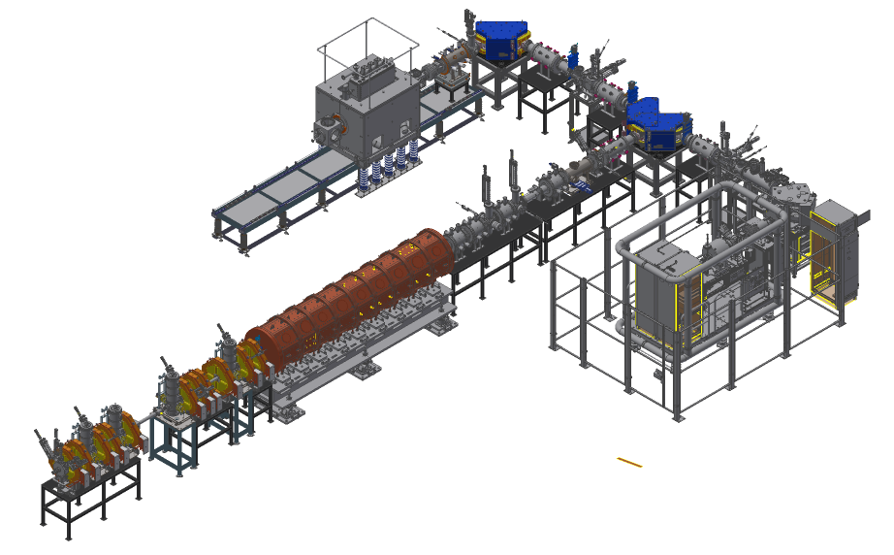
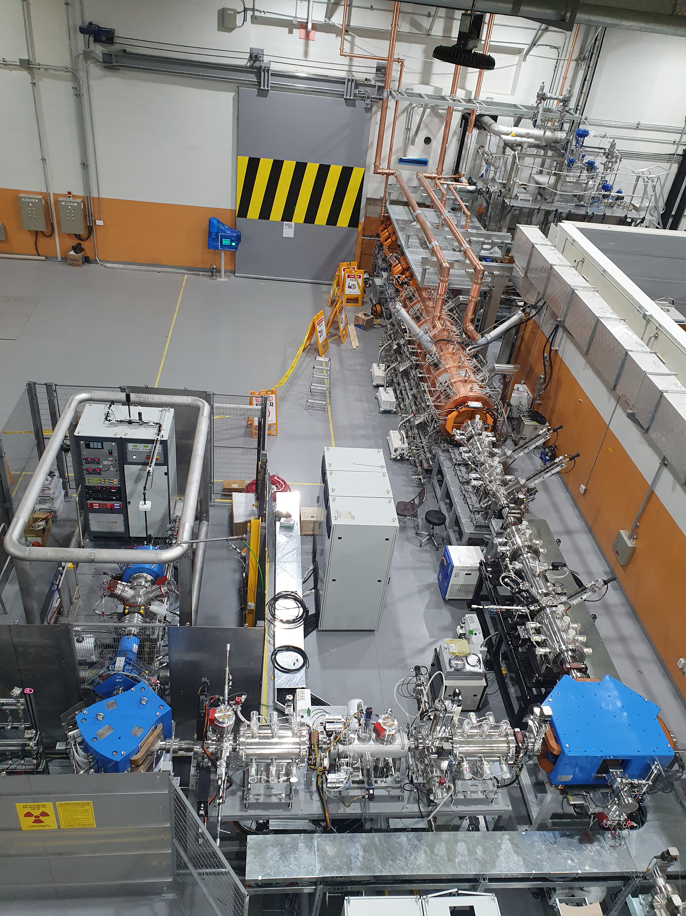
Injector Diagnostics
28GHz
ECR IS
LEBT
- Injector
* Ion Source: 14.5 GHz ECR IS
* LEBT: 10 keV/u
* RFQ: 507 keV/u, 98% transmission
* MEBT: 507 keV/u, 4 bunchers
- Beams: Ar9+(A/q=4.4), Ar8+(5.0), Ar11+(3.6)
- Beam Diagnostics
RFQ
14GHz
ECR IS
MEBT
 | LEBT | MEBT
Allison scanner | 2 (X,Y) | -
Wire scanner | 4 | 4
Faraday cup | 4 | 2
ACCT | 1 | 2
BPM | - | 6
Beam viewer | 2 | 1
Fast Faraday Cup | - | 1
MEBT
RFQ
14GHz
ECR IS
LEBT
LEBT

Slide 24
Injector Beam Commissioning
Measurements for commissioning
MEBT Bunchers RF set-point (phase scan, BPM)
Beam energy (phase scan, TOF with BPMs)
Beam current, transmission (ACCT, FC)
Orbit correction (BPM / Wirescanner & dipole steerer)
Beam transverse profile (wirescanner)
Transverse matching (wirescanner)
Beam emittance (X and Y) : Allison scanners, Beam size fitting, quad scan methods
Physics applications for commissioning
BIPAM (Beam Input Parameters And Matching)
CAPS (Cavity Amplitude and Phase Scan)
Orbit correction application
Emittance data analysis & wirescanner data analysis

Slide 25
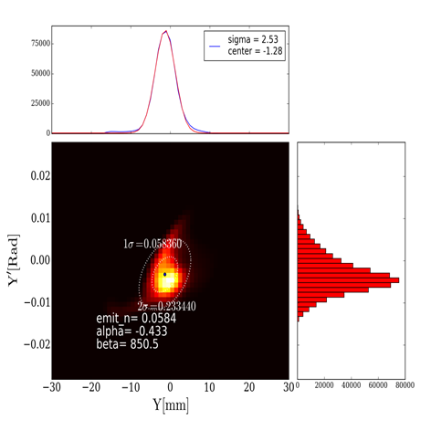
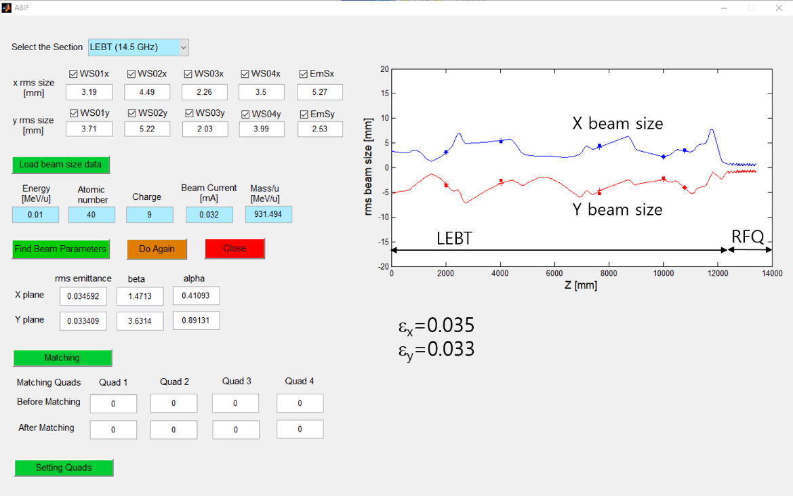
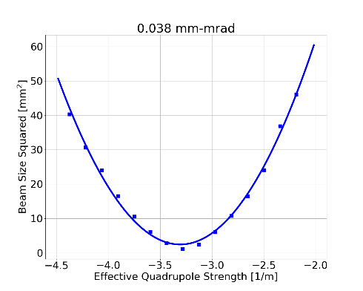
Low Energy Beam Transport (LEBT)
Beam parameter measurements (Allison scanners, wirescanners)
measuring initial beam parameters (fitting beam sizes of wirescanners)
controlling optics when needed
do matching to RFQ
Emittance measurement (Allison scanner, quad scan)
Beams: Ar9+ (~30μA), Ar8+ (~47μA)
Beam emittance
(Allison scanner)
LEBT beam parameters
Beam emittance
(quad scan)
emittance comparison
 | X | Y
Allison | 0.048 | 0.067
Quad Scan | 0.041 | 0.038

Slide 26
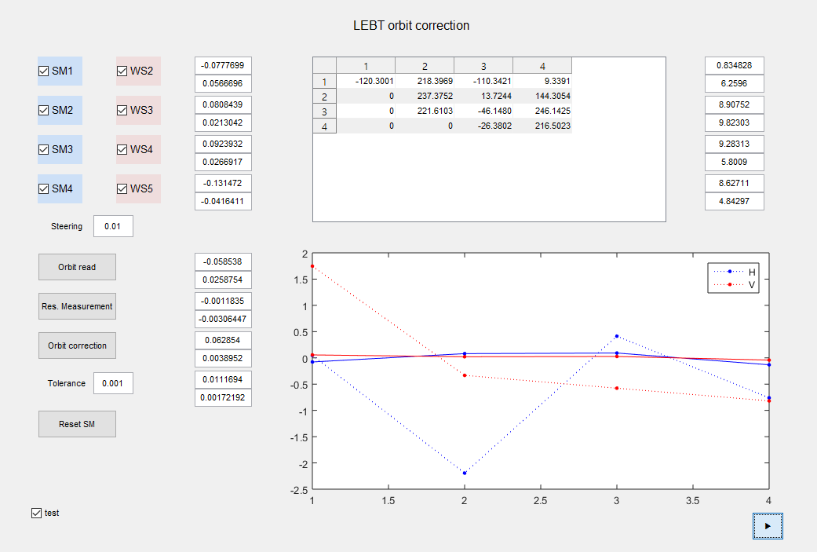
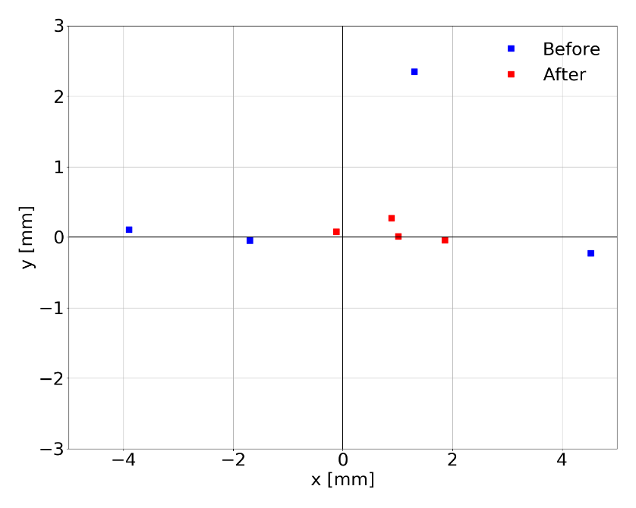
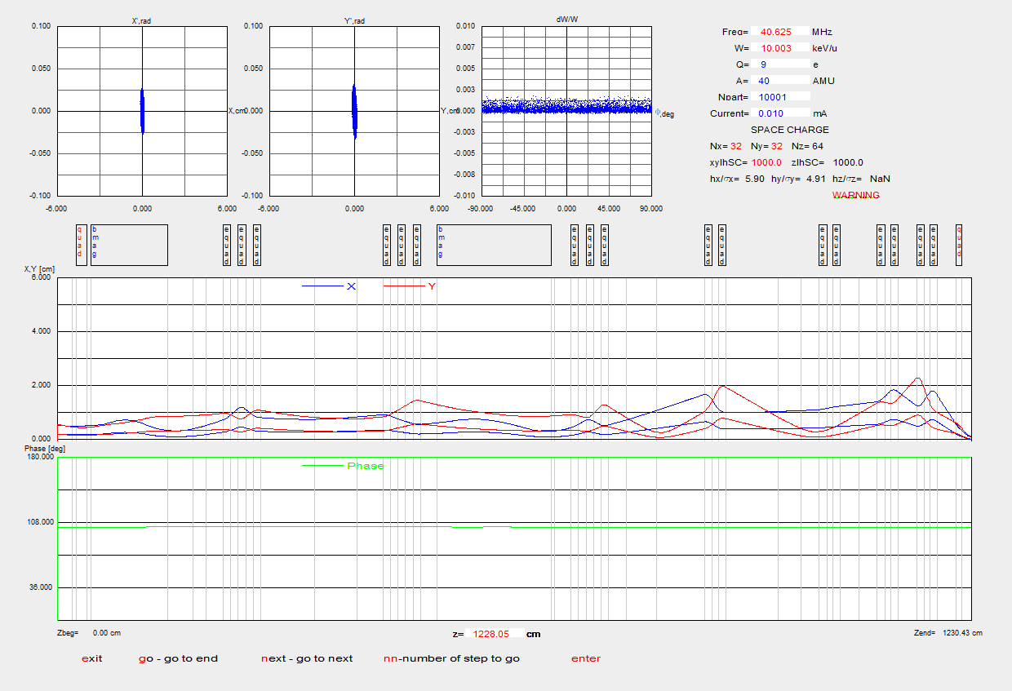
LEBT Orbit Correction
- orbit correction
- beam tracking (TRACK, DYNAC codes)
LEBT orbit correction
TRACK (beam dynamics code)

Slide 27
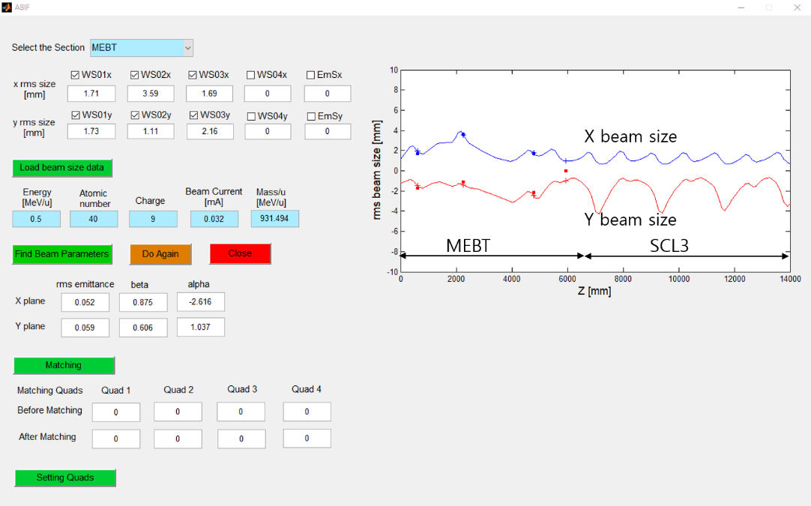
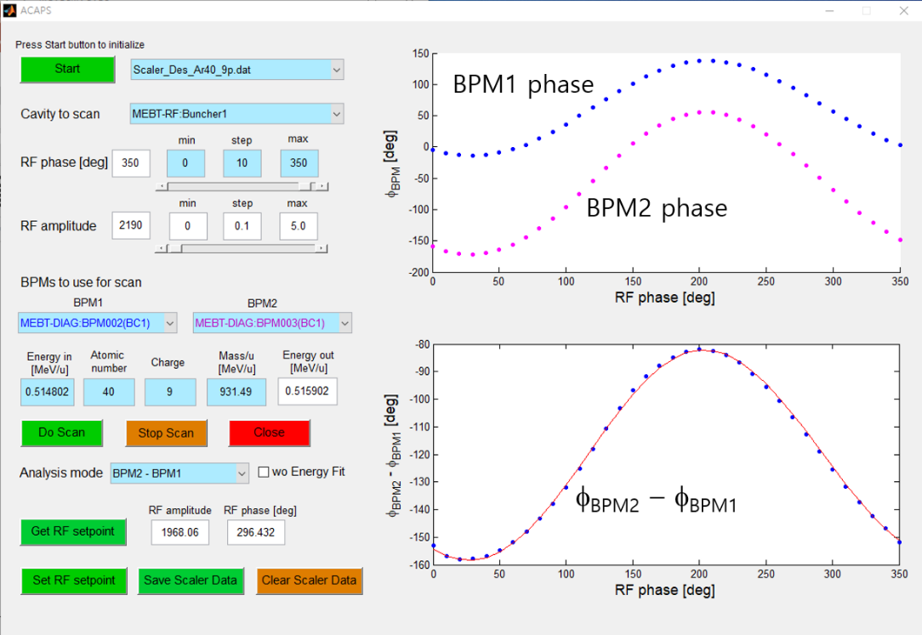
Medium Energy Beam Transport (MEBT)
MEBT beam parameter measurements
using beam sizes from wirescanners
measure initial beam emittances & parameters
can do matching to SCL3
ε_{x}=0.052
ε_{y}=0.059
MEBT buncher RF set-point
using phase scan technique
determines RF amplitude & phase
RF set-points of 4 bunchers obtained
Beam energy is 514 keV/u (design 507 keV/u)

Slide 28
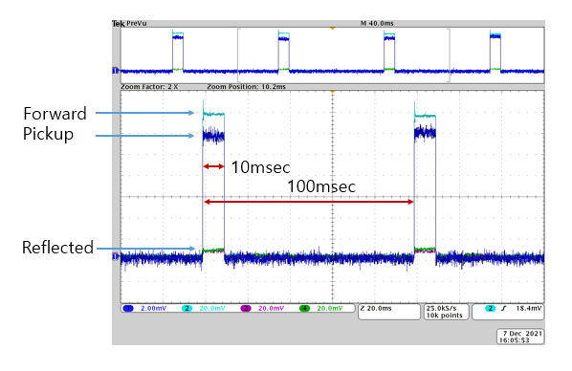



Injector Transmission
- 10% beam duty operation: 96 minutes, 10Hz, 10msec (2021.12.07.)
* Injector transmission > 94%
- MEBT beam emittance measurement based on quad scan
MEBT quad scan
emittance measurement
ε_{x} = 0.059 mm-mrad
ε_{y} = 0.081 mm-mrad
Injector beam transmission

Slide 29
Cryo-plants readiness check
All conditions checked for first cool-down
  - Helium leak tests (final) - done
  - Pressure tightness (final) - done
  - Circulation by SCL3 Cryoplant/check of filters - done
  - Check purity of helium in the cryogenic lines – fine
  - Check insulation vacuum – fine (for starting cool-down)
  - Readiness of all interlock systems - done
  The first cool-down : started @ 7th of Sep. 15:30

Slide 30


Sequences
SCL3 Cryogenic Operation Modes (based EPICS + PLC)
Now

Slide 31

First Cool-down on September 15, 2022
Cooling down cryogenic distribution system, thermal shields of all cryomodules with SCL3 cryoplant, simultaneously.
Step cool-down (Cryogenic lines, End-box, and all thermal shields)
4.5 K reached
End-Box
Control (by-pass flow and stability)
Cavities : Cool-down

Slide 32
First Cool-down Status
Cool-down of Cryomodules
  54 % progress (30 ea/55 ea cooled down)
  All QWR cavities – fast cooled down
  Now, HWR A sections almost finished
Stability
  All cold masses have not been cooled down yet
    Once cooling down all components, need to optimize the stability
  For the first beam commissioning @ QWR CM #1~5
    SHe (Subcooled Helium Supply) – flow rate controlled for stability
    Mitigation by controlling bypass flows (1. GHe return – Very Low Pressure return, 2. End Box) + vibration from flows
    QWR CM #1~6 sections – Control improvement (for Pressure stability by using cryogenic valves + heaters’ control)

Slide 33
SRF Linac Commissioning Plan
Measurements to perform
QWR/HWR RF set-point (phase scan, BPM)
Beam energy (phase scan, TOF with BPMs)
Beam current, transmission (ACCT, FC)
Orbit correction (BPM & dipole steerer)
Beam transverse profile (wirescanner)
Transverse matching (wirescanner)
Beam emittance (X and Y) : beam size fitting, quad scan
Physics applications for commissioning
BIPAM (Beam Input Parameters And Matching)
CAPS (Cavity Amplitude and Phase Scan)
Orbit correction application
Emittance data analysis & wirescanner data analysis

Slide 34

Available Diagnostics in QWR Section
cryomodule
quadrupole
beam box
Halo Collimators(aperture 36 mm) installed at beam boxes

Slide 35


CAPS (Phase Scan Tool, Cavity RF Setpoint)
Phase scan with BPMs (Time of Flight measurement)

Slide 36


First Acceleration was Done on Oct. 7 !!
First five QWR modules are activated because of the position of F/C.
Next beam operation aims at delivering beams to HWR A5 (Dec.).

Slide 37
Part 4.
Summary & Outlook

Slide 38
Summary & Outlook
RAON installation and system integration was successfully done :
Progress rate is more than 97% for Phase 1
Injector beam commissioning was carried out, achieving machine setting and key measurements :
measured beam parameters (energy, emittance, Twiss parameters, beam sizes etc)
capable of controlling LEBT and MEBT beam optics freely as needed
achieved beam transmission of 95% max (routinely > 90%)
machine verification including diagnostics devices
First beam acceleration was demonstrated on Oct. 7 using first five QWR modules :
First cool-down to 4.5K was completed without any serious problems
Next beam commissioning starts after 2K cool-down of HWR modules

Slide 39
Summary & Outlook
DONE
September : Cool-down of QWR/RF conditioning
First Beam injection to first five modules
October : Cool-down of HWR/RF conditioning
November : 2K pumping for HWR section/RF conditioning
December : 2K stabilization for HWR section/RF conditioning
Second beam commissioning toward HWR A5.
January-March : Beam commissioning for whole SCL3

Slide 40
Technical Challenges of the Project RISP
Optimize test procedures
Find right cavity treatments
Mature cavity production process
Monitor long transportation
Deal with pandemic issues correctly
Complete long cryo-distribution line without cold leak
Control cryo-plant operation with small thermal load

Slide 41

Thank You for your attention!

