Slide 1
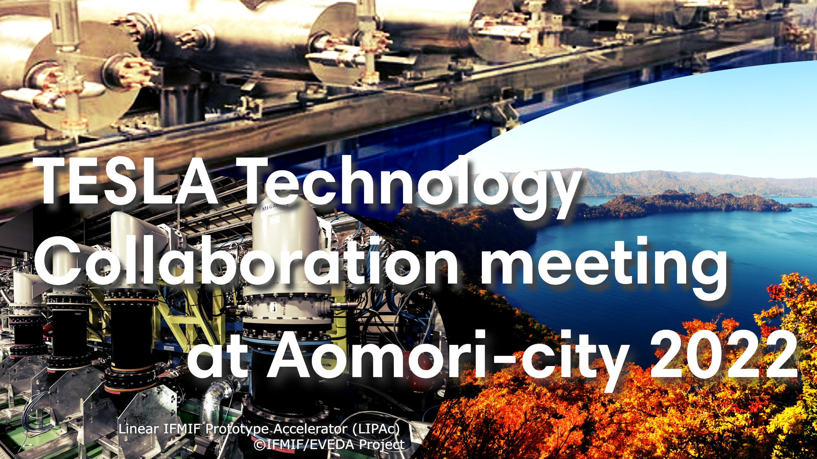

Slide 2
Announcements
Meeting rooms are opened at 8:45 every morning.
Please wear your mask at all time.
Eating / drinking in the lobby is not allowed.
Conference photo will be taken in the 2nd day, before the morning coffee break in this room.
You can use the PC prepared by LOC for the presentation.
Your own PC can be used as well.
Please upload your presentation on Indico. You can ask the LOC staff to upload also.

Slide 3
Lunch place
We would recommend ‘Swan’ in Hotel Aomori for lunch,
BUT closed Today, unfortunately.
Several Restaurants nearby, as well as the one in the venue, but the seats are limited. Please follow a Japanese colleague to find a local place!
You can buy your own lunch at Lawson in front of the venue.

Slide 4
For Attendees of Technical Tour in Rokkasho on Oct. 14 (Fri)
Bus will depart from the entrance to Rokkasho at 12h35 on Oct. 14.
No lunch break, so please prepare and bring your own lunch.
Please get your bus ticket at the reception during coffee break, and please say your destination after the tour (i.e., Shin-Aomori Station, Aomori Airport, Shichinohe Towada Station, or Link Station Hall).
Please go to the restroom before getting on the bus.
It will take 1.5 hours from the venue to Rokkasho w/o a stopover.

Slide 5
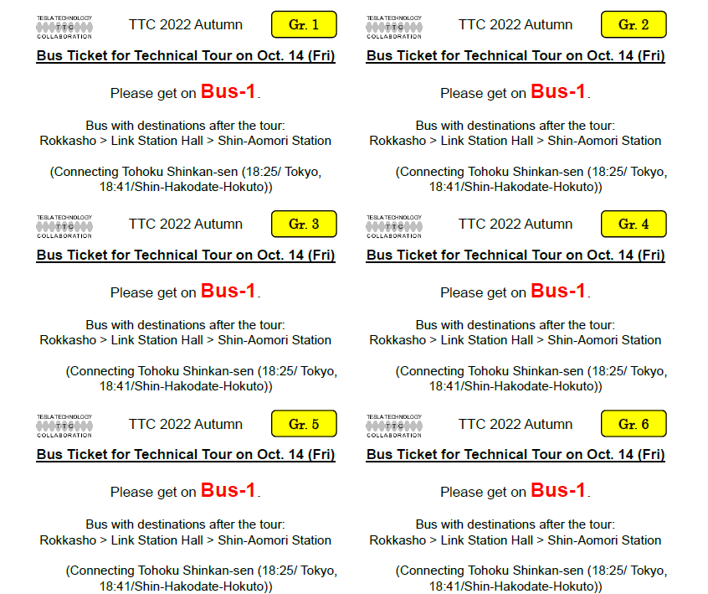
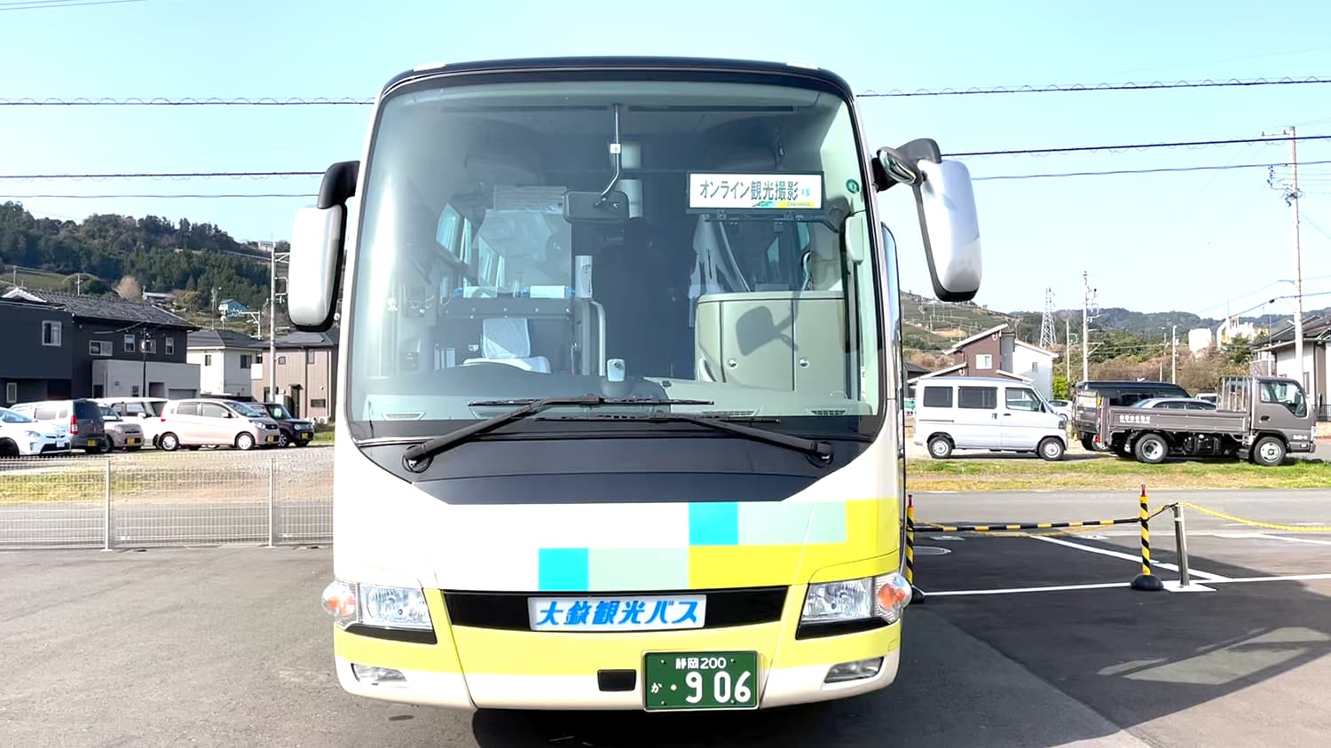
For Attendees of Technical Tour in Rokkasho on Oct. 14 (Fri)
Bus-1: Go to Shin-Aomori Station via Link station hall,
Bus-2: Go to Aomori Airport via Link station hall,
Bus-3: Go to Shichinohe Towada Station, then go to Link station hall.
You should check Bus No. on the sticker here:
Bus-1
Bus-2
Bus-3
LOC staff will check your ticket when you get on the bus.

Slide 6
Please don’t hesitate to contact a QST staff if you need any help.
We wish you a pleasant stay in Aomori and enjoy the meeting!

Slide 7
Present status of LIPAc / IFMIF at Rokkasho
Keitaro Kondo (QST)
TTC2022 Aomori
11 Oct 2022

Slide 8
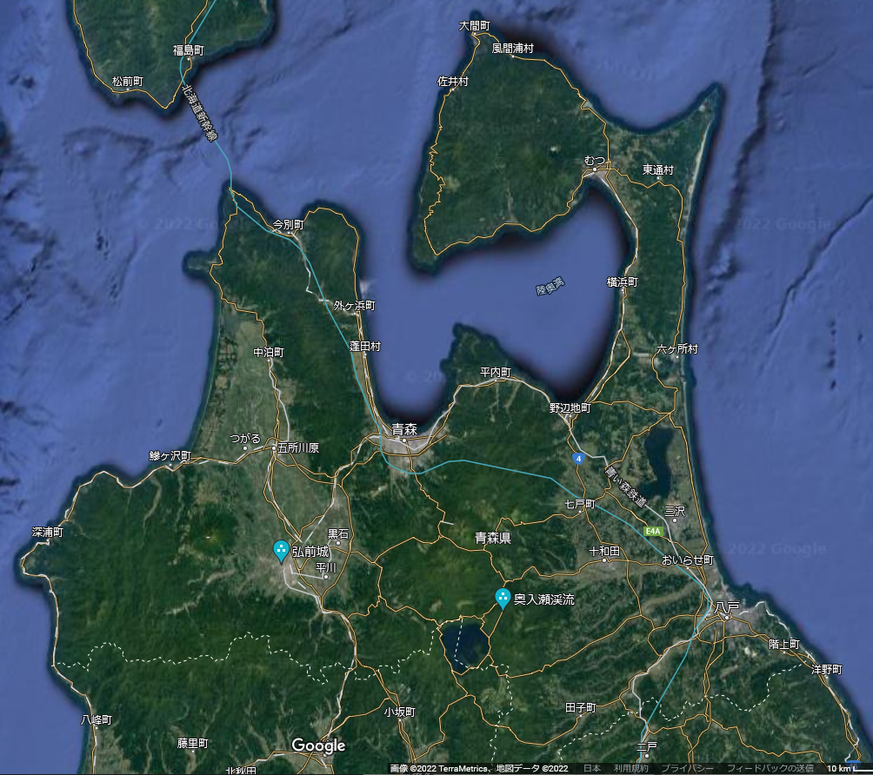
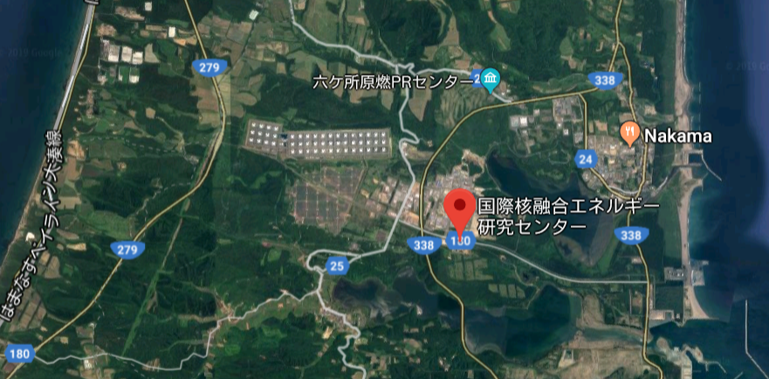
QST Rokkasho Fusion Institute
Construction of the Rokkasho site started in Apr 2007 and completed in Apr 2009.
Rokkasho Fusion Institute was established in Apr 2015.
2 major Broader Approach activities, which complement the ITER project and aim to accelerate the realization of fusion energy, are conducted: IFMIF/EVEDA and IFERC-CSC
Aomori city
Fuel reprocessing plant
(JNFL Co.)
Rokkasho Fusion Institute

Slide 9
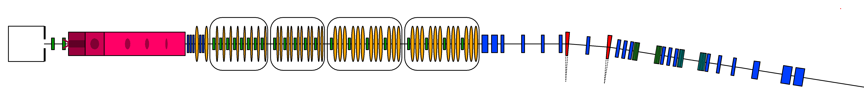
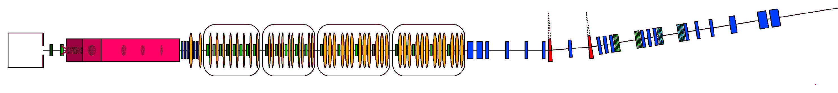
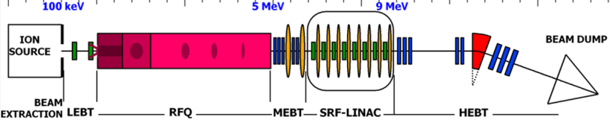
Neutron source for fusion energy development
IFMIF (International Fusion Materials Irradiation Facility)
  Accelerator-based intense neutron source (D-Li, 40 MeV, 250 mA)
  Subjecting candidate materials for fusion reactors to similar conditions expected to be experienced by a future power plant (DEMO)
Deuteron ion source
140 mA, 100 keV
Superconducting RF Linac 40 MeV
(Half Wave Resonators)
Lithium Target
Beam footprint shape
200 x 50 mm²
Test Cell
RFQ 5 MeV
L
M
40 MeV, 2 x 125 mA/CW, 2 x 5MW
H
LIPAc :
Prototype for IFMIF
constructed in Rokkasho, Japan
High > 20 dpa/y, 0.5 L
Medium > 1 dpa/y, 6 L
Low < 1 dpa/y, > 8 L
9 MeV, 125 mA/CW, 1.125 MW

Slide 10
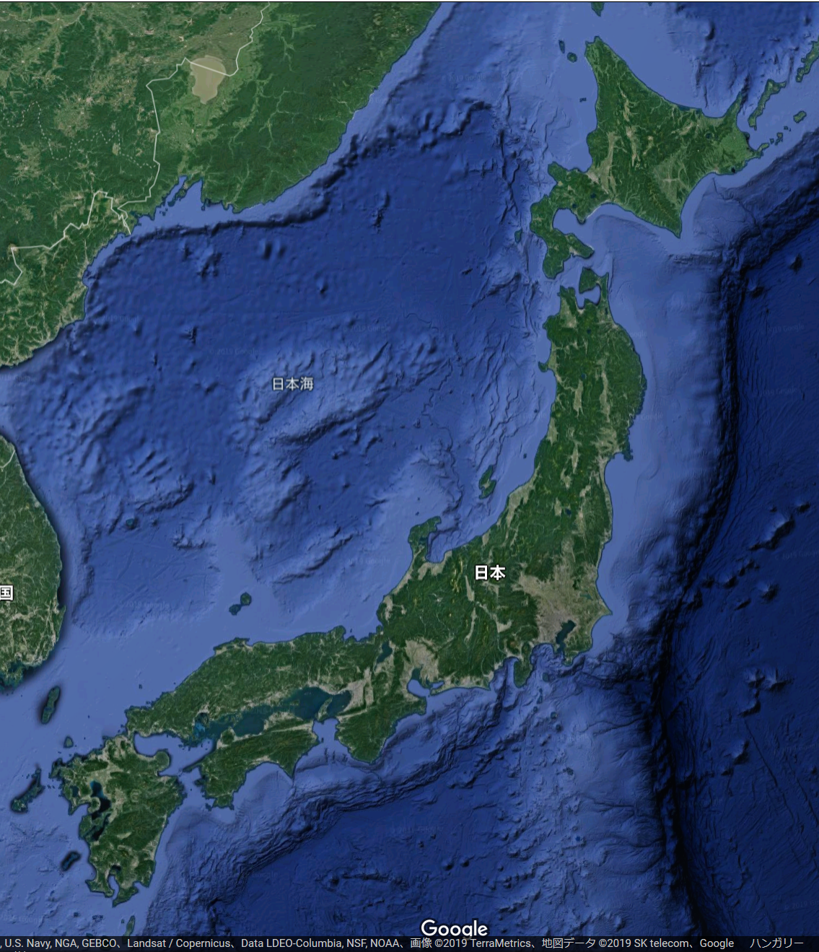

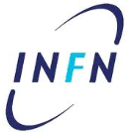









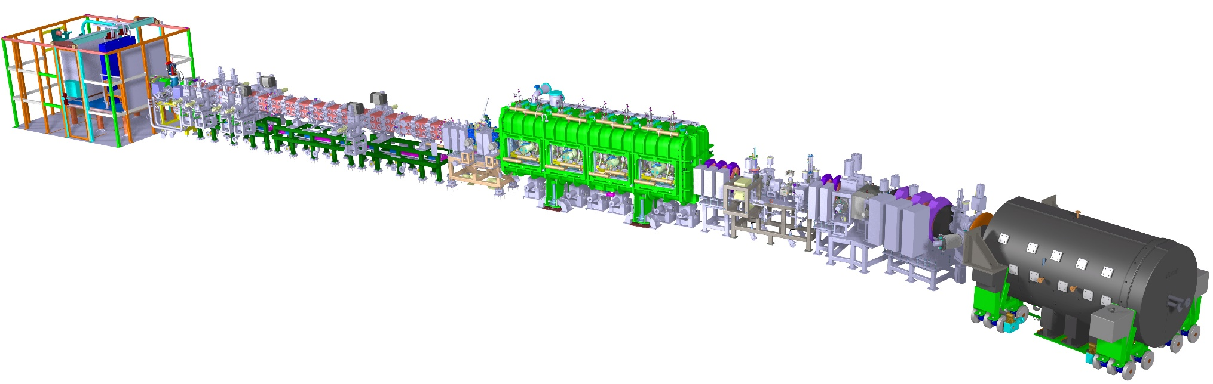

LIPAc Engineering Validation in Rokkasho
Japan-Europe scientific collaboration
based on in-kind contribution
under BA framework
Rokkasho
Ion Source LEBT
CEA
Cryoplant
CEA, QST
RFQ
INFN, F4E, QST
MEBT
CIEMAT
SRF Linac
CEA,
CIEMAT, F4E
HEBT
CIEMAT, F4E
Control System
QST,
CIEMAT,
CEA,
INFN,
F4E
36 m
RF Power System
CIEMAT,
CEA,
SCK·CEN
Diagnostics
CEA,
CIEMAT, INFN
Building, Auxiliaries,
System Installation
QST
BD
CIEMAT, F4E

Slide 11
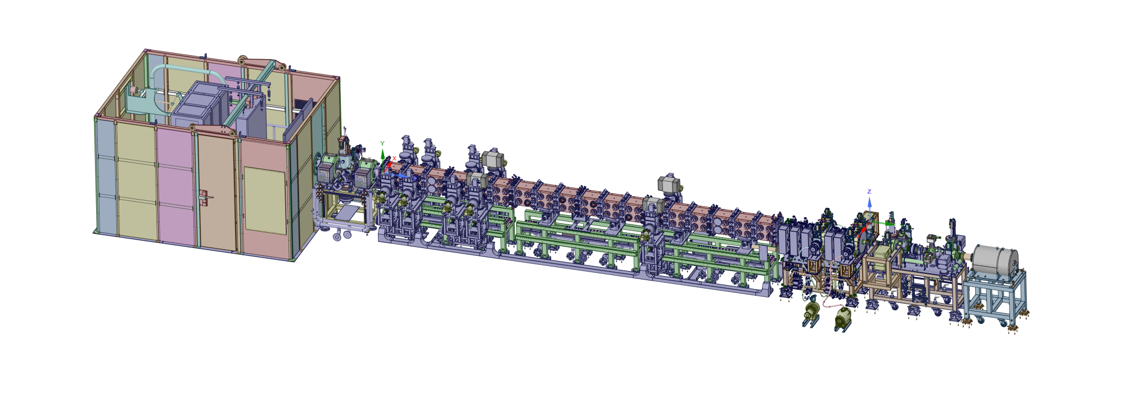
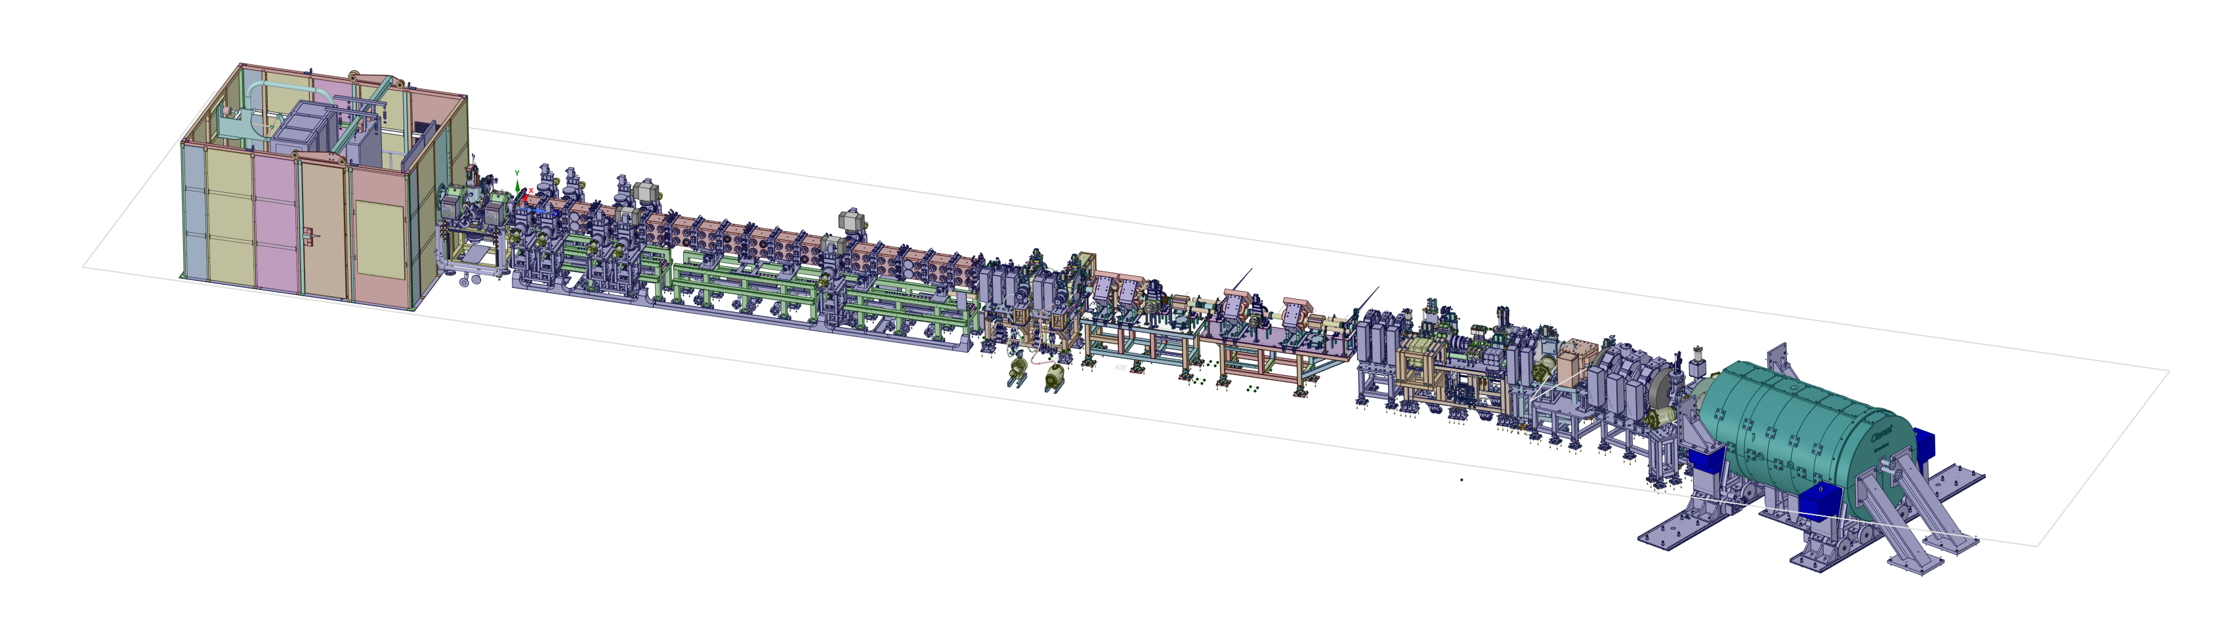
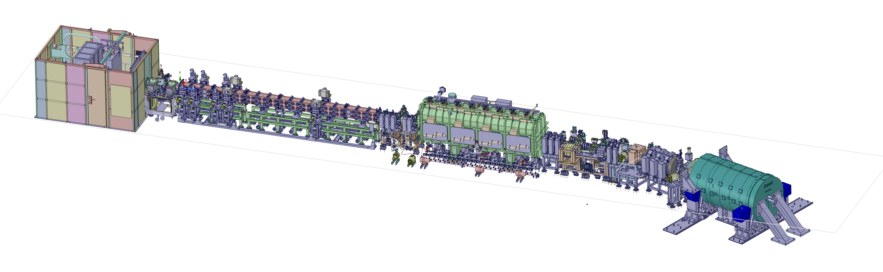
Stepped approach toward CW/9MeV
MEBT
(Medium Energy
Beam Transport)
LPBD (Low Power Beam Dump)
up to 1 ms (0.625 kW)
Phase-B
RFQ
1st proton beam: 13 June 2018
1st deuteron beam: 11 March 2019
Completed in Aug 2019
5 MeV
D-Plate
(Diagnostic Plate)
Phase-B+
RFQ
MEBT
Beam dump
0.625 MW, CW
D-Plate
HEBT
5 MeV
Started
in July 2021
Beam transport line
Phase-C
RFQ
MEBT
D-Plate
Beam dump
1.125MW, CW
HEBT
5 MeV
SRF
9 MeV

Slide 12
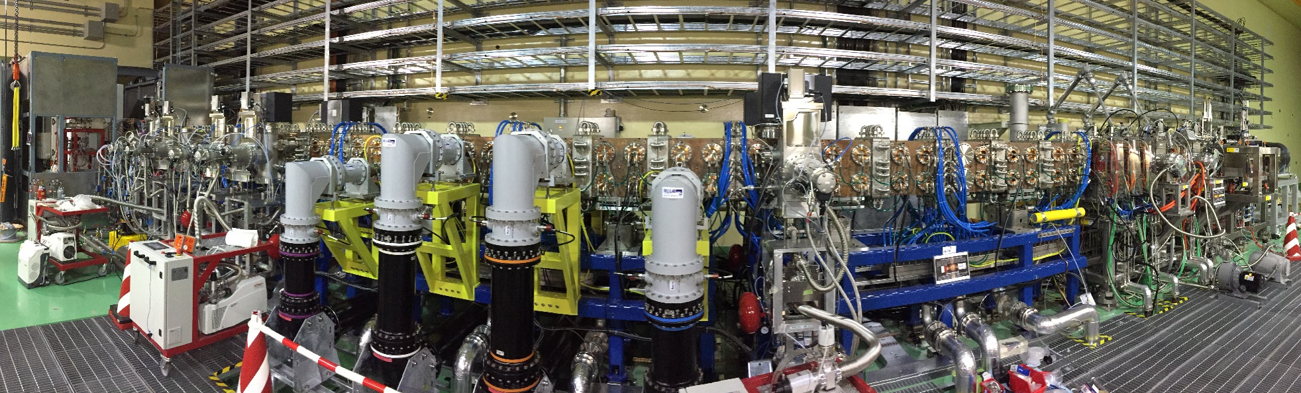
LIPAc installation for Phase-B
Injector
RF coupler
MEBT
LPBD
RFQ
10 Cryopumps
5 Quadrupoles,
2 Bunchers
Diagnostic Plate
Coaxial RF wave guides
LIPAc RFQ is the world longest (9.8 m) and delivering the highest power in the world
(5 MeV x 125 mA = 0.625 MW). 125 mA deuteron beam (1 ms, 1 Hz) acceleration was successfully achieved on July 24, 2019 first time in the world.
RF is injected from eight different RF couplers.
MEBT has two bunchers that perform matching to SRF.

Slide 13
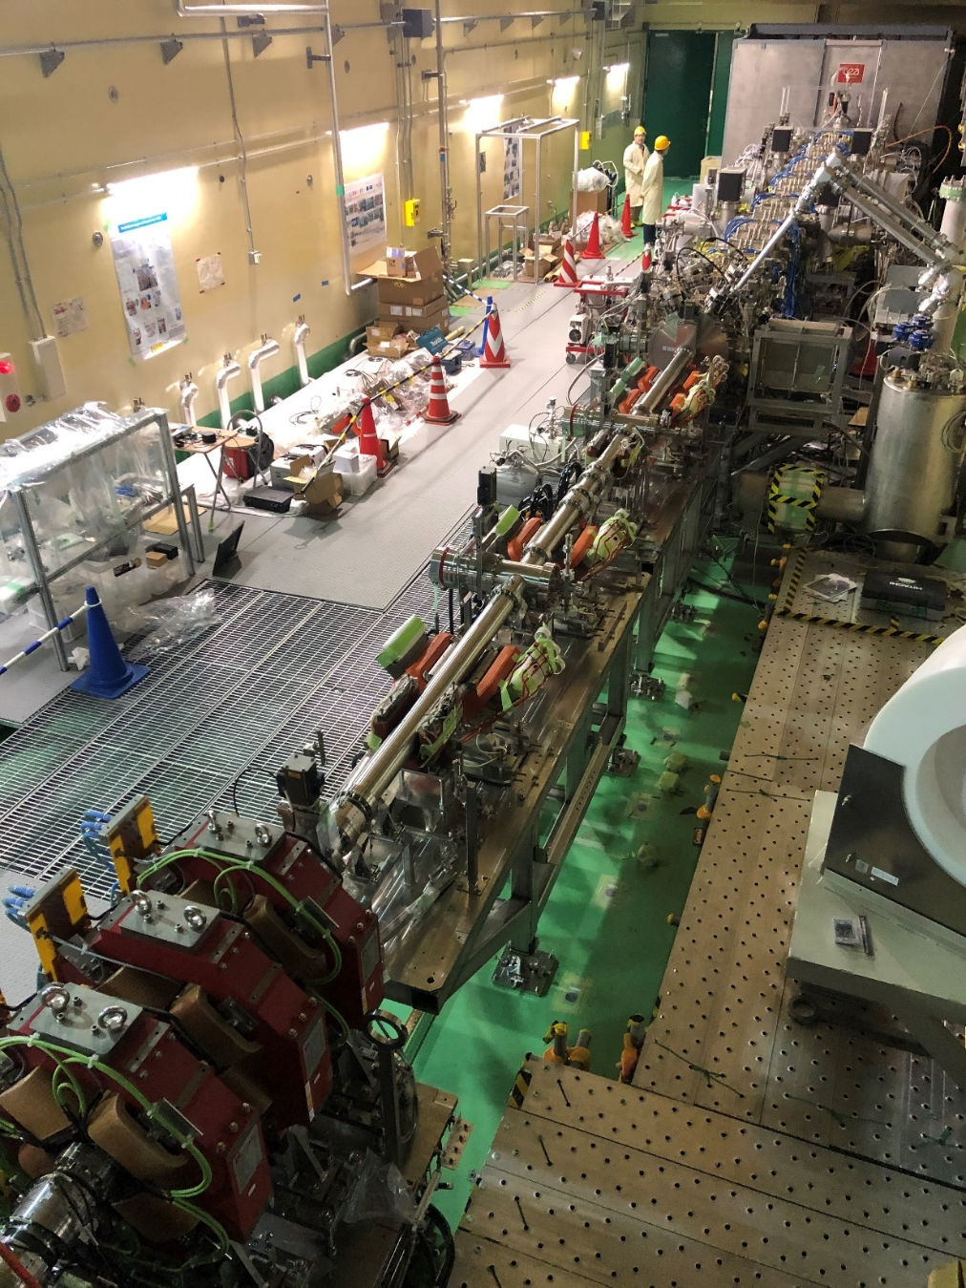
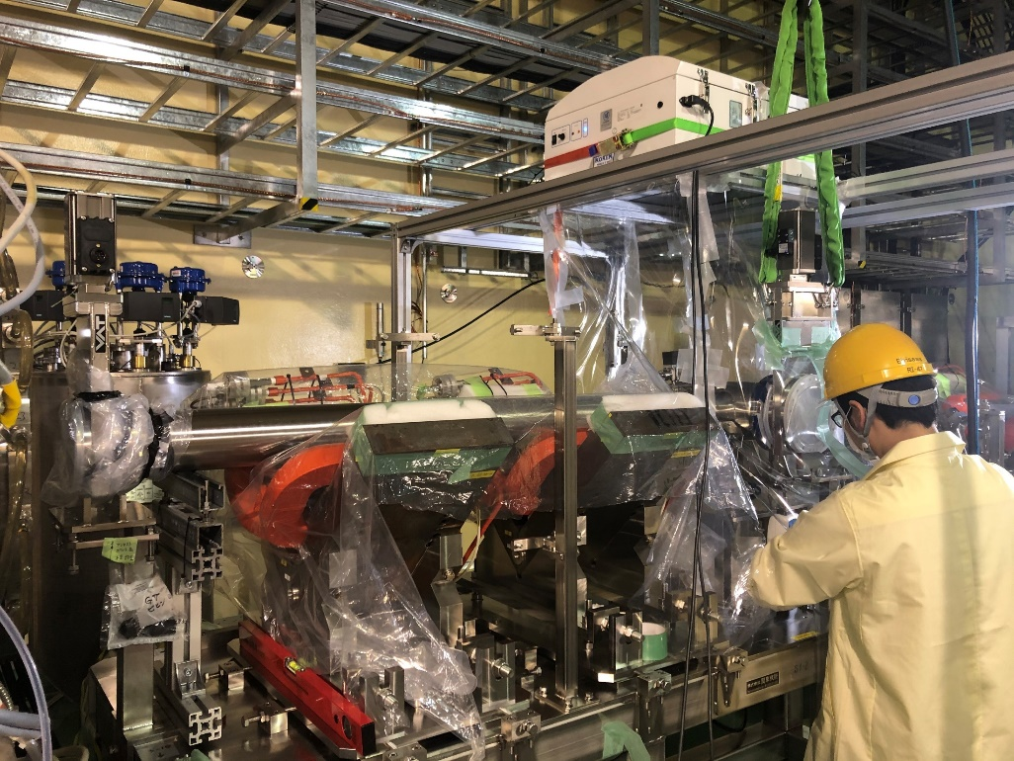
Phase-B+ beam line construction
Construction of the MEBT extension line (MEL), connecting MEBT and HEBT, started 2019 summer and completed in Mar 2020.
MEL enables the beam injection to the high-power beam dump that can accept 1 MW, CW beam.
Great care was taken to avoid the contamination in MEBT and HEBT and kept its cleanliness during the installation.
MEBT exit
HEBT entrace
Construction of the beam line
in local clean unit.
MEBT extension line

Slide 14
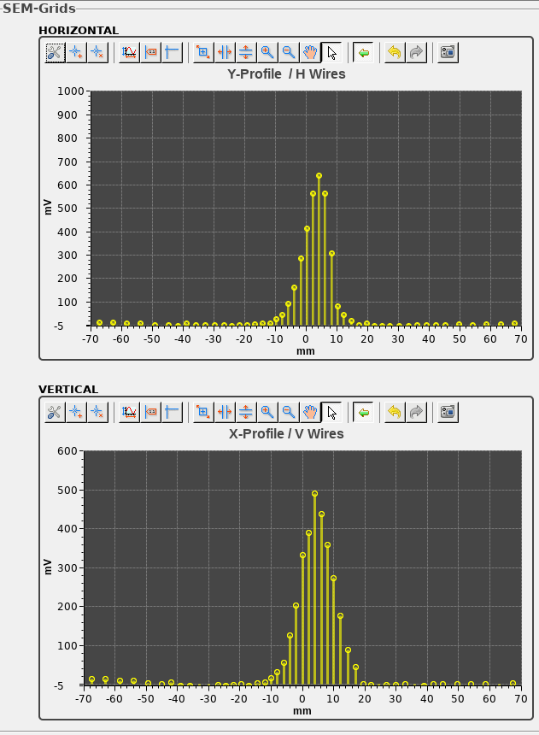
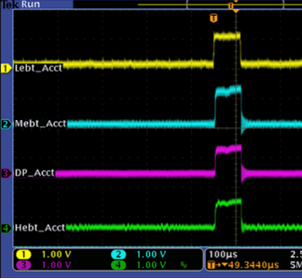
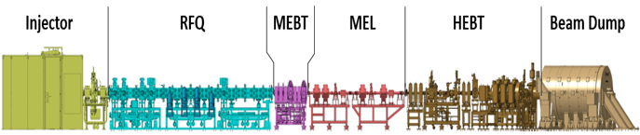
COVID and preparation for Phase-B+
COVID significantly impacted on the check out of HEBT and BD.
On-site staff finished the HEBT/BD system commissioning with the assistance of Spanish experts via remote connection.
Effort was paid on training of the onsite staff, documentation and preparation of data sharing with Europe.
Finally, the beam injection into the beam dump were carried out in July 2021. The real-time data sharing system was employed to connect with European research institutes over the Internet.
The characterization of the beam with
short pulse was completed
by the end of 2021.
100 μs
~ 16 mA

Slide 15
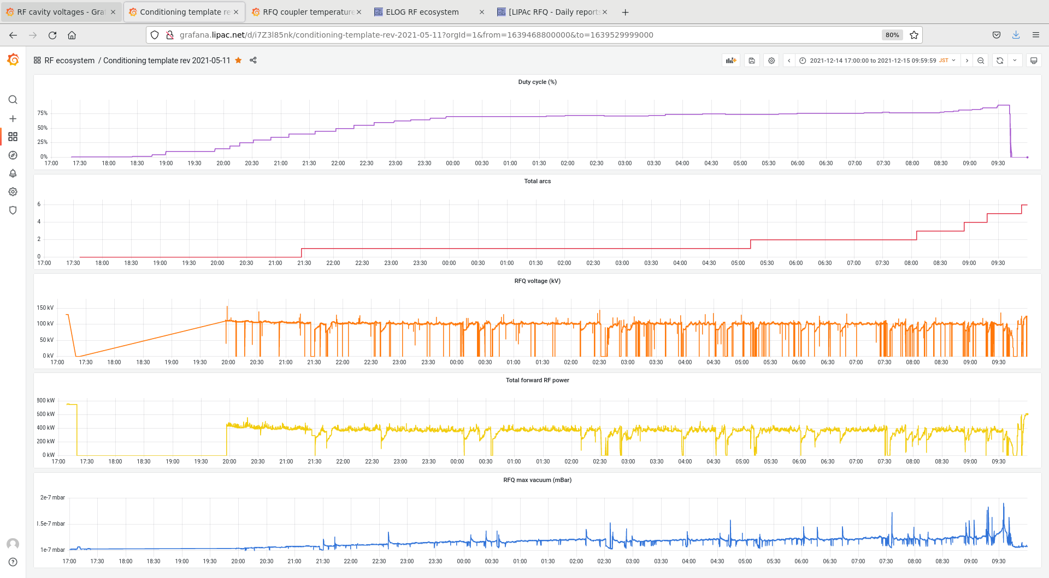
RFQ cavity conditioning towards CW
Completed RF conditioning of the RFQ cavity up to 25% duty (pulse width 5 ms, repetition 50 Hz) at the nominal vane voltage of 132 kV for deuteron acceleration.
Successfully achieved steady-state (CW) injection of RF at 80% of the nominal voltage (about 105 kV) by the end of 2021. RF characteristics and cooling functions were confirmed to be working as designed.
→ Demonstrate that LIPAc RFQ is capable of steady-state operation
→ Important step for the beam commissioning targeting CW !
90%
Duty Cycle
17:00
09:30
RF power
~ 400 kW
Vacuum

Slide 16
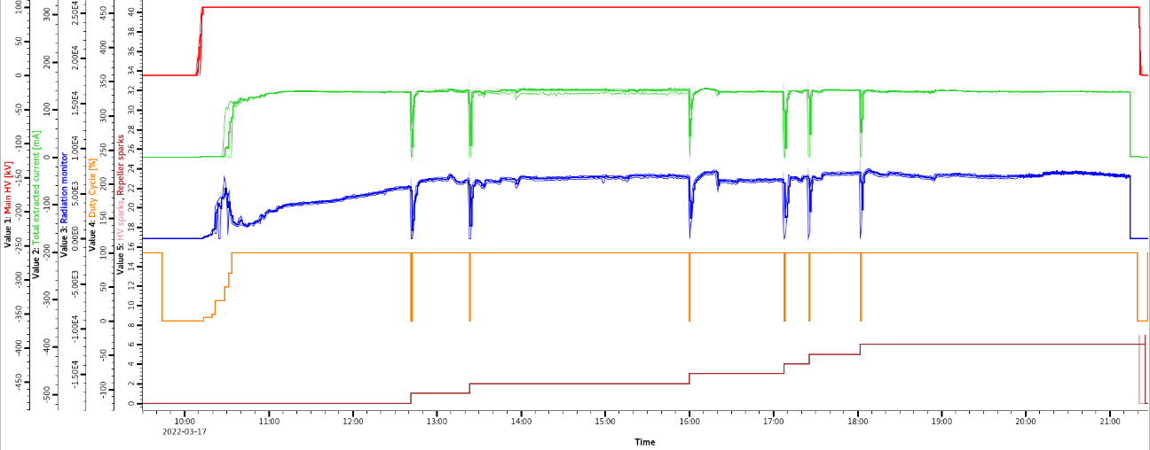
Injector operation at high current, CW
Injector is tested for CW at high current (150-160 mA required)
Successfully completed long-time continuous CW operation tests at 140 mA and 150 mA beam current (CW operation for > 10 hours )
CW operation at 160 mA extraction achieved in July 2022. Continued optimization for stable operation over long periods
Total extracted current
Measured Current
Duty cycle
Neutron production
Trend during long-time CW operation tests of the injector at 140 mA

Slide 17
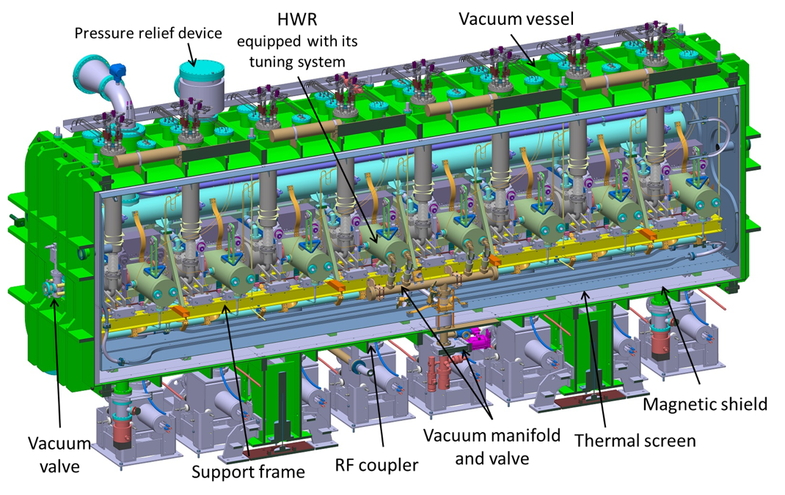
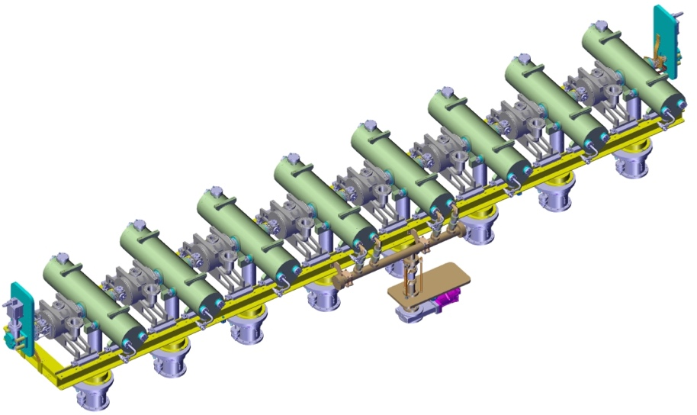
LIPAc Cryomodule
Design under CEA/Saclay responsibility as well as procurement of the individuals components except the solenoid packages designed and procured by CIEMAT.
Eight half-wave resonators
  175 MHz, β=0.094
  E_{acc-nom} = 4.5 MV/m, Q₀ ≥ 5×10⁸
  Operating temperature: 4.4 K
Power Couplers
  Designed to handle 200 kW CW
  70 kW CW maximum on LIPAc
Eight superconducting solenoid packages
  Two-nested solenoids to focus the beam (6T) with reduced fringe field (20 mT on cavity flange)
  Two steerers for horizontal and vertical orbits
  Beam position monitor (BPM)
Cavity string, Cold mass
Cavity
Solenoid
Cold-Warm
transition
Cavity pumping line
Power coupler

Slide 18
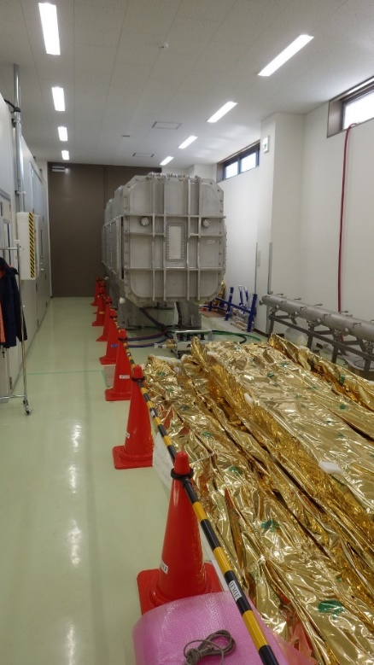
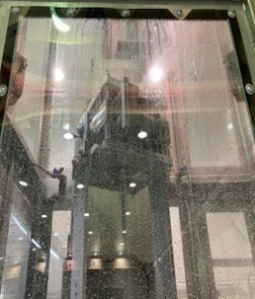
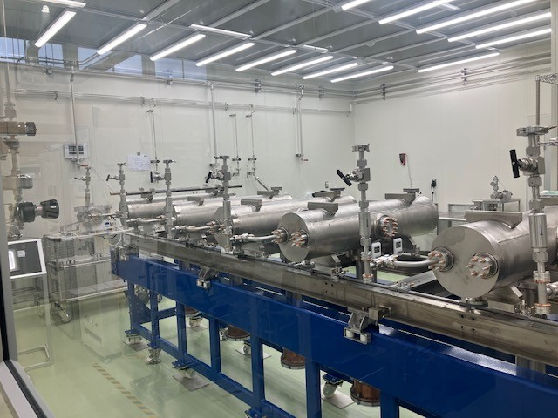
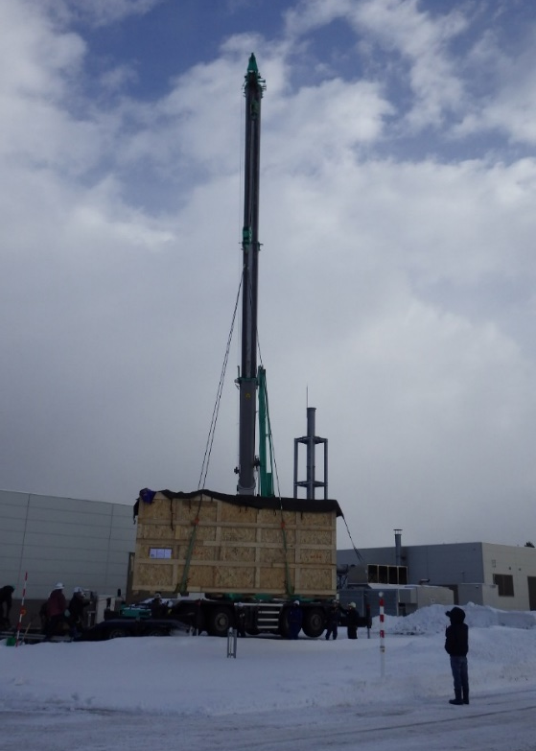
Cryomodule assembly
Most of the cryomodule components (cavity, power coupler, and cryostat) were delivered to Rokkasho by March 2019, and the solenoids arrived by the end of 2021 finally.
QST are taking the responsibility to prepare the infrastructure and F4E to assemble the Cryomodule with the support of the experts from CEA and KEK.
Assembly of the cryomodule is resumed in Aug 2022!
  → Details will be presented in WG2 on 12th by Janic (F4E) and Ebisawa-san (QST)
Cryostat
Tooling ready in clean room
Phase separateor
Solenoid package
Cryostat arrived at
Rokkasho
Thermal shield
Solenoid HPR at MHI
in Apr-June 2022
Cavity-coupler connection completed
in Sep 2022
20 Feb 2018
Cavity-coupler assembled

Slide 19
Summary
Validation of Linear IFMIF Prototype Accelerator (LIPAc) is ongoing at QST Rokkasho Fusion Institute in collaboration with EU and Japan.
LIPAc RFQ demonstrated that 125 mA, 5 MeV deuteron acceleration with short pulses in 2019 first time in the world.
Due to COVID outbreak, there was a delay of about 1 year, nevertheless the new beam line, including MEL, HEBT and the beam dump, to operate RFQ at CW was completed by intense collaboration with Europe experts remotely.
First deuteron beam was injected into the beam dump in July 2021, and the result is promising. Commissioning is progressing to achieve the nominal current and longer pulse operation targeting CW.
Finally, the assembly of SRF cryomodule is resumed in Aug 2022!

