Slide 1
Mid-T Bakes on Multi-mode Coaxial Cavities
TTC Aomori 2022
Philipp Kolb,
RuthAnn Gregory, Mattias McMullin, Zhongyuan Yao, Tobias Junginger, Robert Laxdal
Frequency and field resolved TEM mode cavity performance characterizations with different treatments
Philipp Kolb

Slide 2
Outline
Motivation
Cavities
Mid-T bakes vs 120C/48h on BCP’ed cavities
Magnetic field sensitivities
Summary & Outlook
Notes:
I’ll be talking about what motivated this study and the cavities we’re using. Then I’ll be going into the latest results from the halfwave cavity and combine this with the quarterwave data to show you some results of the frequency dependence of the resistance parameters. To finish up, I’ll show some results of the first Nitrogen infusion test of the our quarterwave cavity.

Slide 3
Motivation
Great improvements on Q₀ and E_{acc} in recent years
N2 doping & infusion, two-step baking, mid-T bakes, Nb3Sn…
But research is focused on 1.3GHz, elliptical cavities for big projects like LCLS-II, SHINE, ILC… operating around 2.0K.
Question: What about low frequency, TEM mode cavities like QWR & HWR, typically operating at low frequency, 4.2K, and are BCPed, not EPed?
Question: Do different geometry leads to different sensitivities to magnetic fields? Does a different cooldown scheme help expel magnetic flux?
Question: Do we find the origin and mitigation strategies of medium field Q slope in TEM cavities?

Slide 4
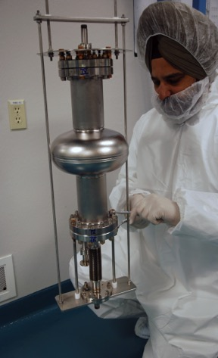
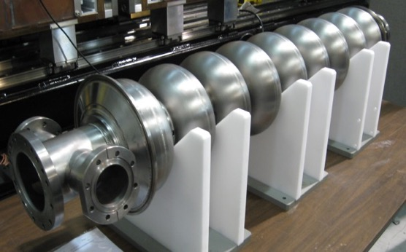
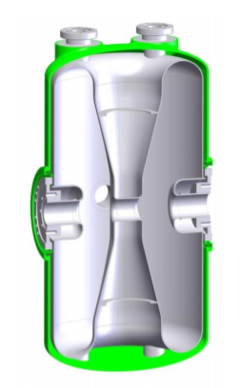
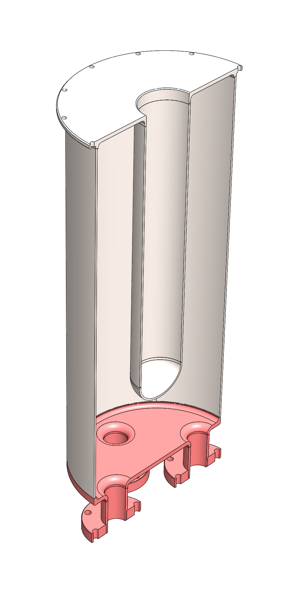
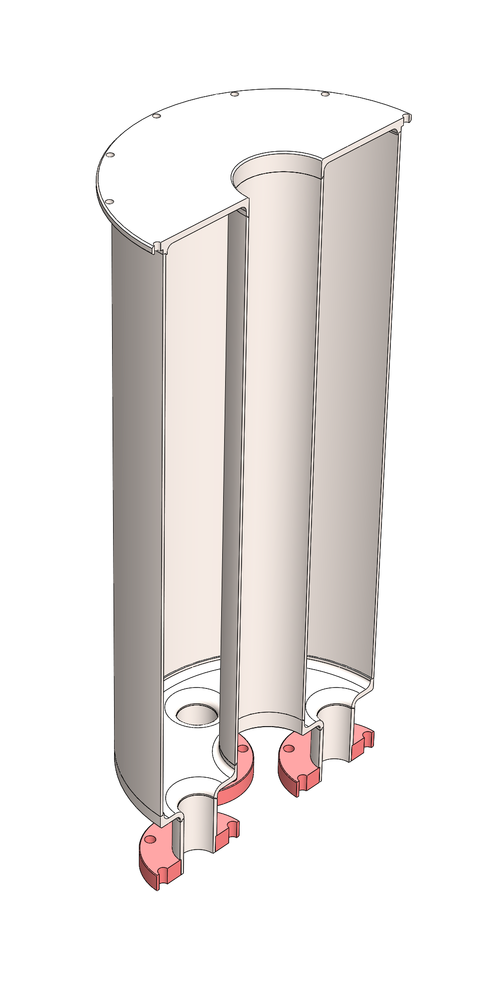
TEM Cavity equivalent to single cell elliptical cavities
ARIEL Tesla style
1.3GHz nine-cell elliptical cavity
Single cell
1.3GHz elliptical cavity
?
ISAC-II QWR
FRIB HWR

Slide 5
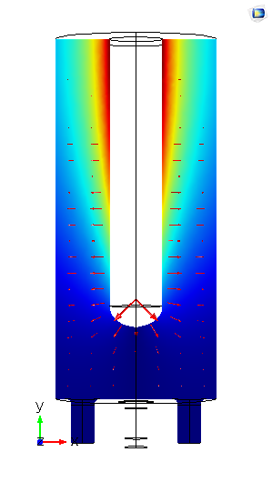
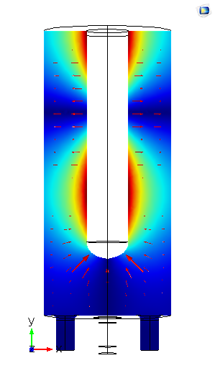
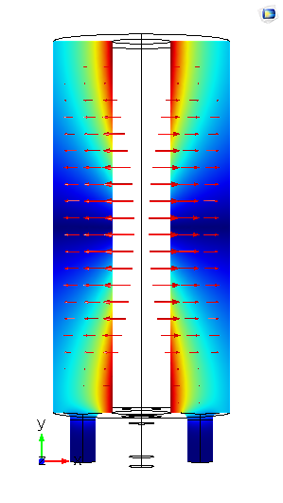
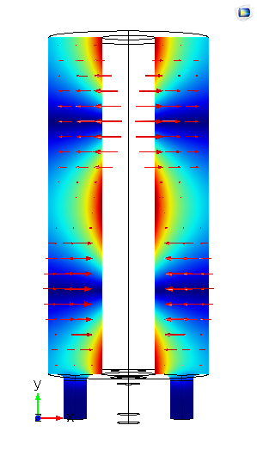
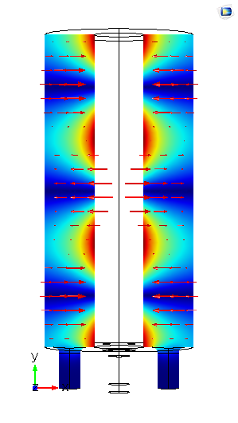
Coax Test Cavities
40cm
Designed and build two coax cavities, QWR and HWR, with a similar purpose & size as a 1.3GHz single cell cavity.
No beam ports on cavity, simplifying geometry.
RRR grade Nb for cavity walls, reactor grade for ports/bottom plate (QWR),
No NbTi -> less sources of contamination.
More details in: Phys. Rev. Accel. Beams 23, 122001
Some notes:
$R_{s }(=R_{BCS}(T)+R_{Res})$ is field distribution corrected (see Delayen et al.), better comparable to $R_{s}=G/Q_{0}$ from elliptical cavities.
All data shown is with external magnetic field compensated to $\left|B_{ext}\right|<0.5μT$, unless otherwise stated.
20cm
217MHz
648MHz
389MHz
778MHz
1166MHz
Notes:
To answer these questions we designed two coaxial cavities. One quarter-wave, one halfwave. Roughly same size as a 1.3GHz elliptical cavity and their purpose is similar to a single cell cavity as a test cavity for new treatments. We test them in these TEM resonant modes to get the frequency dependence. We started with the QWR, but now the HWR is catching up and we’ll get a large dataset of surface resistance data at different frequencies.

Slide 6
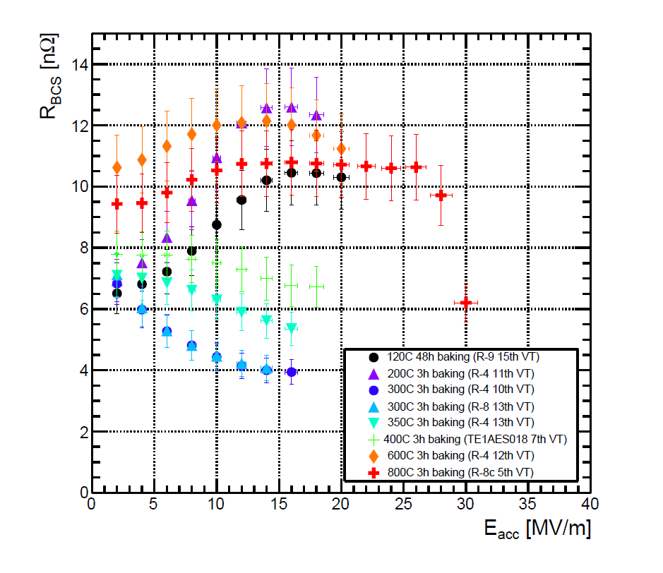
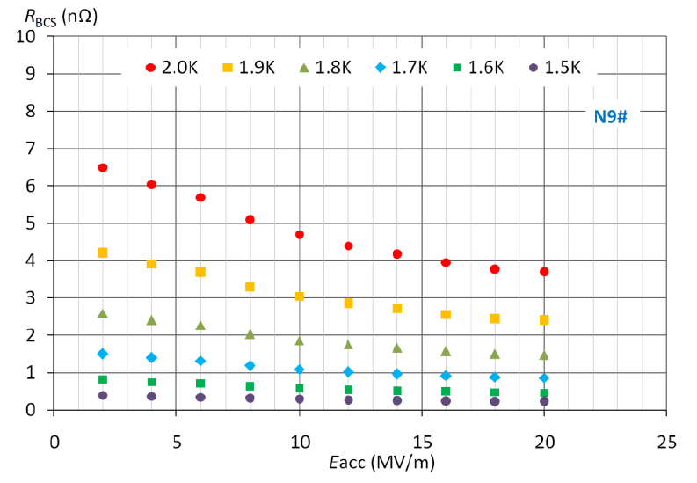
Mid T bake - 250 to 400°C
Mid T bakes between 250 and 400 °C on EP’ed elliptical 1.3GHz cavities have been shown to increase $Q_{0}$ with rising RF field.
Rise in $Q_{0}$ is attributed to a decrease in $R_{BCS}$ with low $R_{Res}$.
Very promising heat treatment for heavy ion accelerators like the ISAC-II LINAC at TRIUMF, operating at 4K where $R_{BCS}$ is typically dominant.
Q: does this translate to BCP’ed cavities with low frequencies in a different geometry?
H. Ito et al, arXiv:2101.11892v1
F. He et al, arXiv:2012.04817

Slide 7
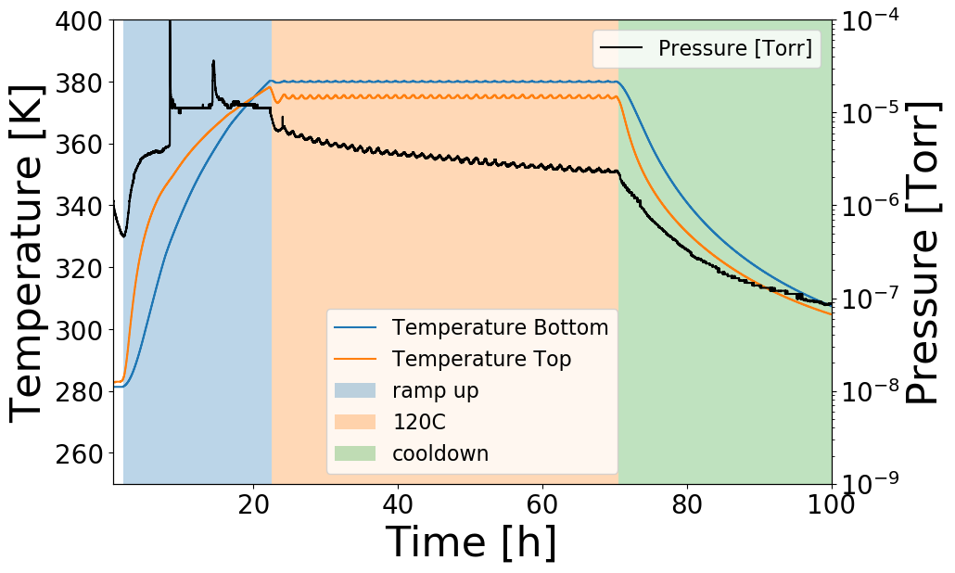
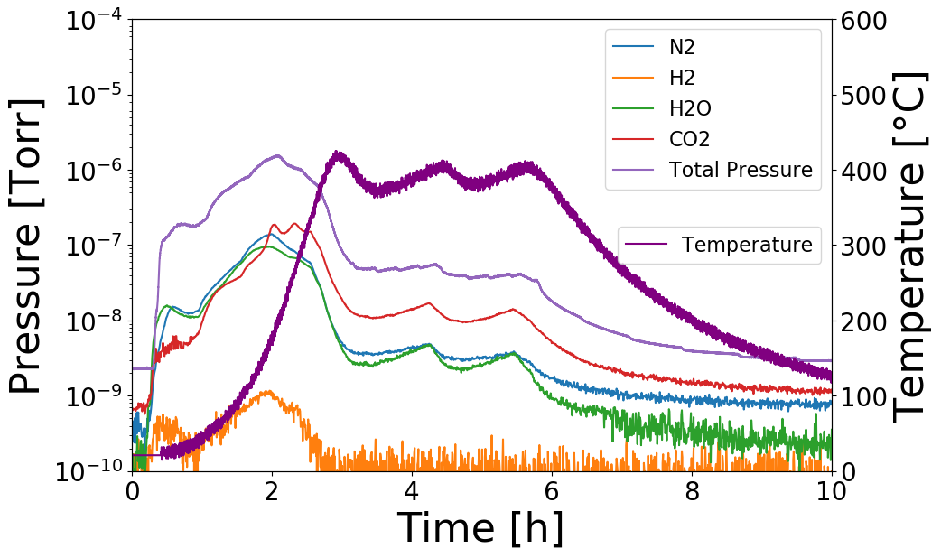
Cavity Treatments Discussed
120C/48h QWR
Baseline:
800 °C for 5-6h for hydrogen degassing
15$μ$m flash BCP
120 °C/48h:
Baseline + In-situ bake for 48h inside cryostat – no air exposure before measurement
Mid-T bakes - 400(300) °C/3h
Surface reset with 15$μm$ BCP
UHV induction furnace heat treatment
Caps on flanges
Air exposure before HPR and clean assembly
No chemistry after heat treatment
400C/3h HWR

Slide 8
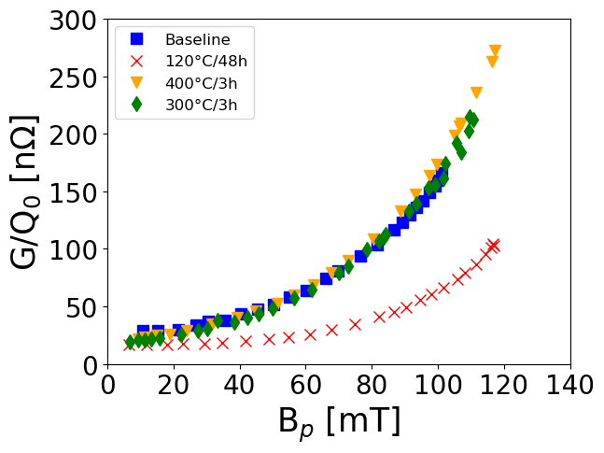
Long story short: not at low frequencies & 4K
$R_{BCS}$ dominated 4K regime, 120 °C/48h low temp bake significantly better. Both mid-T bakes similar performance as baseline (flash BCP)
QWR Fundamental mode @ 217MHz
Extracted from R(T) data

Slide 9
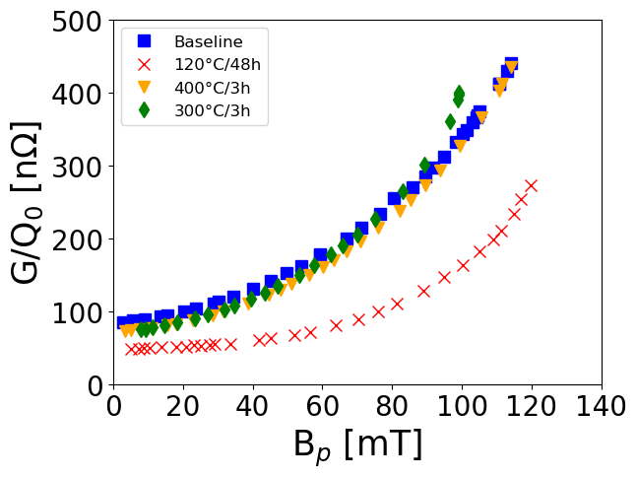
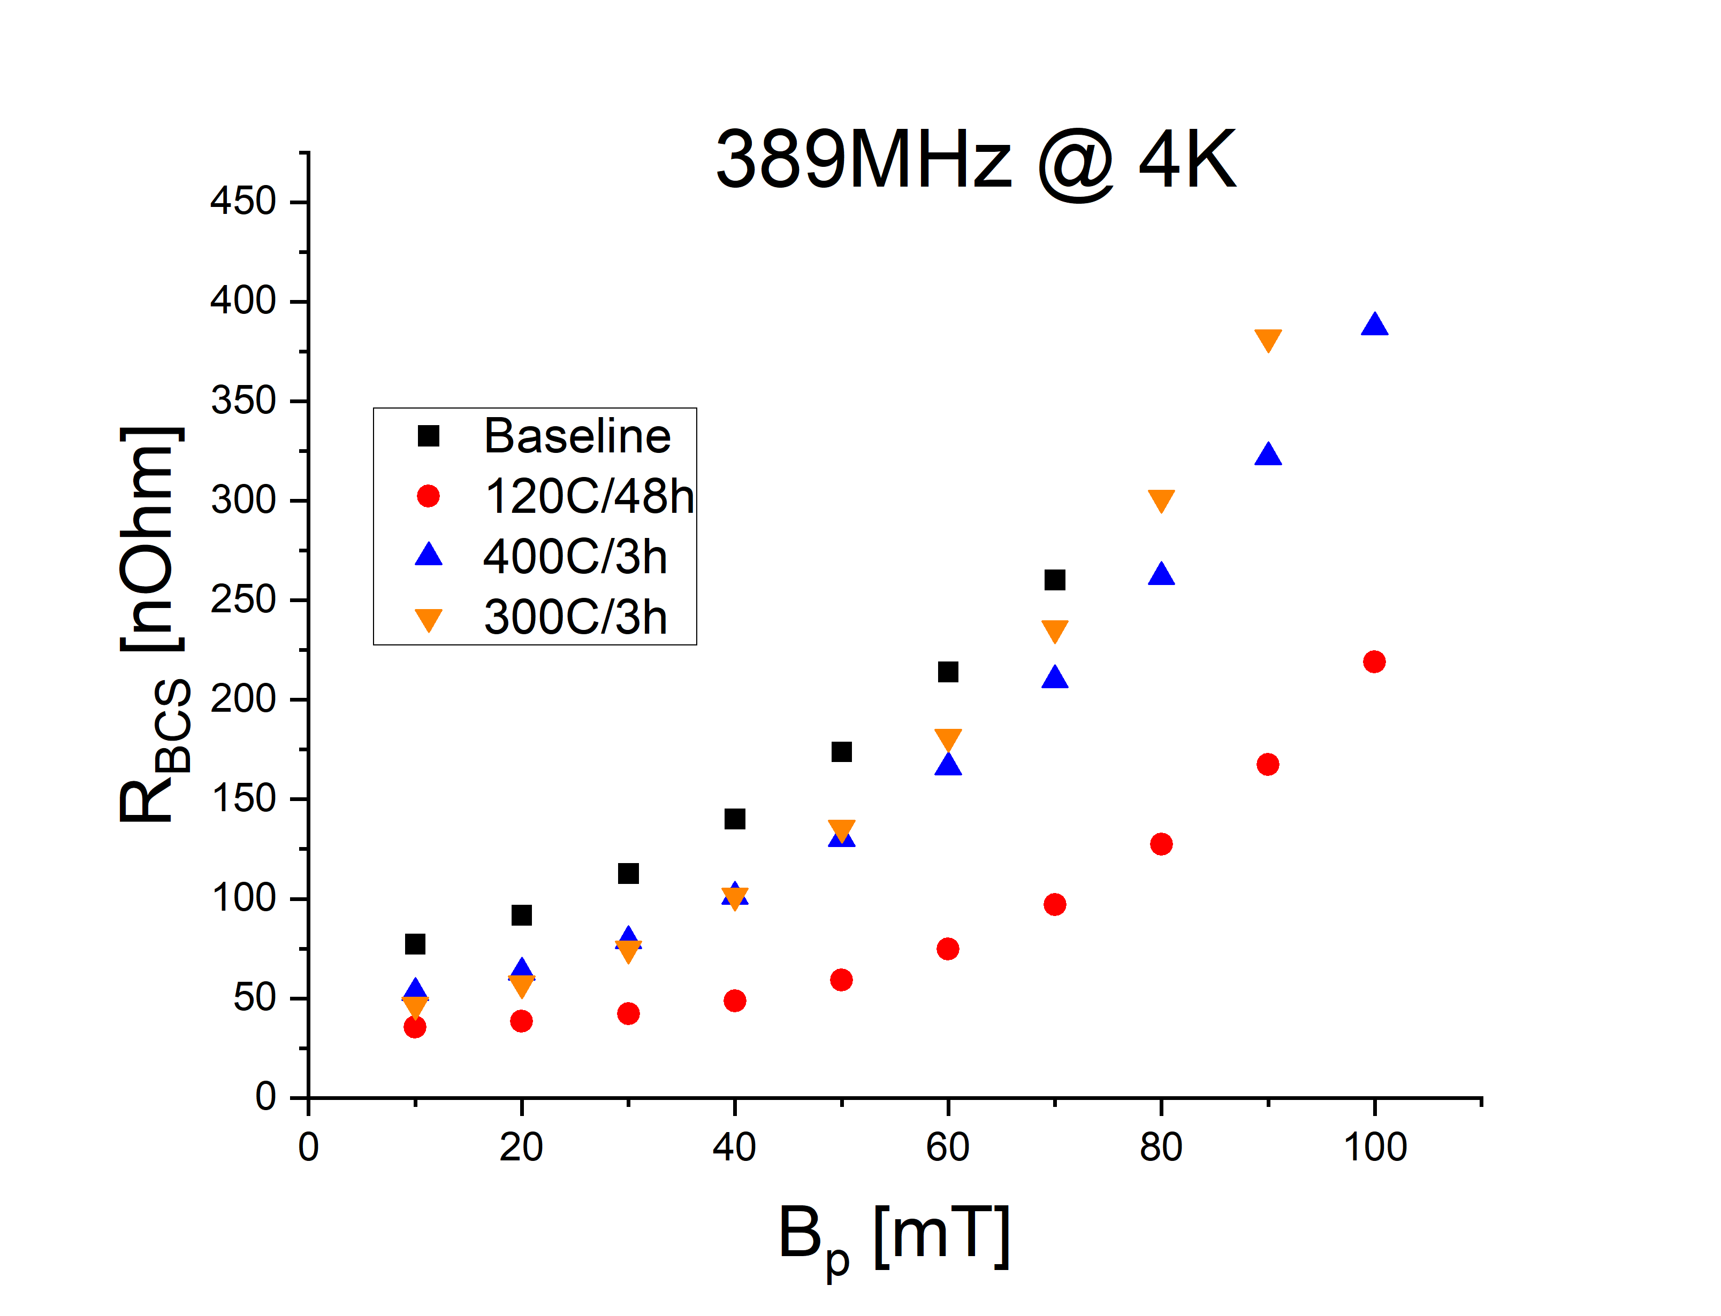
Same for the HWR fundamental mode
HWR Fundamental mode @ 389MHz
Extracted from R(T) data

Slide 10
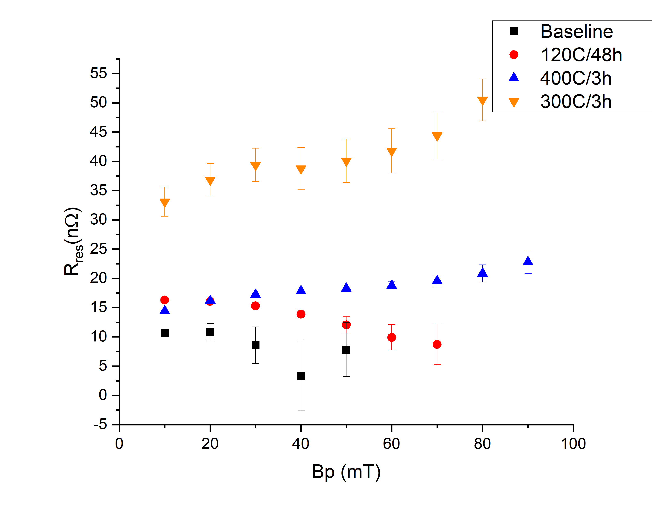
But at high frequency and 2K something interesting happens
$R_{BCS}$ is very low and flat, barely any change with RF field amplitude.
But at a cost of a high $R_{res}$
HWR 3rd mode @ 1166MHz
Extracted from R(T)data

Slide 11
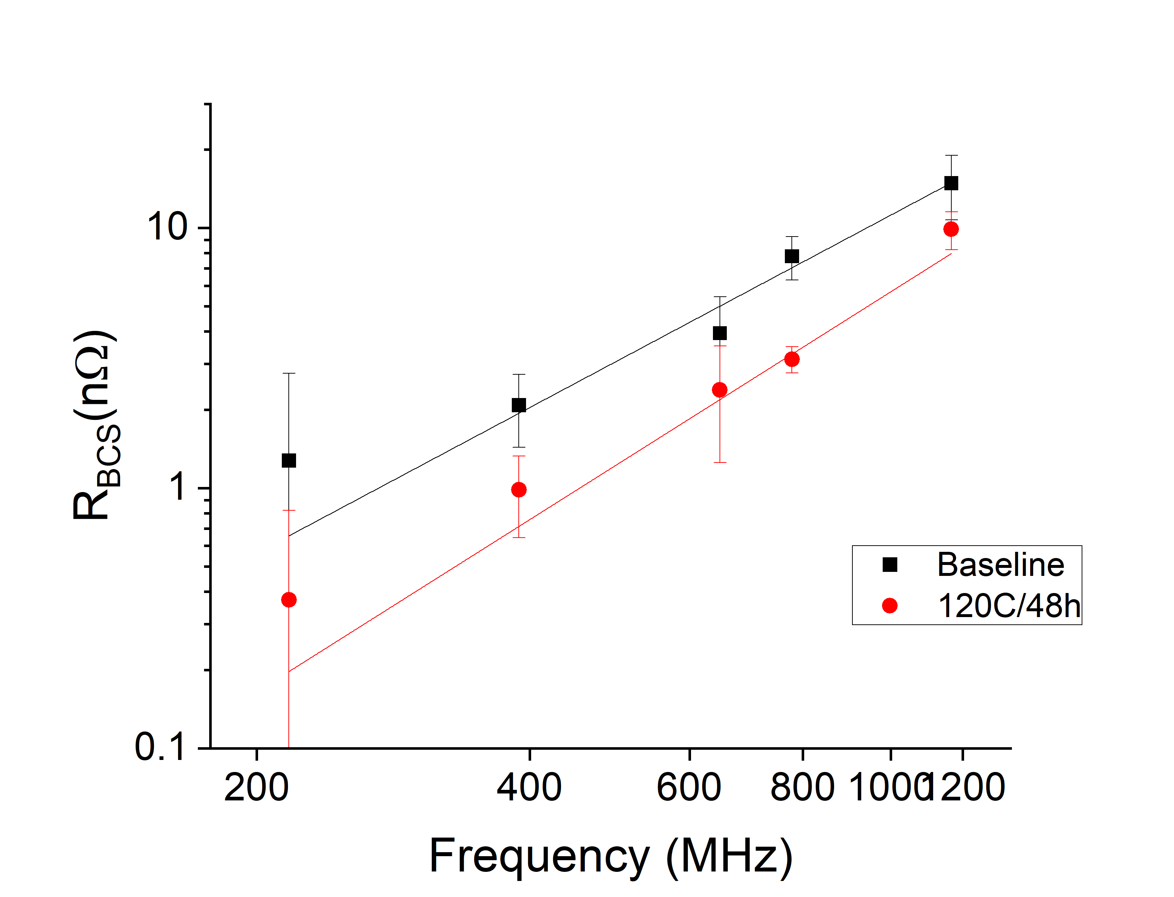
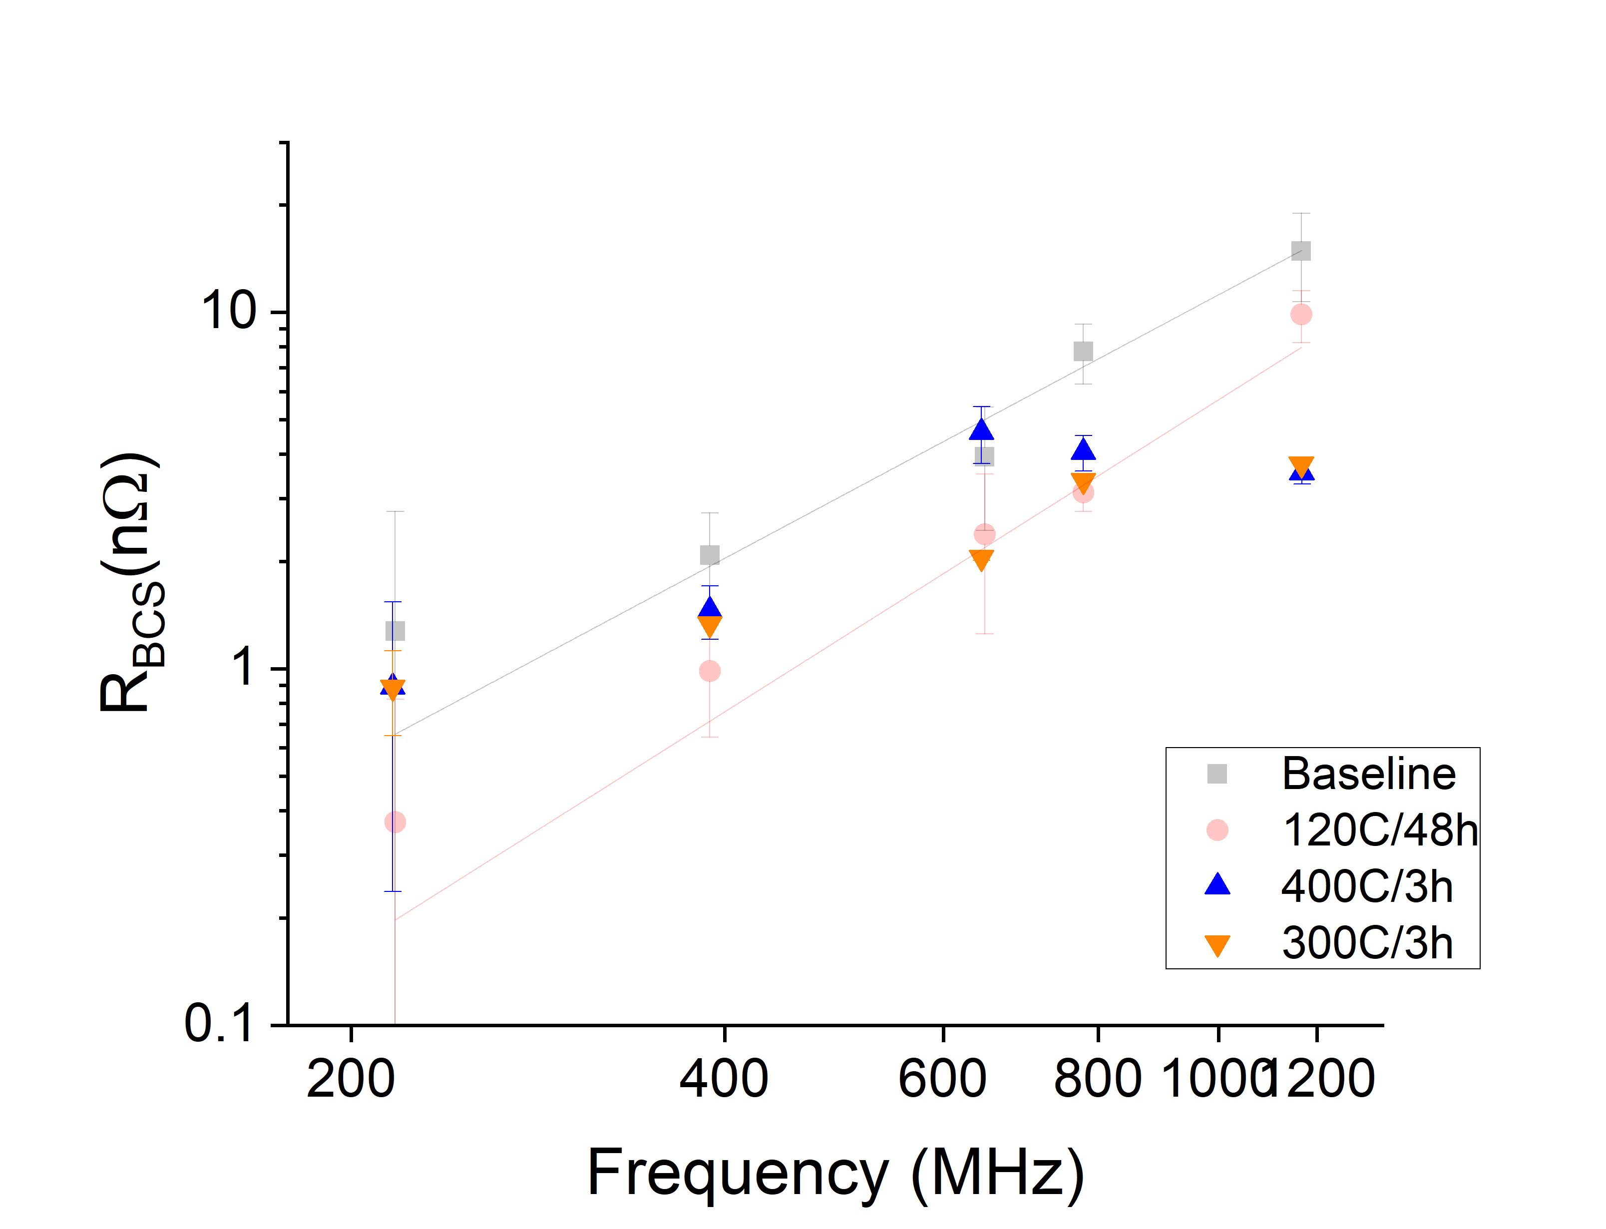
Frequency resolved
$R_{BCS}(ω, T=2K,B_{p}=50mT)$
Baseline and 120 °C/48h follow theoretical pattern.
Data shows that mid-T bake changes frequency response of $R_{BCS}$ differently than Baseline or 120 °C.
Discussion point: Why does the frequency dependence change?

Slide 12
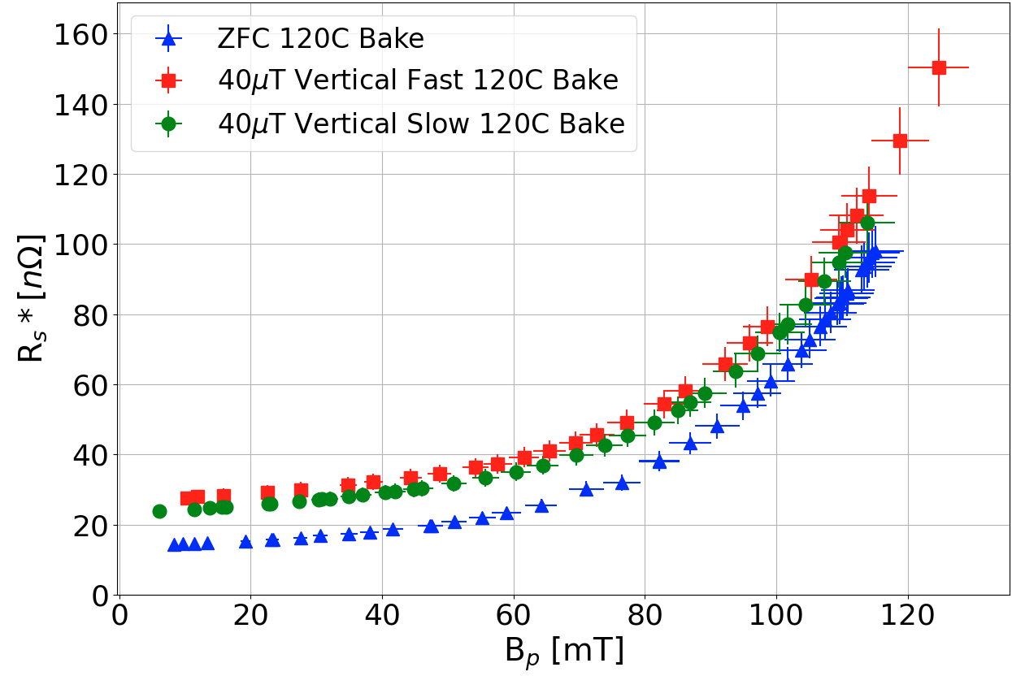
External Magnetic Field Sensitivity Studies
217MHz – 4K
$$G/{Q_{0}}$$
$$G/{Q_{0}}$$
QWR is more sensitive to horizontal field flux trapping with a slow cooldown than a with a fast cooldown.
With vertical field the cooldown speed does not change the performance much - > low sensitivity to trapped flux.

Slide 13
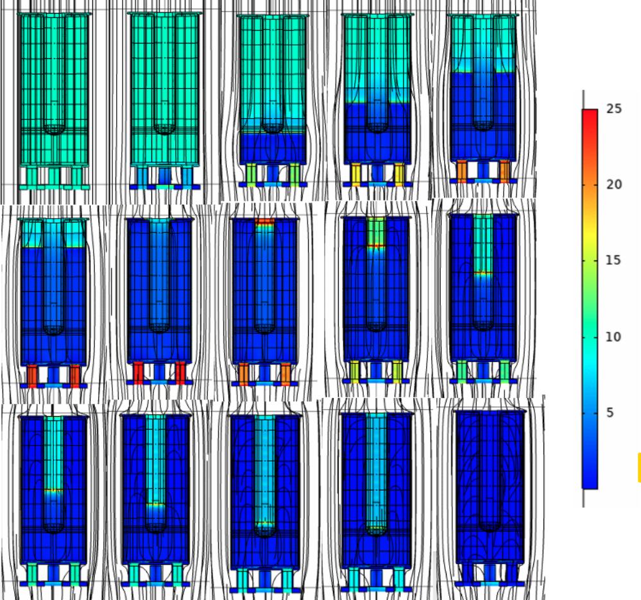
Cooldown flux dynamics - Vertical
Vertical field: flux gets pushed to tip of inner conductor
$→$low $B$ field area
$→$low sensitivity to fast vs slow cooldown – amount of trapped flux not critical.
RF field distribution

Slide 14
Cooldown flux dynamics - Horizontal
Horizontal field cooled: flux gets pushed to the top
high $B$ area
$→$high sensitivity to slow/fast cooldown due to more/less trapped flux
RF field distribution

Slide 15
Findings and summary
Mid-T bake on low frequency (BCPed) cavities:
At 4K: not better than a flash BCP after degassing and worse than 120C/48h.
Mid-T bakes alter frequency dependence. Why?
At frequency > 1GHz, low $R_{BCS}$ - lower than expected. But no decrease with higher RF field.
Ext. Field studies:
QWR sensitive to horizontal fields if the cooldown is slow through $T_{c}$, and effective at expelling flux when the cooldown is fast.
Vertical field sensitivity not strongly correlated with cooldown speed.
Geometry and cooldown dynamics integral to sensitivity.

Slide 16
Thanks!
Thanks go to the people who make things happen in the background:
Bhalwinder Waraich, Ruminder, Sekhon, James Keir, Devon Lang, David Kishi, Johnson Cheung, Ben Matheson…
And you for your attention!

Slide 17
Some references
Summary paper on cavities and methodology: P. Kolb et al: Phys. Rev. Accel. Beams 23, 122001
Cavity design: Z. Yao, SRF2017 TUPB065, LINAC2018
First QWR cold test results: P. Kolb, TTC 2019 Vancouver
Further QWR test results: P. Kolb, SRF2019: TUP046
Baseline results for QWR & HWR: P. Kolb, TTC@Cern 2020
Results from 120C/48h low temperature bake: P. Kolb, TTC 2021

Slide 18
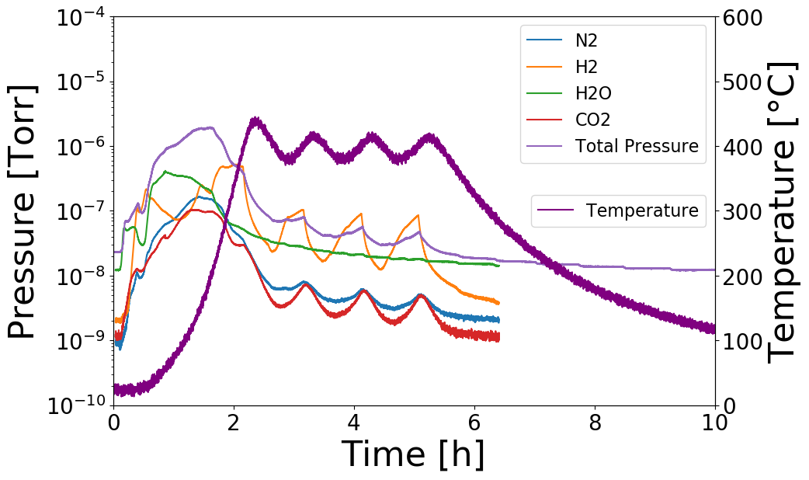
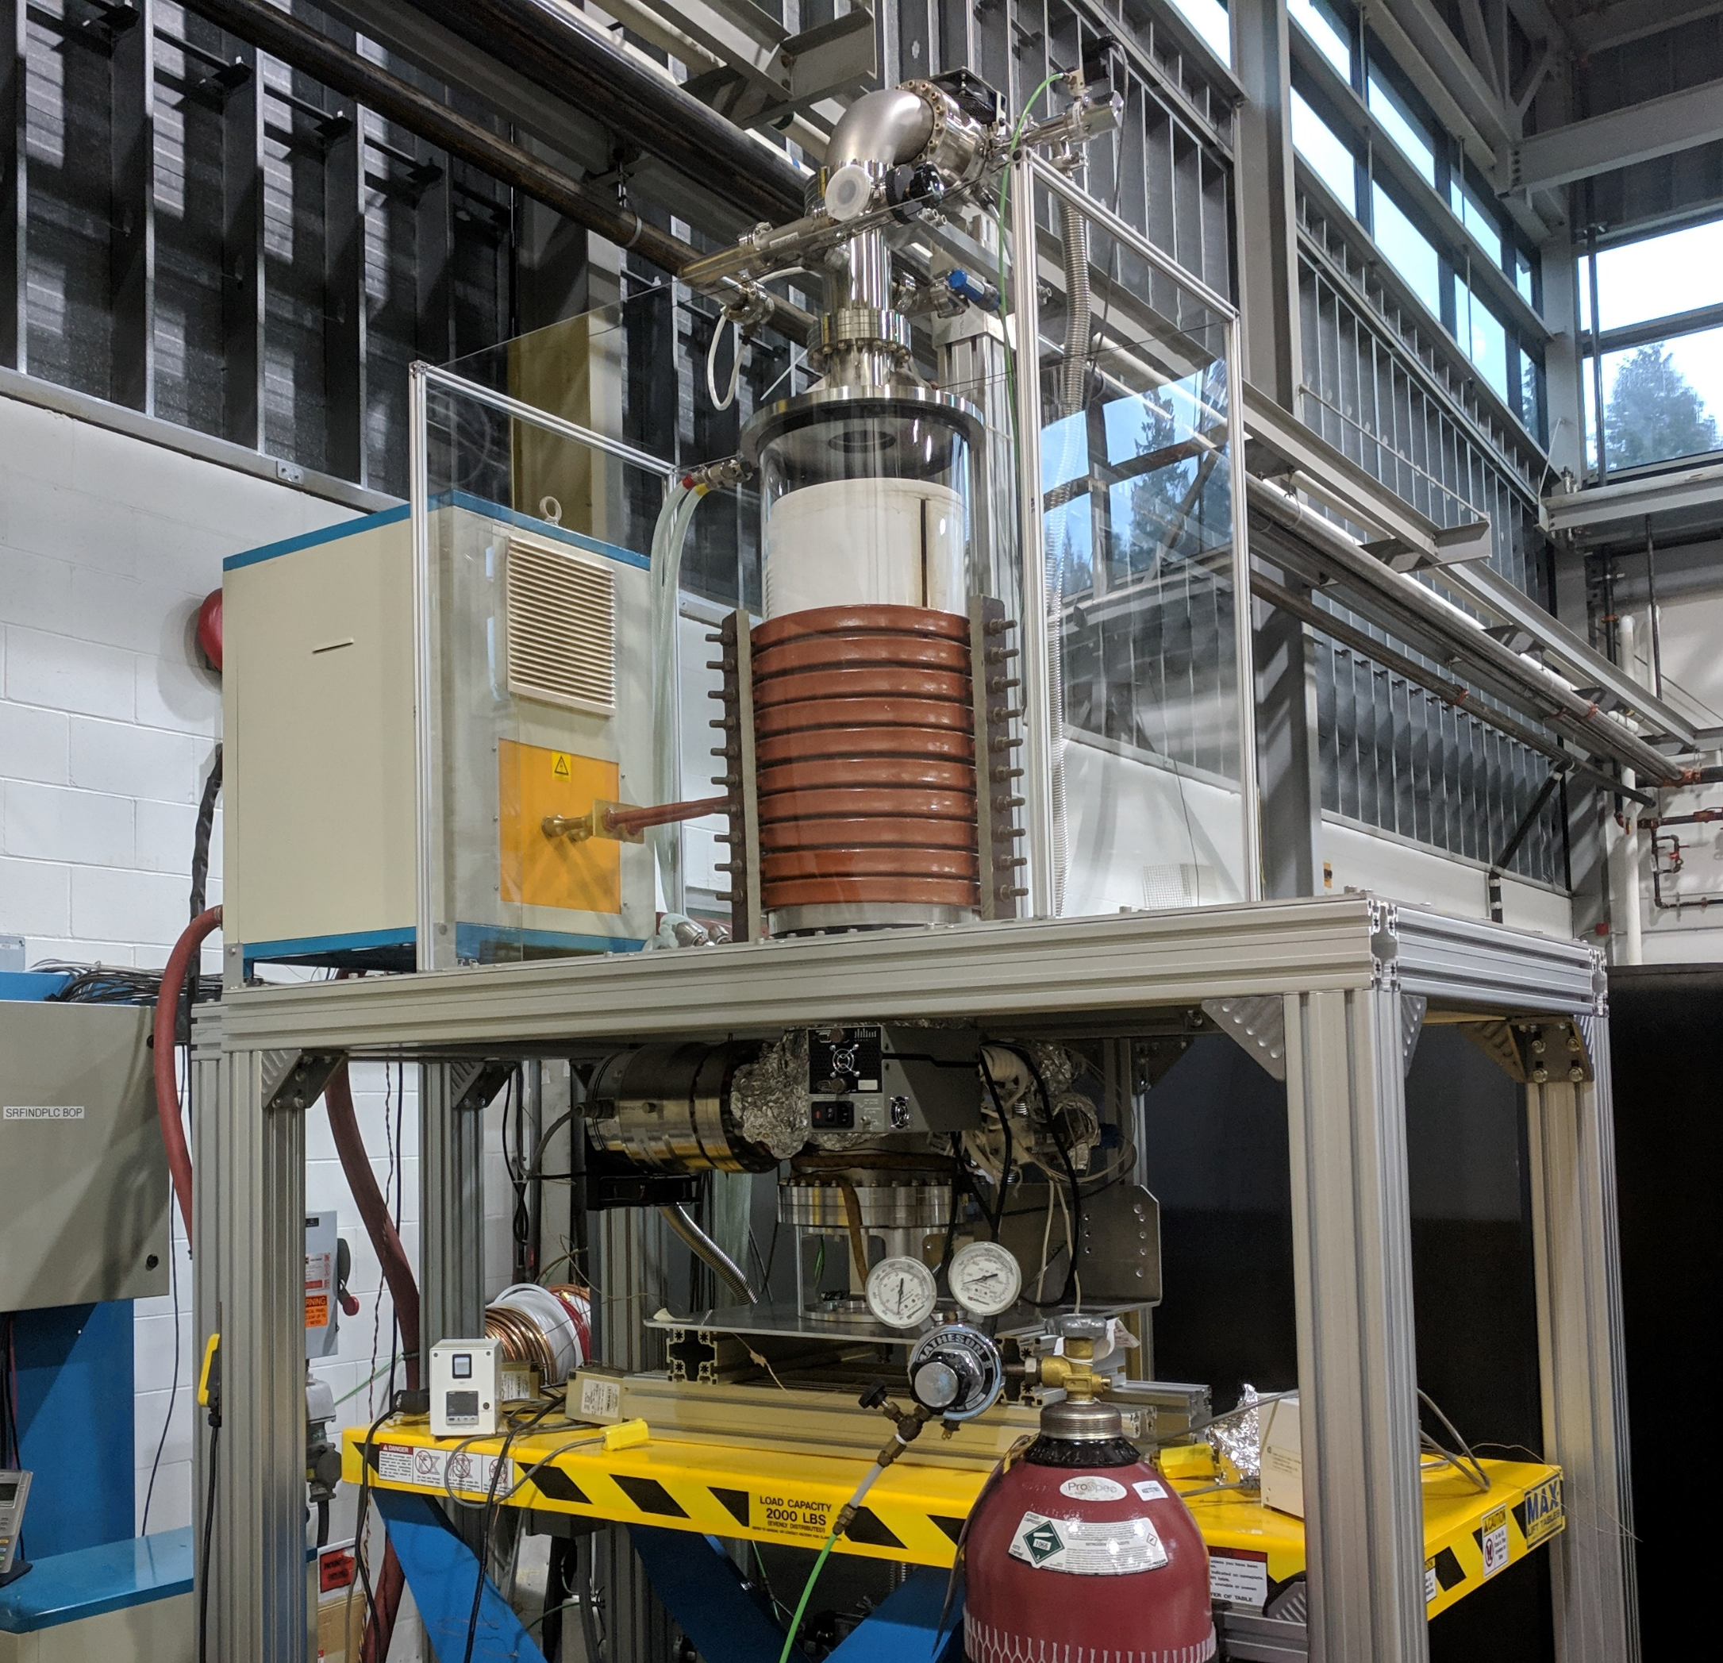
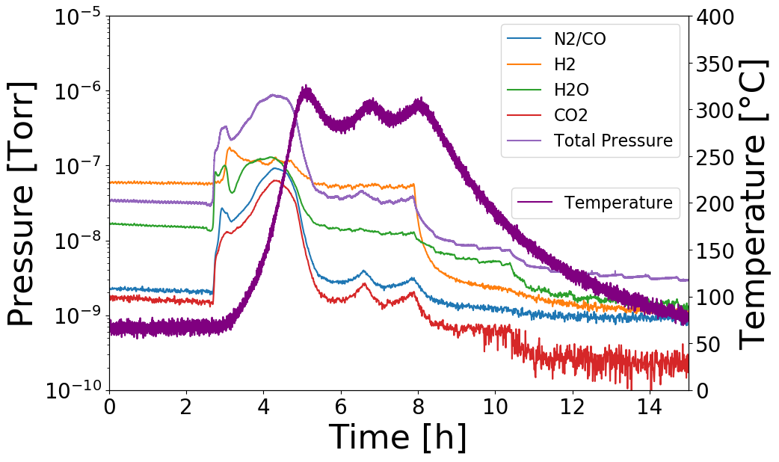
Heat Treatments
QWR 400C/3h
HWR 400C/3h
Temp is regulated on Cavity temp, not furnace temp
causes some over/under-shoot
QWR 300C/3h
HWR 300C/3h

Slide 19
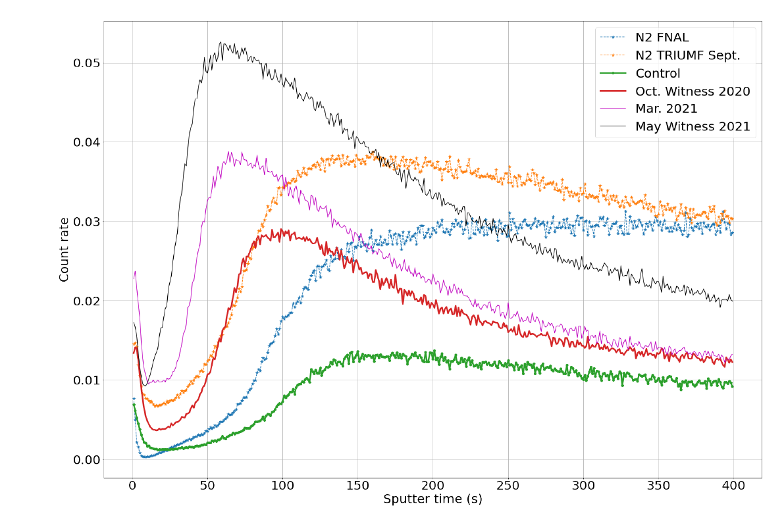
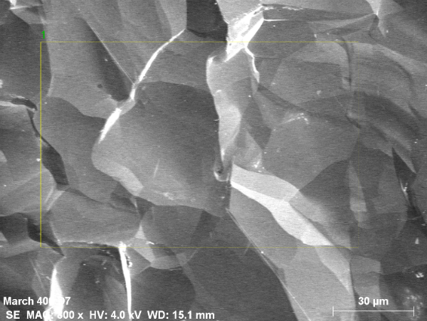
Witness sample SIMS/SEM
400°Cavity Witness Sample
SEM image before and after furnace cleaning. Bright areas are indicative of low Z materials
After Furnace Cleaning
ToF-SIMS data for first 400C treatment compared to a baseline sample (no furnace treatment).
400C treatments after surface cleaning show no signs of carbon reduction.

Slide 20
R(T) fits 778MHz - 300C/3h

Slide 21
R(T) fit 1166MHz – 300C/3h

Slide 22
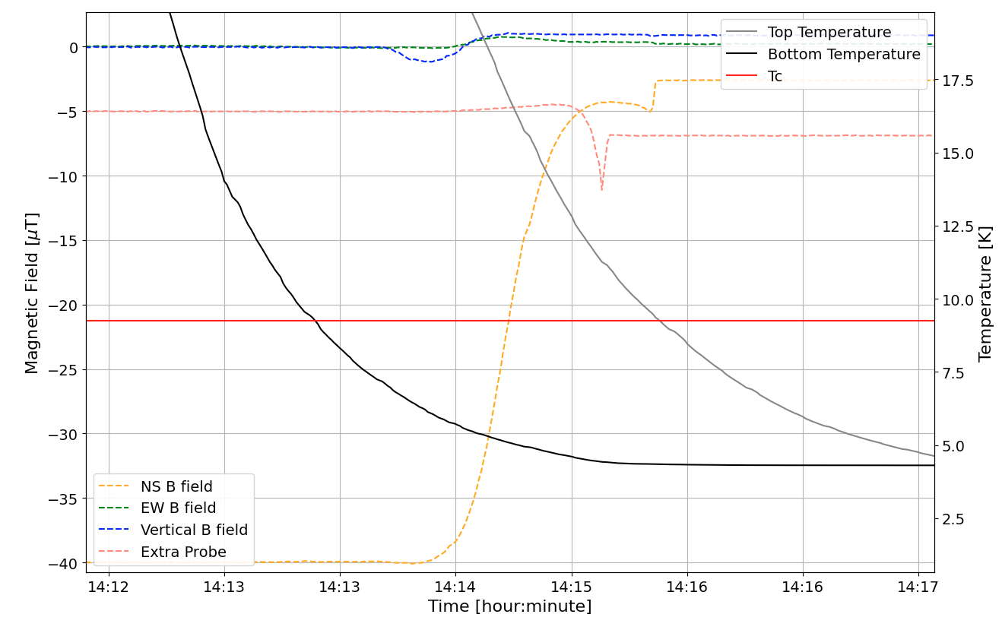
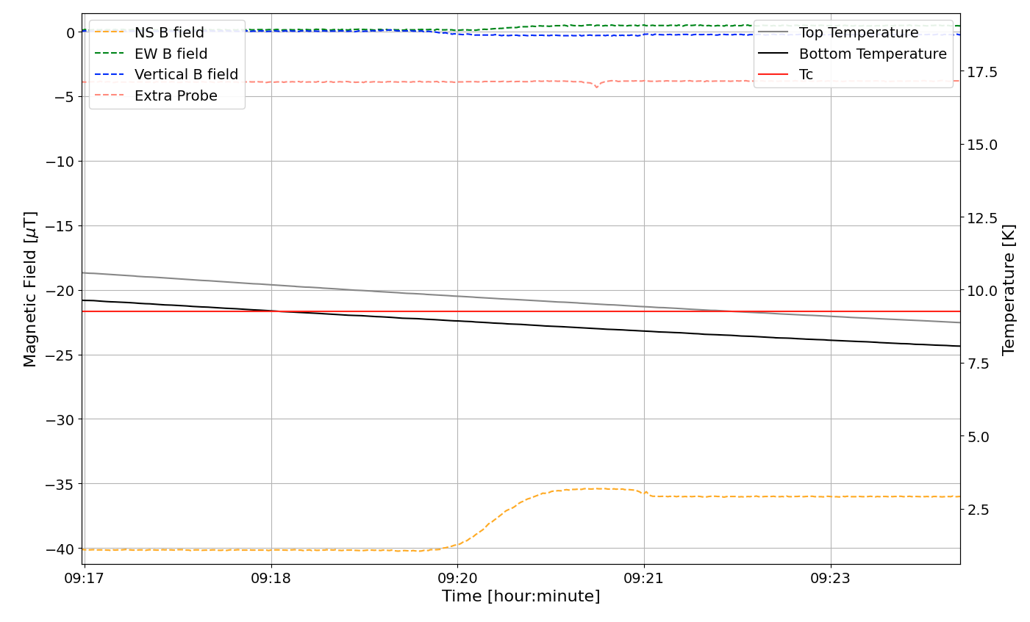
Fluxgate probes with fast/slow cooldown - HFC
~7% trapped
~6 K/min
~0.24 K/min
~88% trapped
Mag field probes are in the center of the cavity. “extra probe” on the top of cavity – in vertical direction.

Slide 23
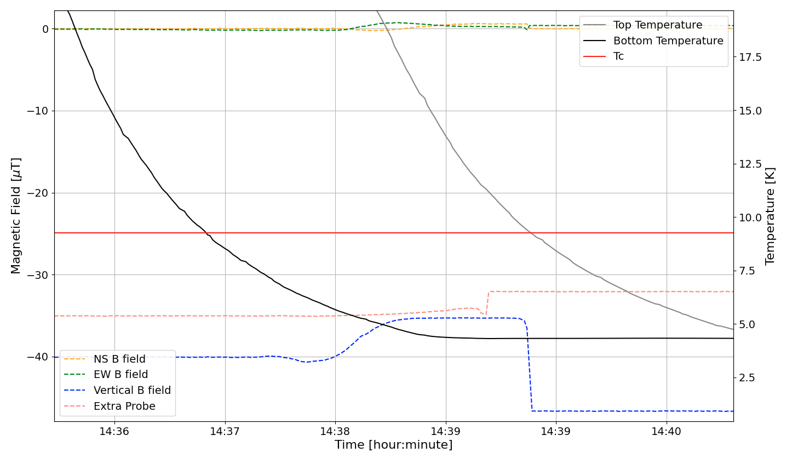
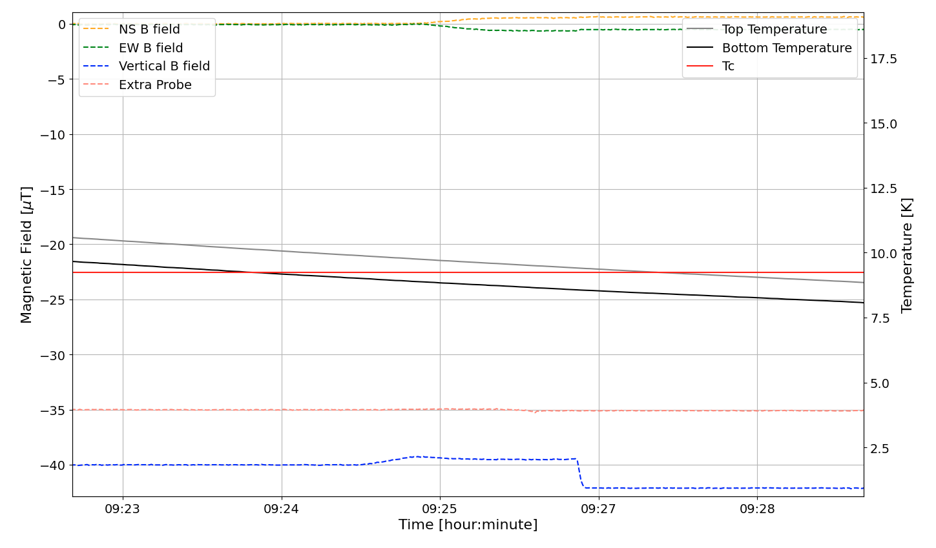
Fluxgate probes with fast/slow cooldown - VFC
~6.5K/min
~0.25K/min
Vertical flux gets funneled into the center of the cavity -> enhanced field expected.
Less enhancement in slow CD -> more trapped flux
High enhancement in fast CD -> less trapped flux

